Slide 1
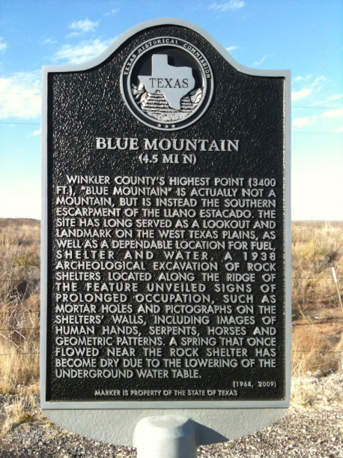
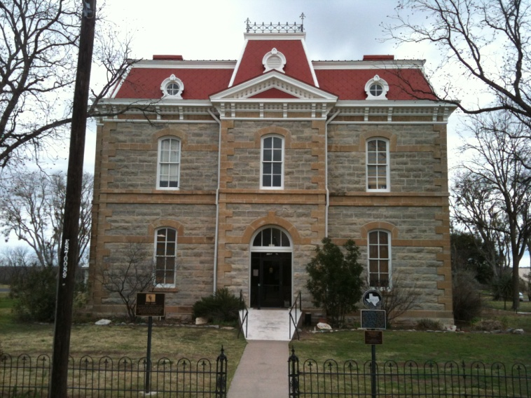
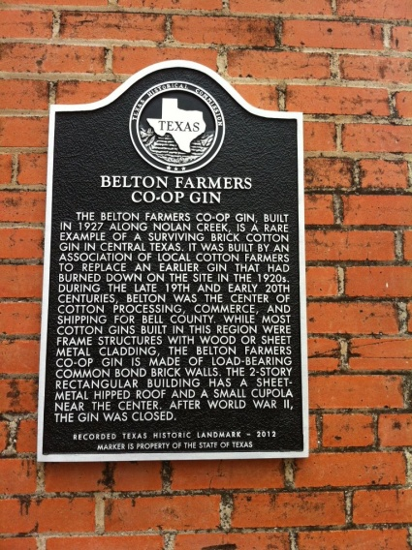
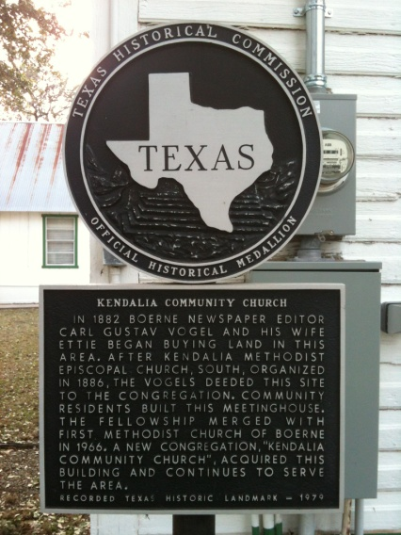
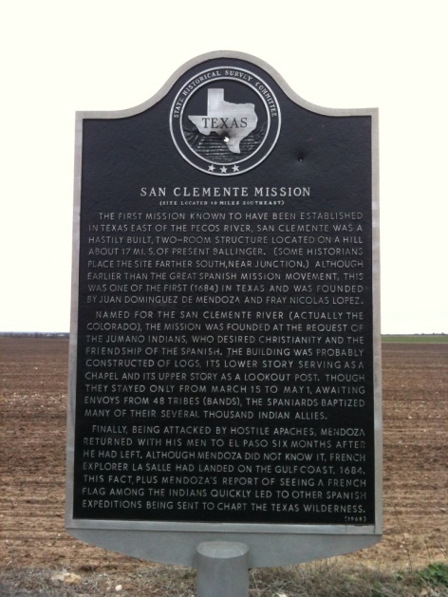
OFFICIAL TEXAS HISTORICAL MARKERS
Notes:
Welcome to training video #2: the marker application process. This presentation will cover the application process, application criteria, how to fill out the application, what to submit for a marker application, and important details about the upcoming 2015 marker round.

Slide 2
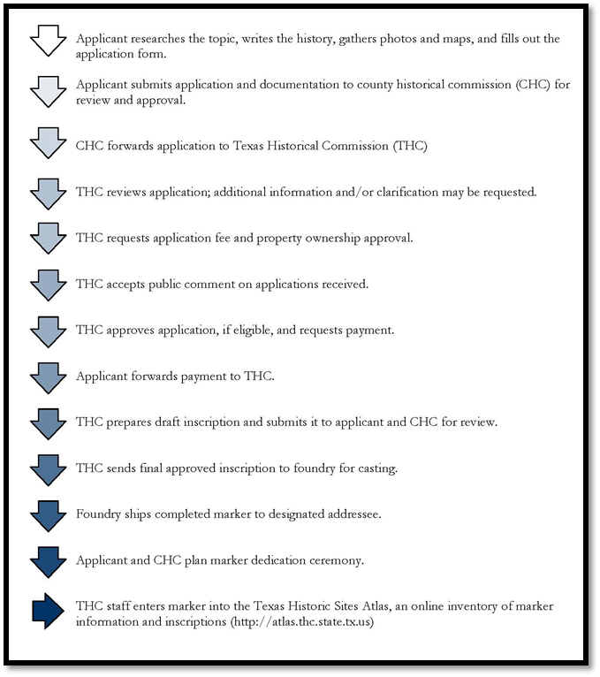
Marker Application Process – flow chart
Notes:
First, we will cover the application process. Please download the Marker Process flow chart on our website to follow along through this section.

Slide 3
Marker Application Process
Applicant researches topic and writes narrative
Applicant contacts CHC
CHC forwards application to THC
THC requests application fee
THC reviews & scores applications
THC accepts public comments on applications
Applications are approved in January
THC requests marker payment
Applicant sends in payment
Notes:
The first step is to choose your topic, compile research and write the narrative history. It is a good idea to contact the county historical commission (CHC) chair and/or marker chair to let them know you are interested in applying for a marker. These essential volunteers can help you along the way and are often valuable resources on the history of the area. Once the narrative is complete, the applicant submits all required materials to the CHC. The CHC forwards the application materials to the THC during the application period. Once all required components of the application are checked and received, the THC requests the application fee of $100. From mid-November to the end of December, the marker staff reviews and scores all applications. Also, during this time, THC accepts public comment on the applications received. At the end of January, the THC commissioners vote and approve selected marker topics. THC requests payment for the marker payment and the applicant sends in the payment.

Slide 4
Marker Application Process
Marker staff prepares inscription
Inscription is sent to CHC and applicant for review
Changes, if any, are made to inscription
Once approved by CHC, marker is ordered
Foundry casts and ships the marker
CHC and/or applicant installs marker
CHC and/or applicant plans marker dedication
Marker staff enters information on Atlas
Notes:
Once payment is received, the topic is placed on a list (in order) to have the inscription written. The draft inscription is emailed to the CHC and the marker applicant/sponsor for review. Changes, if any, are made to the inscription. The CHC approves the inscription and THC orders the marker. The foundry casts the marker and ships it to the designated person or to the proper TxDOT office. CHC/applicant/TxDOT installs the marker and begins plans for a marker dedication ceremony. Marker staff enters the information on the Historic Sites Atlas. As you can see, this is a lengthy process that takes 12 -18 months.

Slide 5
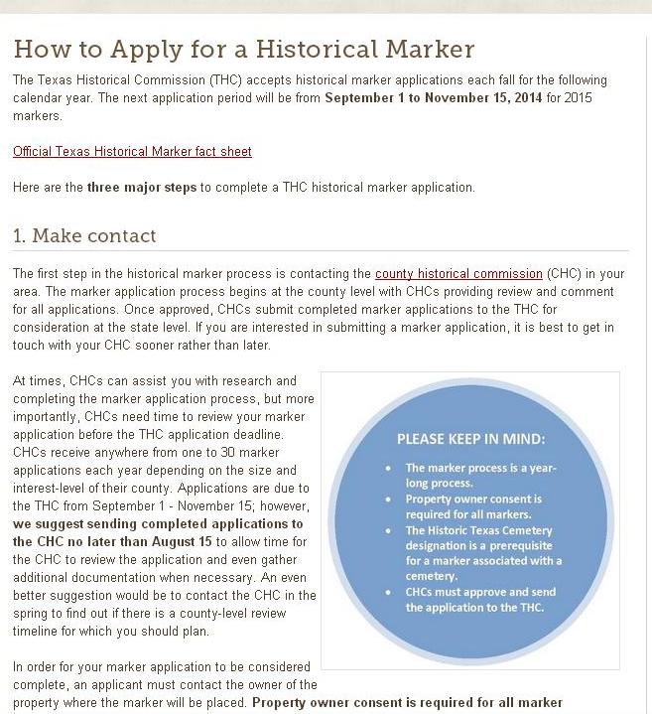
MARKER TOOLKIT
http://www.thc.state.tx.us/preserve/toolkits/how-apply-historical-marker
Notes:
In addition to the flow chart we just discussed, the website has a variety of helpful tools. One helpful tool and outline is the Marker Toolkit.
The toolkit breaks the process down into steps and makes it a bit easier to understand. For CHCs, this is a good starting point for you to direct folks who want to know more about the process. At the end of the toolkit is a chart showing exactly what to submit for each type of marker.

Slide 6
http://www.thc.state.tx.us/preserve/toolkits/how-apply-historical-marker
RTHL | HTC | SUBJECT
Application | Application | Application
Property owner consent (notarized) | Property owner consent | Property owner consent
Proof of ownership | Proof of ownership | Proof of ownership
5-page narrative | 5-page narrative* | 5-page narrative
Historic photo
Current photos (N, S, E, W elevations | *Note: a narrative is not required for a name & date plaque or a medallion only
Floor plan (hand-drawn)
Site plan (hand-drawn)
Notes:
First, a completed application must be submitted with all applications. There are three different applications available: RTHL, HTC, and subject marker. Part of the application is acquiring property owner consent to place the marker. The last page of the application may be filled out on your computer, printed out and then signed. Once it is signed, locate proof of property ownership in the form of a deed or tax record. If the property is a cemetery, the administrator may sign the form. The form is then sent via email, mail, fax or dropped off in person. In addition to the application, a 5 page narrative history is required. 5 pages is a minimum, especially if you want a large marker. This is where THC staff get the information that will go on the marker. RTHL applications also require at least one historic photograph, current photographs of the property, floor plans and a site plan. For applicants that are seeking a name and date plaque for a cemetery, you do not need to write a narrative history. Again, for name and date plaque orders, all that is required is the application form with property owner or administrator consent and the proof of ownership. Also name and date plaque orders are processed first with no wait.

Slide 7
Official Texas Historical Markers
Important Facts:
Year-long process
Applications accepted each fall
September 1 – November 15
County Historical Commission (CHC) must approve and send the application to THC
Cemeteries must go through Historic Texas Cemetery (HTC) designation process first
Property owner consent & proof of ownership is required for all markers
Notes:
Before we go over the application form, there are a few important facts to remember about the marker process. The most important thing to remember is that this is a year-long process. As I said before, there are many steps along the way and we want to ensure that the information going on the marker is accurate. Second, new applications are accepted each fall, from September 1st to November 15th. All applications must be approved by the CHC and sent from the CHC to the THC. Cemeteries must have the designation process completed before submitting the marker application. And, lastly, property owner consent and proof of ownership are required for all markers, except those on TxDOT Right-of-ways.

Slide 8
Marker Application Form (coversheet)
CHCs complete this section
CHC/applicant complete this section
Notes:
Now we will go over the application for. We will use the subject marker application as an example. This is page 1 (coversheet) of the subject marker application. Note that there is a section for the CHC to enter in comments about the topic. This is now a requirement. THC would like to get feedback from the CHC, show the CHC support level of the application, and convey any important information. For example, it is useful to marker staff when a CHC tells us that in an application for a community, a certain individual should be mentioned. In a narrative with many significant individuals, it may be difficult for marker staff to know that the community feels that one or a group of persons in particular should be mentioned on the marker. If you have concerns about a source, please make a note. The bottom half of the page may be filled out by the CHC or the applicant/sponsor, and it is just a section to verify that these components are included. On the HTC application, this section asks for the HTC designation number and the year it was designated.

Slide 9
Marker Application Form (page 2)
Title, county, town/city, address, district information
Marker coordinates, location description
Will the marker be at the actual site?
Notes:
This is page 2 (application) of the subject marker application. First, enter the proposed marker topic (it is possible that the title will change) and the county where the marker will be placed. Next enter the closest town on a map and the street address of the marker location, as well as the Texas State Representative name and district and the Texas State Senate name and district. The next section requires the marker coordinates (either in Latitude/Longitude or UTM coordinates) AND a description of the location. For example: “Marker will be located on the southwest corner of Main and 1st Streets.” The last section on this page is to signify if the marker will be placed at the actual site of the topic. If not, please enter the reason.

Slide 10
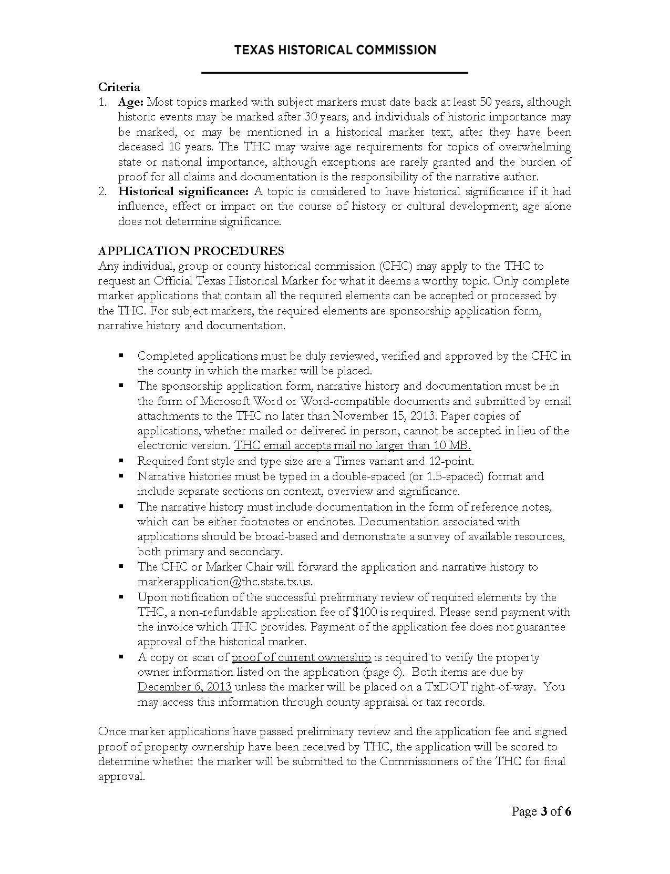
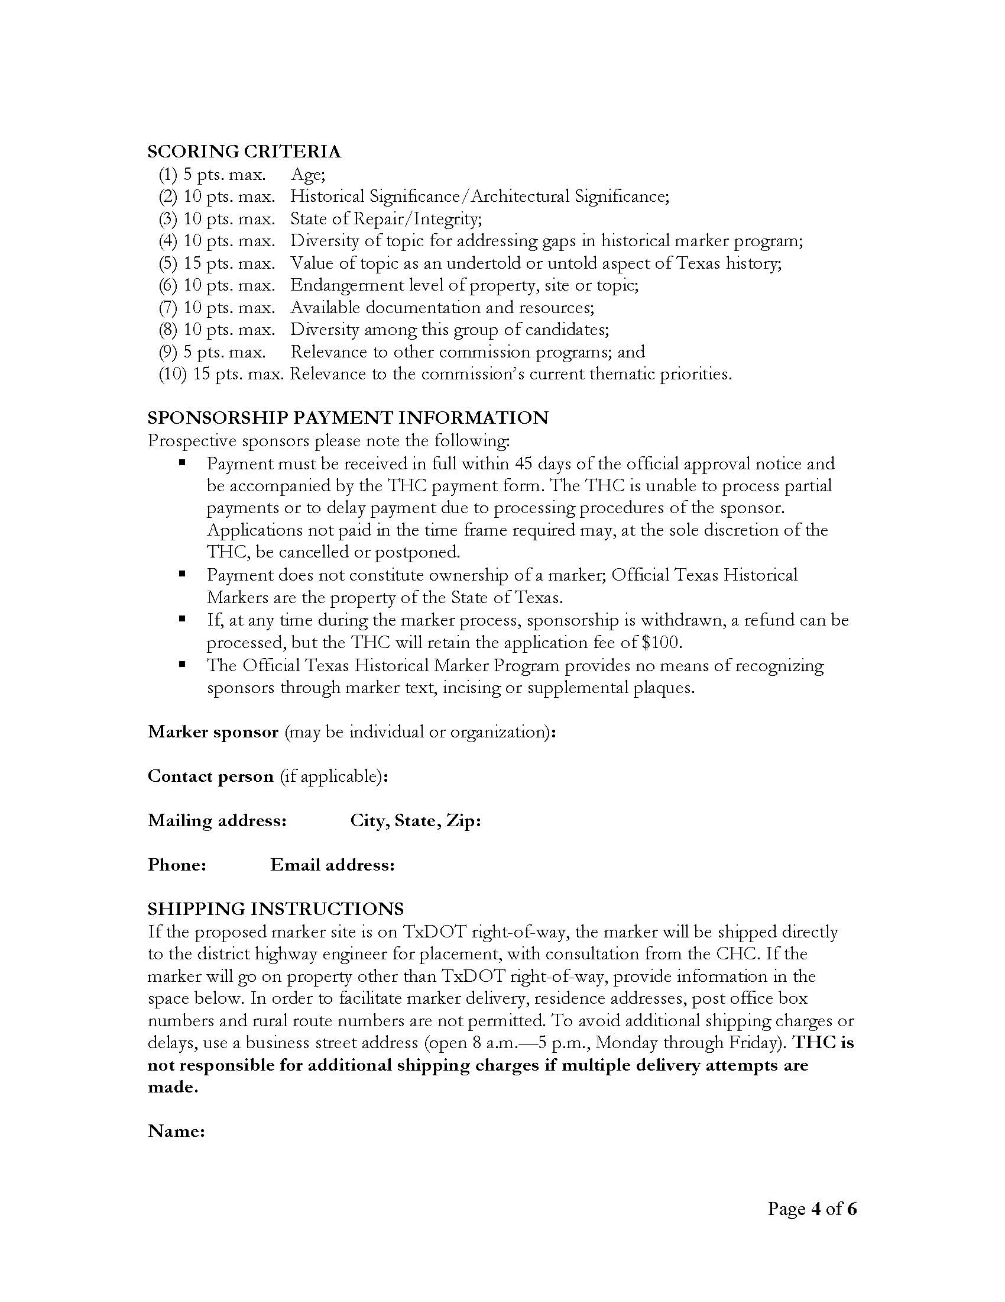
Marker Application Form (page 3 & 4)
Applicant or sponsor fills this out (main point of contact other than the CHC)
Notes:
Page 3 includes information on criteria for the marker type and the application procedures. Page 4 has the scoring criteria and a section discussing sponsorship payment. There is also a section for the sponsor or applicant to fill in their information. This is the section where the person who needs to be the primary contact (after the CHC) for the marker. Please make sure that the email that is entered is a good email address as this is the primary method of contact. The next section is the shipping information that continues onto the next page.

Slide 11
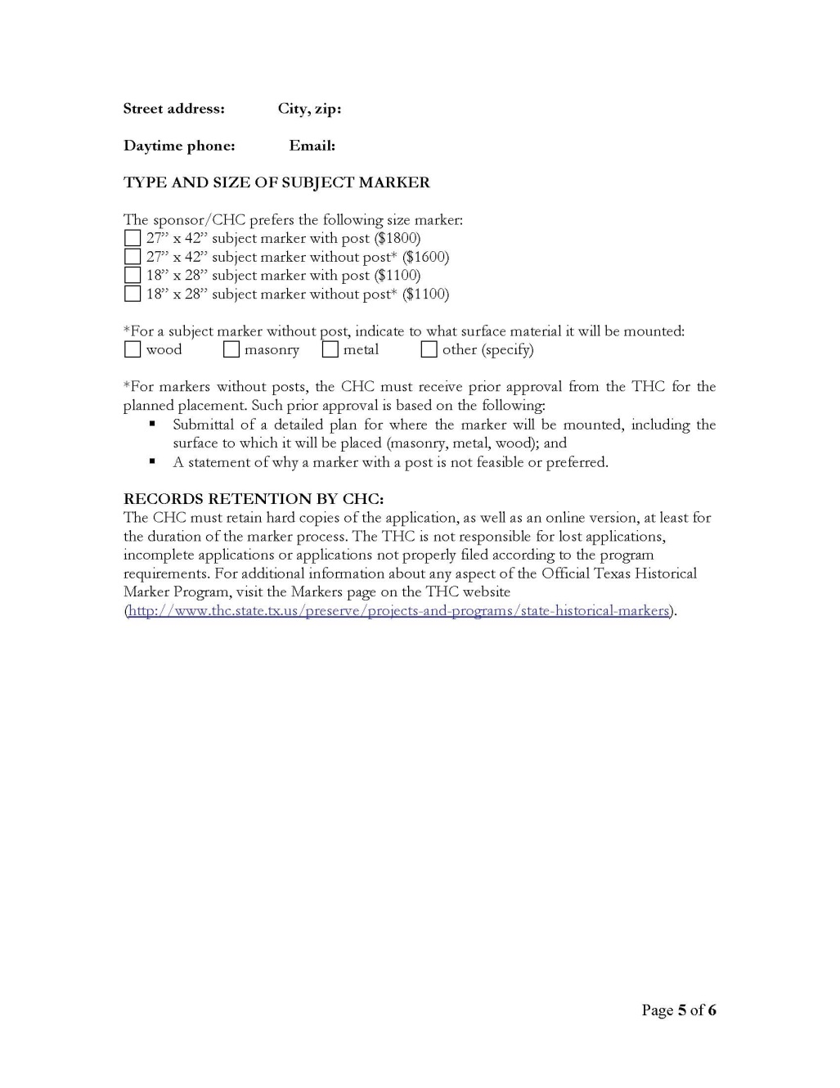
Marker Application Form (page 5)
Shipping information (M-F, 8-5)
Marker size and with or without a post
If without a post, indicate the surface material
Notes:
Page 5 includes a section for the shipping information. This contact must be a Monday through Friday, 8 am to 5 pm address. If the marker ships to a home address and no one accepts the delivery, the applicant may incur charges from the shipping company. If needed, arrange a business to accept the marker. The next section is where you choose what size marker. Decide if a small or large marker would best fit your topic. Will there be enough information to warrant a large marker? Second, decide if the marker will be on a post or mounted to a surface. If the marker is an RTHL marker for a building, consider ordering a marker with a post so that mounting (and potentially damaging the exterior) is not necessary. Also, consider if a marker on a post is visually stimulating. Some applicants have mounted the marker to stone, granite, rock, etc. I would also like to note, for cemetery markers that will be attached to an existing post, please measure the inside diameter of the post and choose the correct size.

Slide 12
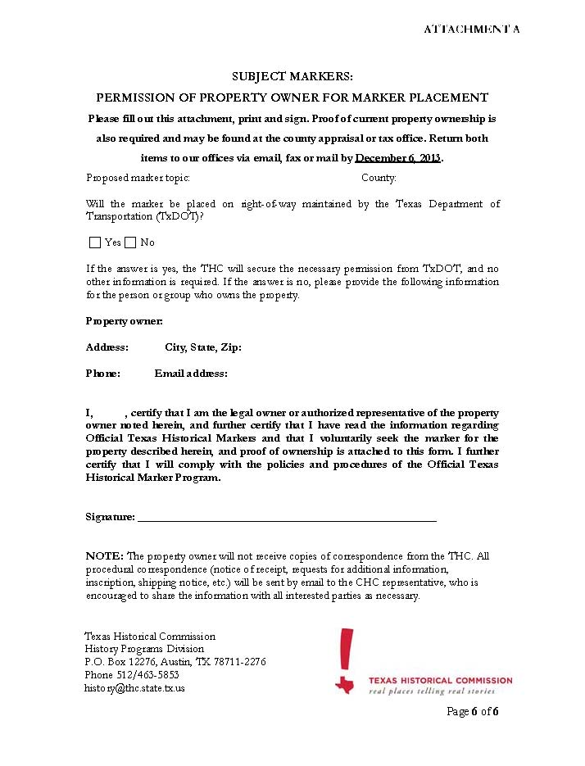
Property owner consent (page 6 or final page)
Proposed title and county
Will it be placed on a TxDOT ROW?
If NO, then the bottom section must be filled out by the property owner or administrator and SIGNED.
*RTHL forms must be notarized
Notes:
The last page of the application is the property owner consent form. First, fill out the proposed title and county. Then, identify whether the marker will be placed on a TxDOT right-of-way. If it will not be placed on TxDOT ROW, then the property owner or the legal administrator of the property needs to fill out the bottom section of the form and then sign it! Please note that the property owner consent form for RTHLs requires that the form be notarized.

Slide 13
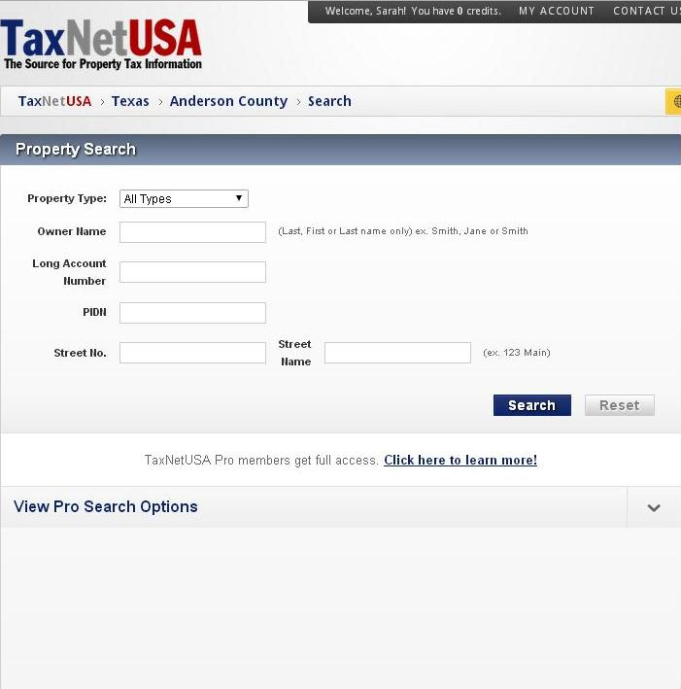
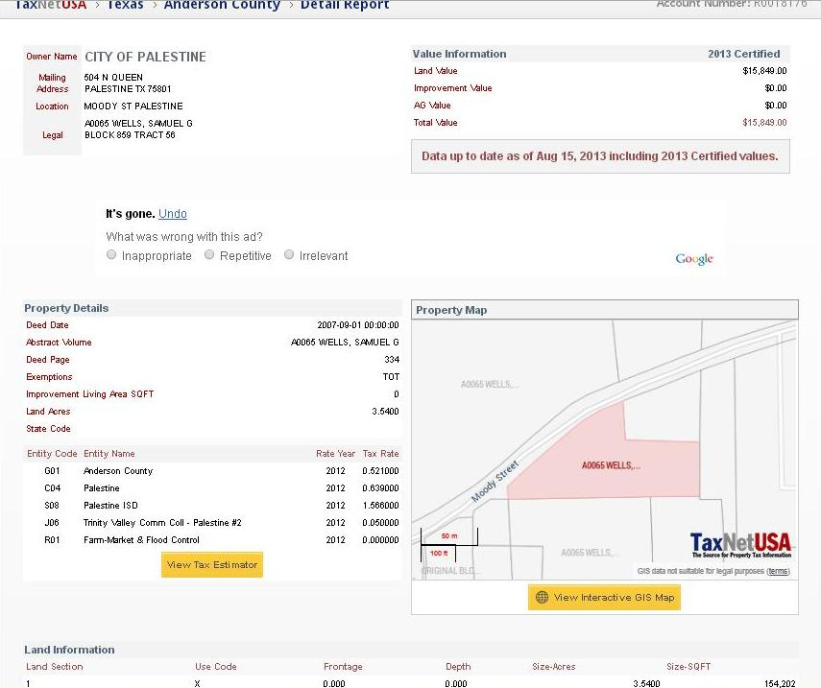
Proof of ownership
http://www.taxnetusa.com/
Notes:
In addition to the consent form, we also require proof that person owns the property or is authorized to make decisions over the property. For this, we ask that a deed, tax records or record from the appraisal district be submitted with the application. The left side of the screen is the home page for taxnet USA. This is a free site that allows you to search for property information. You do have to create a log-in but it is otherwise free. The image on the right side is an example of a tax record found at this site. I would recommend that the CHC or Marker Chairs create a log-in for this site. It will help you find the proof of ownership that is required.
Now, there are some cases where no taxes are paid on the property and no one really knows who owns the property OR there is no deed record. In this case, you need to show that you exhausted all efforts to find the ownership paperwork. If this is the case, then please write a note explaining where you looked. Then, an administrator (such as a cemetery administrator) can sign the ownership consent form and no proof (other than the letter) will be submitted. But something needs to be submitted.
http://www.taxnetusa.com/my_account/

Slide 14
Official Texas Historical Markers
2015 Work Plan Details
THC will process no more than 180 marker applications and no more than 20 through the Undertold Program
Priority Themes for 2015:
Hispanic topics
Industry, Business & Commerce
Recorded Texas Historic Landmark (RTHL) designations
Notes:
Each year, the marker program staff propose a work plan to the commission that includes an annual maximum and priority topics for the upcoming round. For 2015, there is a state-mandated maximum of 180 applications and up to 20 Undertold markers. Remember, not all applications will be accepted.
The priority themes for 2015 are Hispanic topics, Industry, Business and Commerce, and RTHLs. Topics that fit into these themes will receive extra points during scoring.

Slide 15
2014-15 Marker Program Schedule
Jan-Dec | Complete inscriptions for 2013 & 2014 markers
May-Aug | Regional workshops and webinars on historical research and marker policies
May-Jun | Undertold marker applications accepted
July | 2015 applications available on web site
Sep-Nov | New applications accepted for 2015 program
Sep-Jan | Staff evaluates applications
Jan 2015 | Commissioners authorize markers for 2015 program
Jan-Dec | Inscriptions written for 2015 markers
Notes:
This is our schedule for the next year. We are currently closing out 2013 applications and have started writing 2014 inscriptions. With the budget and staff cuts, we are working as quickly as possible. Starting on September 1st, we will accept the regular marker applications for the 2015 cycle.

Slide 16
THC Marker Staff
Bob Brinkman
Coordinator
512/463-8769
bob.brinkman@thc.state.tx.us
Sarah McCleskey
Historian
512/463-4149
sarah.mccleskey@thc.state.tx.us
Ana Clark
Program Specialist
512/463-6063
ana.clark@thc.state.tx.us
history@thc.state.tx.us
Notes:
Please contact us with any questions.

Slide 17
www.thc.state.tx.us
Notes:
Please view the THC website for more training videos.

