Slide 1
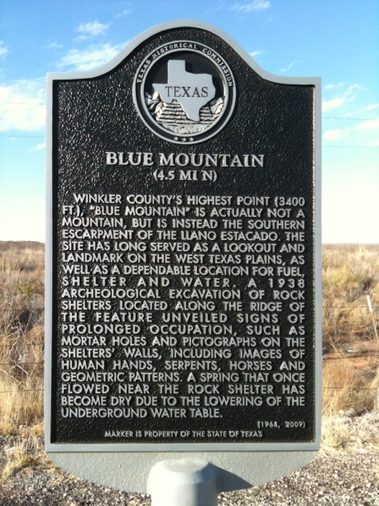
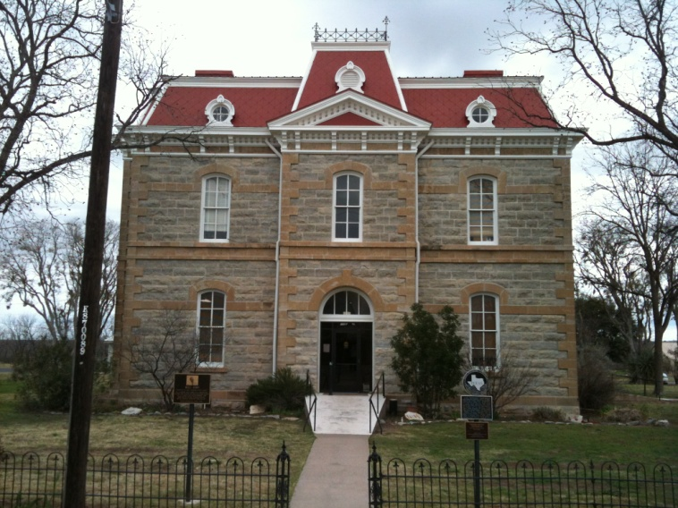
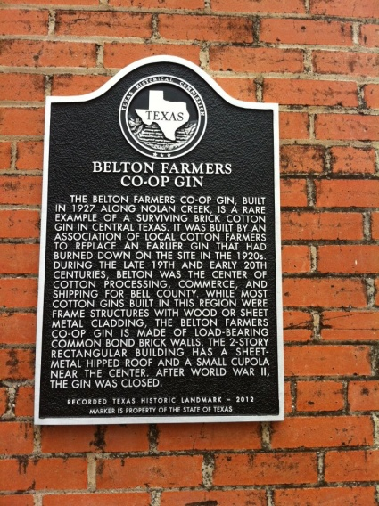

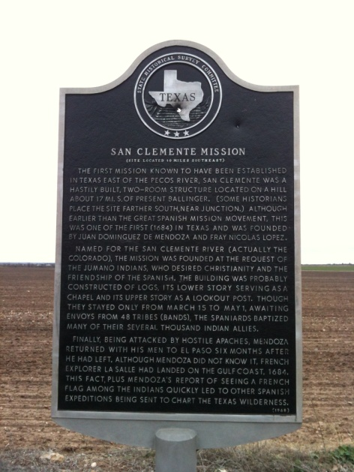
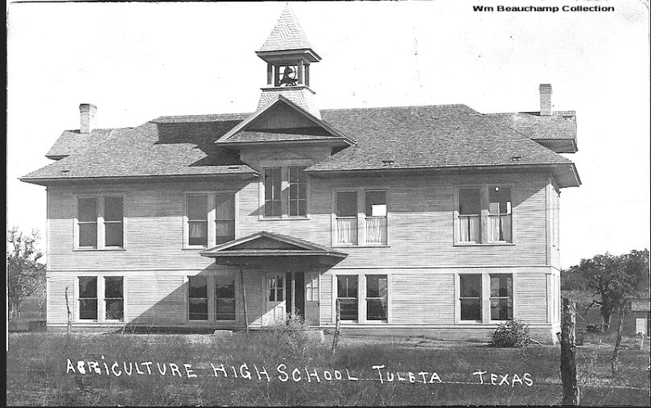
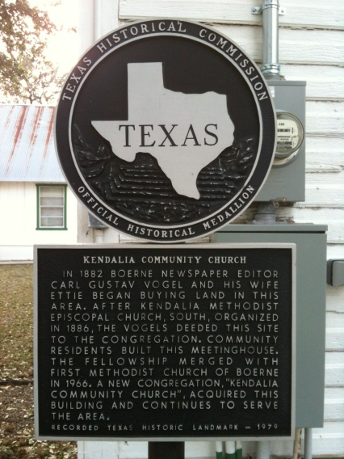
OFFICIAL TEXAS HISTORICAL MARKERS
Notes:
Welcome to Historical Marker training video #1. This is an introduction to Official Texas Historical Markers that will discuss briefly the history of historical markers in Texas, the different types of historical markers, the Undertold Program, replacement and supplemental markers and the THC historical marker website.

Slide 2
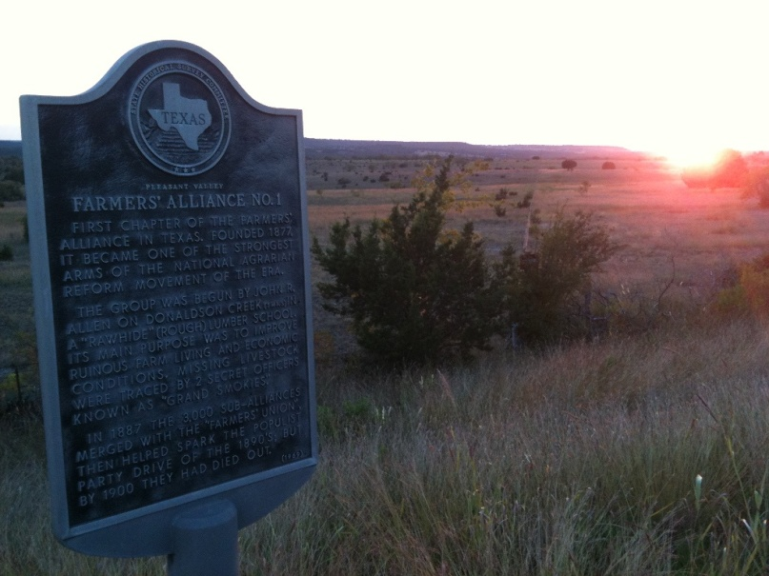

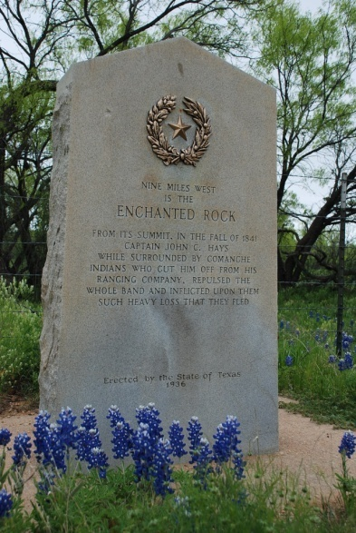
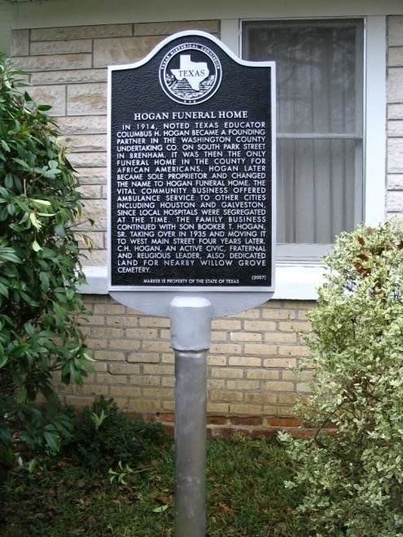
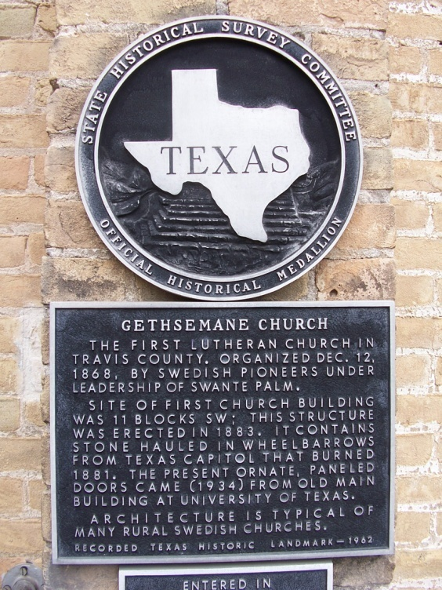
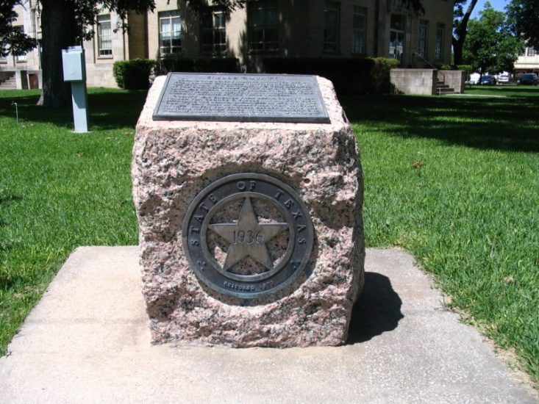
Marker History
Notes:
First, some general history of the marker program. Historical markers in Texas have been around since the 1890s. Some in the early twentieth century were placed in conjunction with other organizations, like the Daughters of the American Revolution. In 1935, the Texas Legislature created the Commission of Control for Texas Centennial Celebrations to celebrate the 100th anniversary of Texas’ independence from Mexico. Under this initiative, the state placed about 1,100 exposition buildings, memorial museums, statues, and granite and bronze markers and monuments around Texas. These continued into the 1940s and 1950s. In 1962, the Texas State Historical Survey Committee, the predecessor of the Texas Historical Commission, began to mark historical sites, buildings, events, and individuals with the aluminum markers that we know today. Total, there are more than 15,000 historical markers in Texas, more than any other state marker program in the U.S. On average, our offices review almost 200 applications every year.

Slide 3
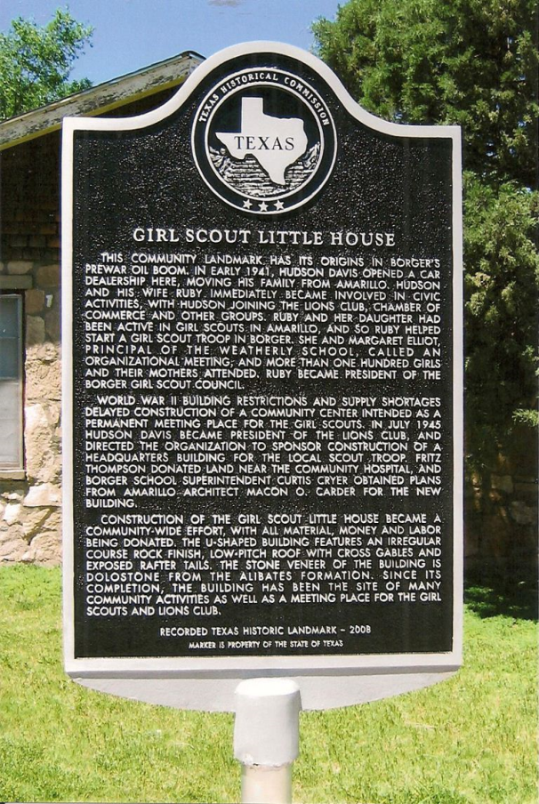
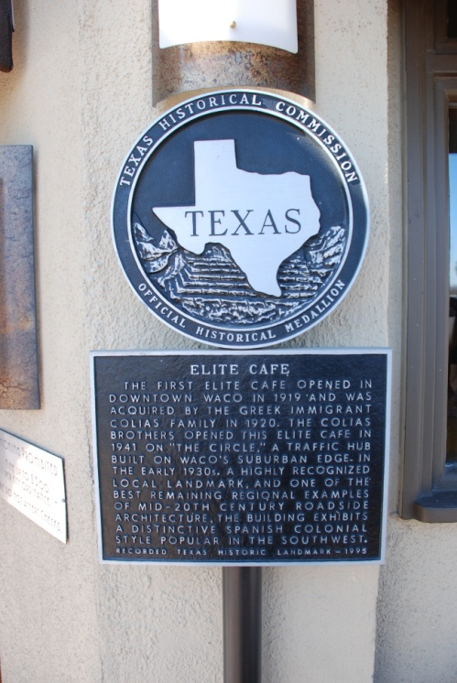
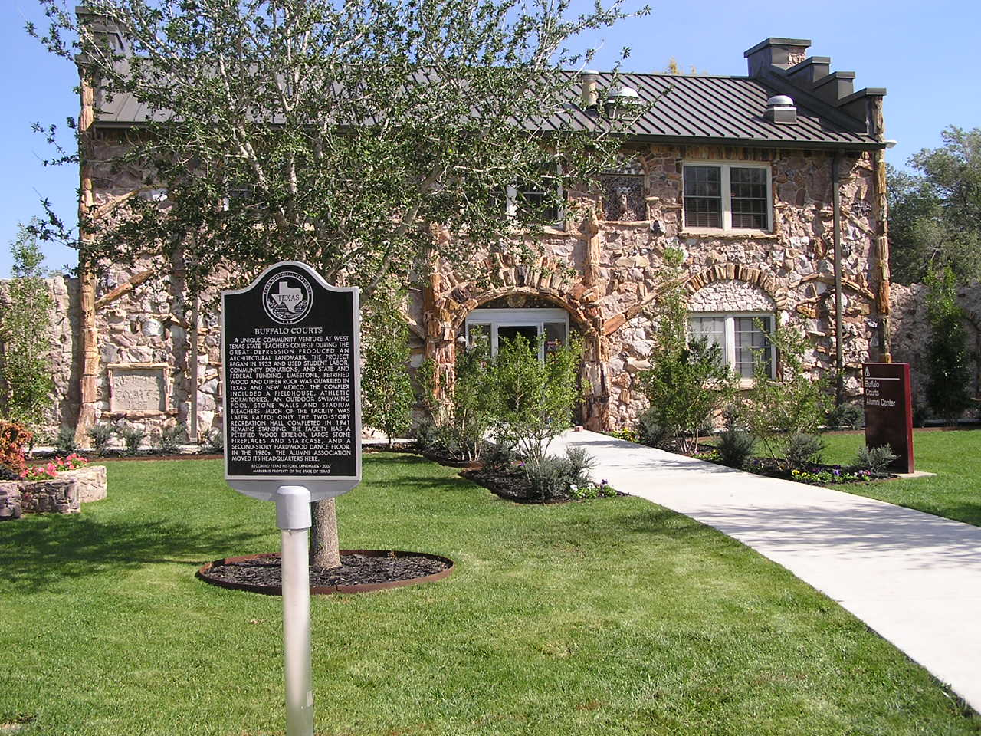
Marker Types
Recorded Texas Historic Landmark (RTHL) Markers
*buildings and structures only*
Notes:
Historical markers may be categorized into three types. The first type are Recorded Texas Historic Landmark markers, or RTHLs. These mark buildings and structures in Texas that have historical AND architectural significance. There are approximately 3,600 RTHL markers in the state. The RTHL designation is a legal designation and, therefore, the designation carries a level of protection over the property. Property owners of an RTHL property are required to notify the THC 60 days prior to any work done to the exterior of the building. There are several advantages to having the RTHL designation. RTHL properties may qualify for economic incentives such as local tax breaks or for the Federal or state tax credit for income-producing properties, and RTHL property owners have access to free architectural technical assistance from THC architectural staff.
RTHL markers may be identified by the tag line located on the bottom of the marker with the year of its designation.

Slide 4
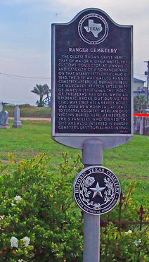
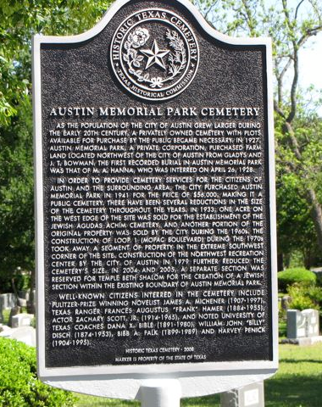
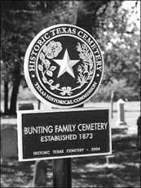
Marker Types
Historic Texas Cemetery
(HTC) Markers
*HTC designation is a prerequisite*
Notes:
The second type of marker is the Historic Texas Cemetery marker, or HTC marker. HTC markers have a different seal on the top of the marker made especially for designated Historic Texas Cemeteries (see the photo on the left). Cemeteries that have the Historic Texas Cemetery marker have gone through the designation process which is a separate program. The designation for a cemetery and a marker for a cemetery are two different processes with different requirements and deadlines. The designation is a prerequisite for a marker. Similar to the RTHL markers, the HTC markers display a tag line at the bottom of the marker with the year of designation.
The Historic Texas Cemetery designation was created in 1998 in an effort to record historic cemeteries in county deed records, and, therefore, preserving them. When the designation was created, a separate type of marker was also created with a different seal. Some cemeteries were marked prior to the 1998 program with subject markers (see the photo on the right). These cemetery subject markers have the standard state of Texas seal and do not have the “Historic Texas Cemetery” tag line on the bottom. THC will not replace a cemetery subject marker until the cemetery goes through the designation process.

Slide 5
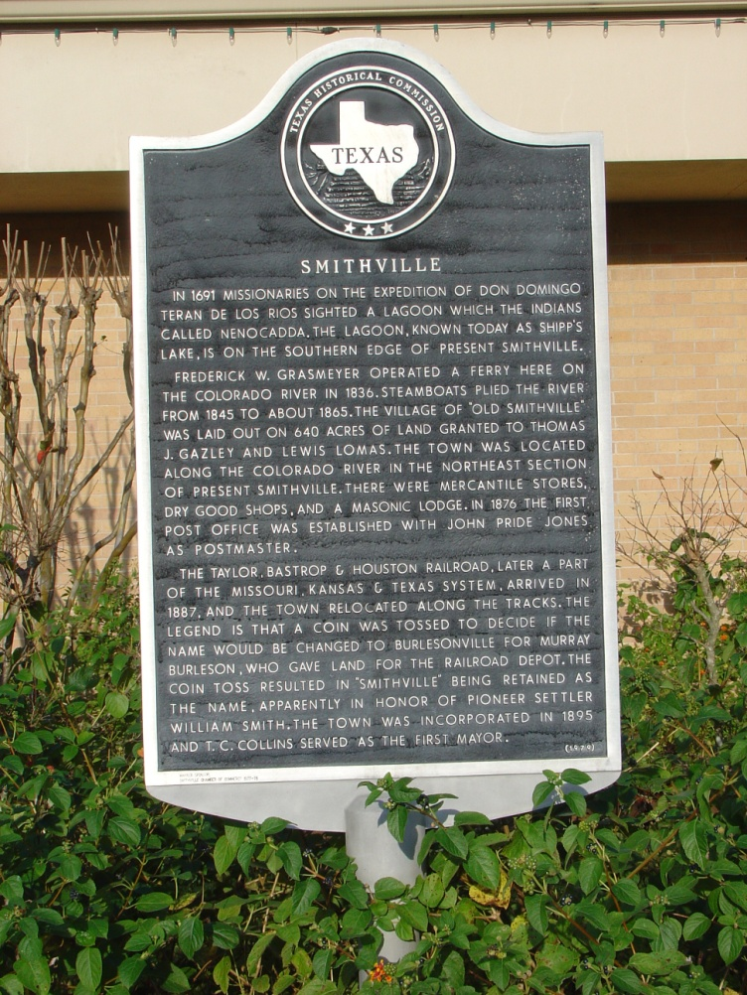
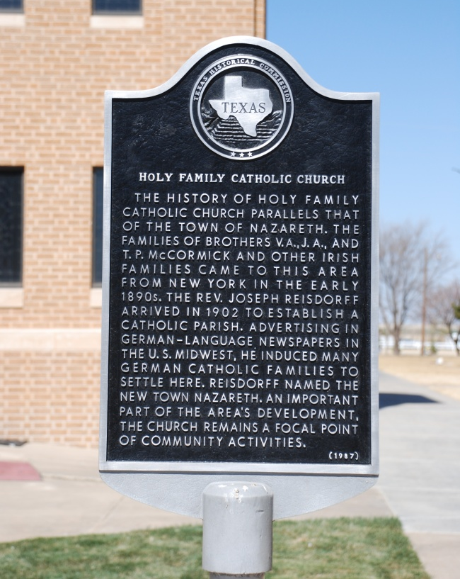
Marker Types
Subject Markers
Notes:
The third type of marker are subject markers, and they cover all other types of markers: communities, events, individuals, schools (unless they qualify for an RTHL), sites, church congregations, etc. Subject markers differ from RTHLs and HTC markers in that they do not carry any type of designation or protection over the site. They are placed for educational and tourism reasons. Sometimes, subject markers are placed on the roadside in coordination with TxDOT. THC organizes the placement of these markers directly with TxDOT engineers and district offices.

Slide 6
Regular Marker Program
THC accepts marker applications once a
year (fall)
Application requirements:
  Application
  Property owner consent & signature
  Proof of ownership (must match consent)
  5-page narrative history w/citations
  RTHL supplemental information
http://www.thc.state.tx.us/preserve/projects-and-programs/state-historical-markers/apply-historical-marker
Notes:
To apply for a marker through our regular program and procedures, the applicant may apply in the fall, typically from September 1st to November 15th. The application packet must include a completed application (with property owner consent and signature for placement of the marker), proof of ownership that matches the consent forms and a 5-page narrative history with end notes or footnotes. If the application is for a building or structure, you will also include photographs, a floor plan and a site plan. The link on this screen will take you to the “Apply for a Historical Marker” web page.

Slide 7
Undertold/Marker Application Funds Program
Intended to address historical or geographical gaps in marker program
Applications accepted May 1 – June 15
Funded topics receive a FREE 27” x 42” marker or the equivalent in historical research
Check the THC website marker page: http://www.thc.state.tx.us/preserve/projects-and-programs/state-historical-markers
Notes:
In addition to the regular marker program, we also have the Undertold or Marker Application Funds Program. This program was established in 2006 when the Sunset Review Committee and the Historical Marker Task Force recommended that we establish a $100 application fee for all markers. The $100 is put into an account that THC uses each year to pay for markers that address gaps in the program. Funds are intended to promote diversity of topics, and proactively document significant undertold or untold stories. Applications are accepted every May through mid-June. Funded topics receive a free 27” x 42” large marker or the equivalent to conduct research on the topic. The application is shorter than the regular application and only requires a 250-word description of the topic with three potential sources. The 5-page narrative history is not required at this stage. If the topic is chosen, a narrative history is required and may be written by the CHC, applicant or THC marker staff. Since 2008, we have funded over 90 markers with this program.

Slide 8
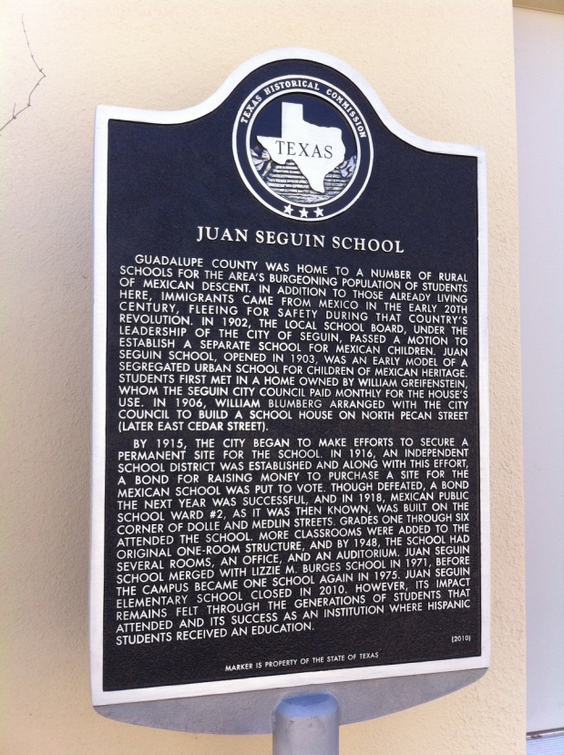
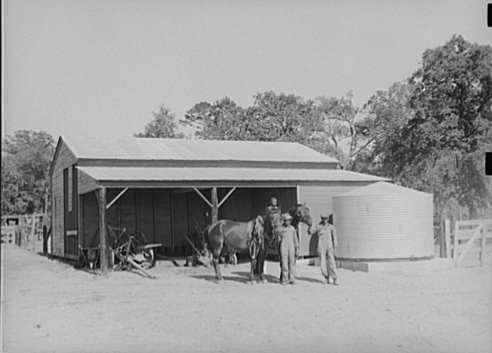
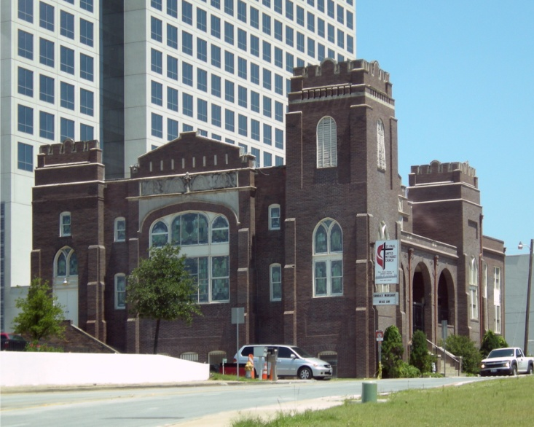
Undertold examples
Sabine Farms, Harrison County (2008)
Juan Seguin School, Guadalupe County (2010)
St. Paul United Methodist Church (RTHL), Dallas County (2013)
Notes:
Here are a few examples of funded topics through the Undertold Program.
Sabine Farms in Harrison County – New Deal Resettlement Community (lots of photos were submitted and are now on record for future researchers)
Juan Seguin School in Guadalupe County – 1903 segregated urban school for Hispanic students
St. Paul United Methodist Church (RTHL) in Dallas County – home to one of the oldest black congregations in Dallas in a 1920s building that also served as a school for African American students

Slide 9
Replacements and supplemental plaques
Replacement Markers
Updated narrative may be required
Current marker policies apply
Applications accepted all year
Supplemental plaques
Applications accepted all year
Include suggested wording on application
Notes:
THC marker staff also process replacement and supplemental orders. These applications may be submitted throughout the year. We recommend contacting our offices for the application (or visit our website) so that we may assign a reference number. Then, fill out the application. Notify your CHC of the request – even send them a copy. THC will review the request and then issue an invoice for the payment. Once payment is received, we process the request. Sometimes we receive replacements in which the wording must be changed or lines need to be added. These take a bit longer to process since extra time is needed from THC staff.
Supplemental plaque orders may also be placed throughout the year. They may be used to add or correct information. For example, if a church moves, they can add a supplemental plaque stating that the church moved in 2003 to its present location. Or, a supplemental plaque can clarify the spelling of a person’s name.
Both applications are available on our website.

Slide 10
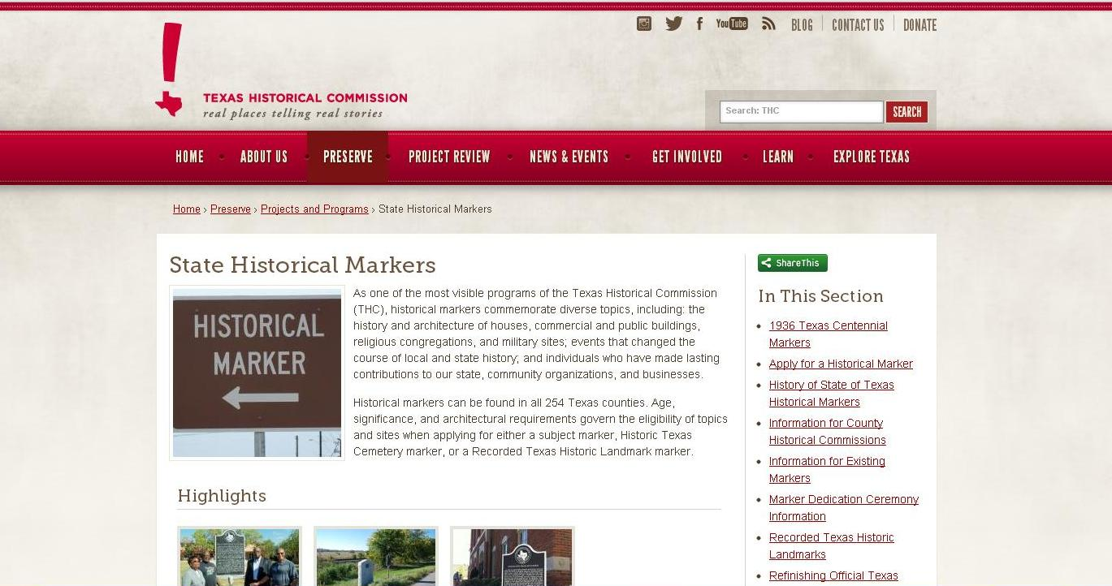
Historical Marker webpage
http://www.thc.state.tx.us/preserve/projects-and-programs/state-historical-markers
Notes:
In addition to the replacement and supplemental applications, the website also has training information, research guides, how-to guides for research, and much more.

Slide 11
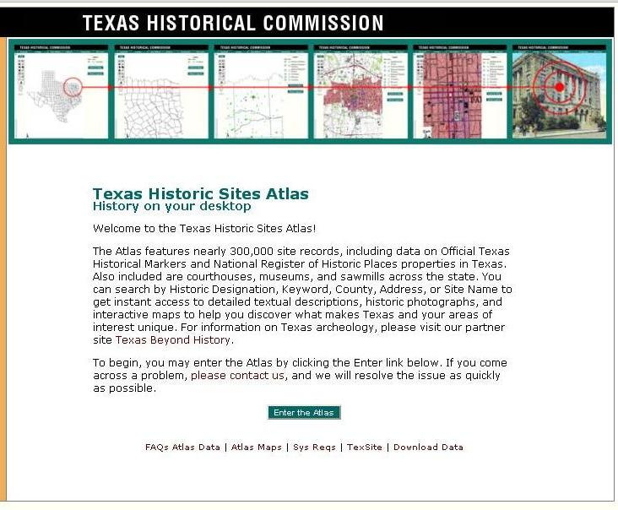
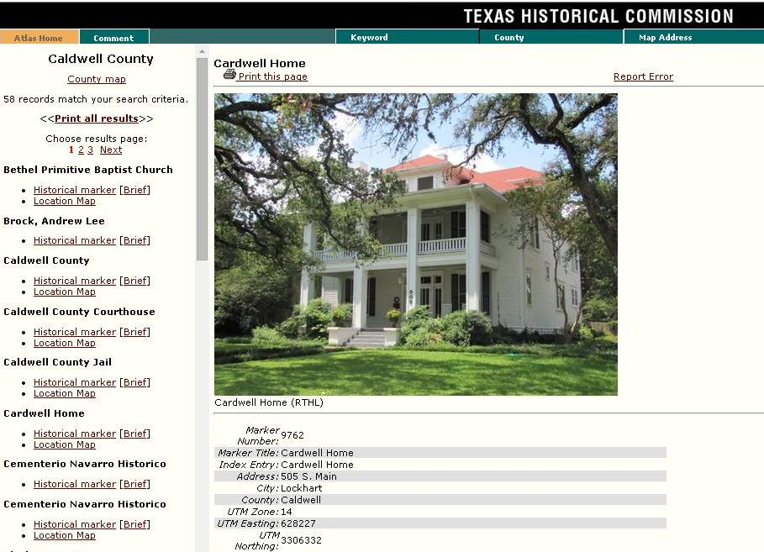
Historic Sites Atlas
Search by:
Keyword
County
Address
Designation
Site Name
Notes:
Also on our website is a tool called the Historic Sites Atlas. The Atlas is a searchable database that has markers, National Register properties, museums, cemeteries, courthouses, military sites, and survey information. You can search by keyword, county, city, designation, or address. The Atlas is a great starting point for research. Please remember that THC has files for historic properties. These files may be helpful to you – maybe there is a building or marker that is closely related to your topic. You may want to request a copy of that file to get ideas for your application. Or, if there is a marker or property of particular interest, send us an email requesting the file.

Slide 12
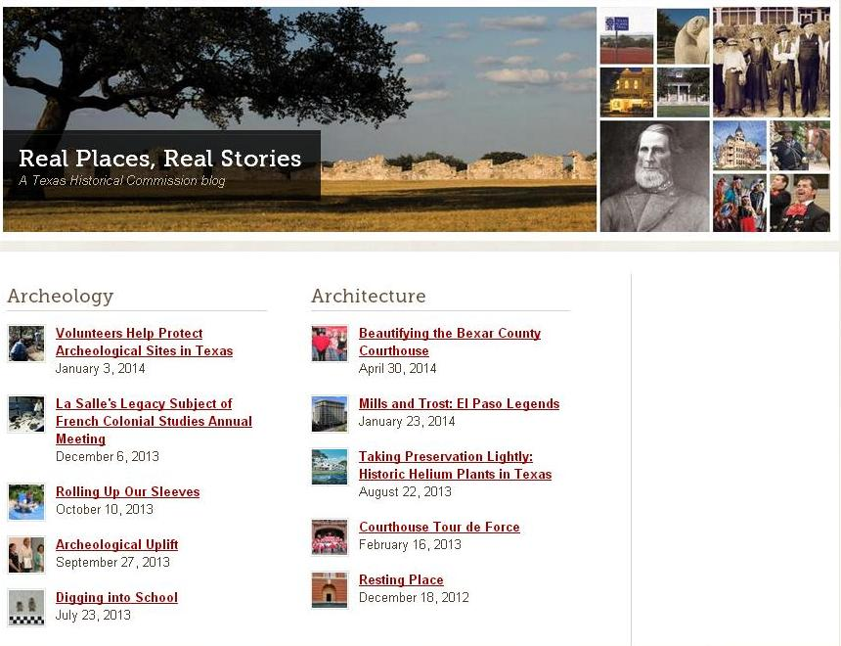
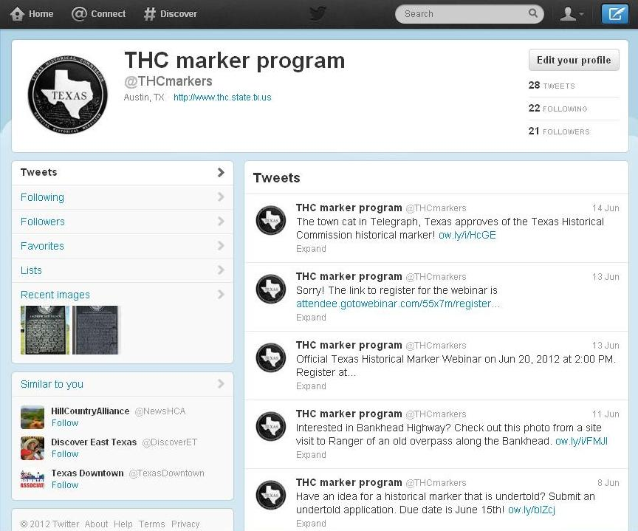
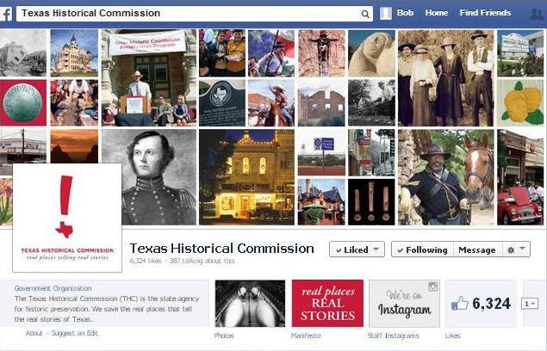
THC Social Media
Visit the THC blog:
Follow THC on Twitter:
http://www.thc.state.tx.us/blog
@TxHistComm
“Like” THC on Facebook:
Texas Historical Commission
Notes:
For those of you who are into social media, THC has a Facebook page and a twitter account. We post photos, information about upcoming marker dedications and events, and it is a place for people to chat and connect about something they love – history. On Mondays, there is a running feature called “Marker Monday” that posts fun facts, program information, and interesting stories related to historical markers. We have even done a trivia contest. You can access the THC blog from the main website to read incredibly interesting stories about Texas history and THC staff and their programs.

Slide 13
THC Marker Staff
Bob Brinkman
Coordinator
512/463-8769
bob.brinkman@thc.state.tx.us
Sarah McCleskey
Historian
512/463-4149
sarah.mccleskey@thc.state.tx.us
Ana Clark
Program Specialist
512/463-6063
ana.clark@thc.state.tx.us
history@thc.state.tx.us
Notes:
To request a marker file or ask a question, here is our contact information. You can also email history@thc.state.tx.us.

Slide 14

www.thc.state.tx.us
Notes:
For more information on the marker program and more training videos, check the THC website. Thank you for viewing “Introduction to Official Texas Historical Markers.”

