Slide 1
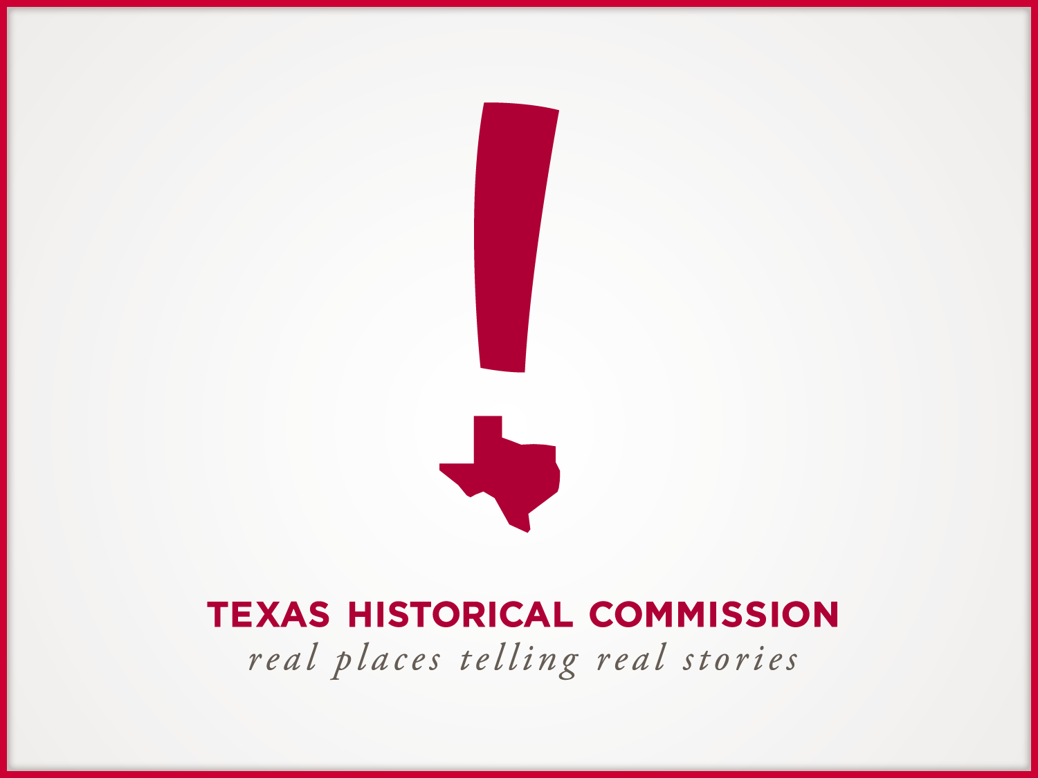

Slide 2
Texas’ Public
Preservation Survey
Results
February 26, 2010

Slide 3

The Survey
Web-based survey
1,089 people responded
  Survey open between Jan. 15, 2009 – Feb 7, 2010
Distribution
  Press releases
  Email to list servs, partners, schools, churches
  Link on websites
  Reminders

Slide 4
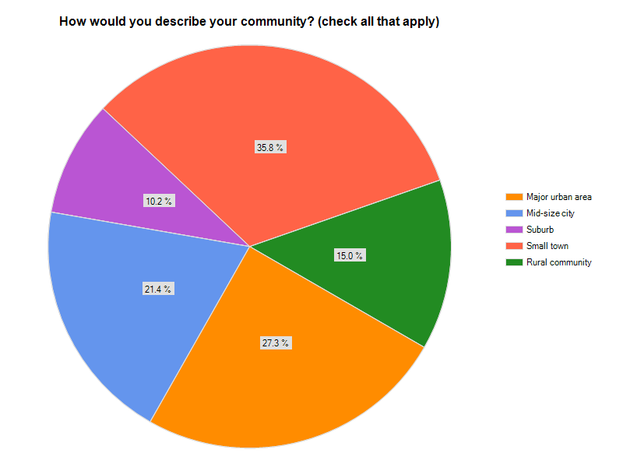
Demographics & Geography
64% of Texas counties are represented
59% urban
41% rural

Slide 5
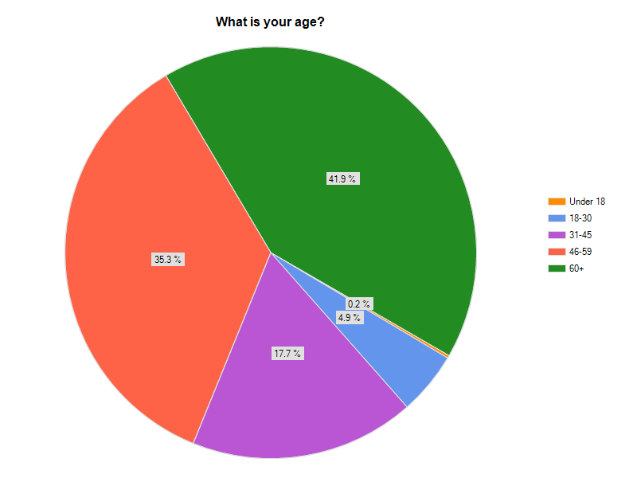
Demographics & Geography
77% over 45 years

Slide 6
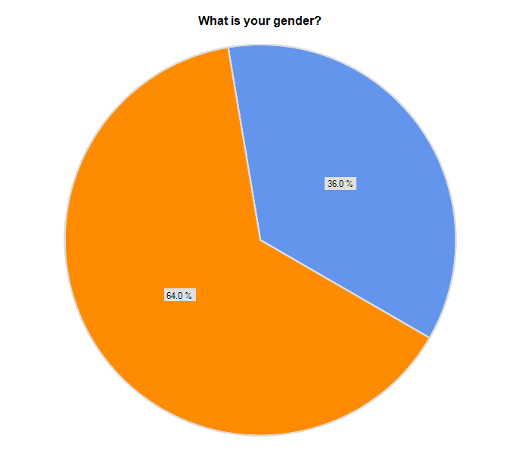
Demographics & Geography
Male
Female

Slide 7
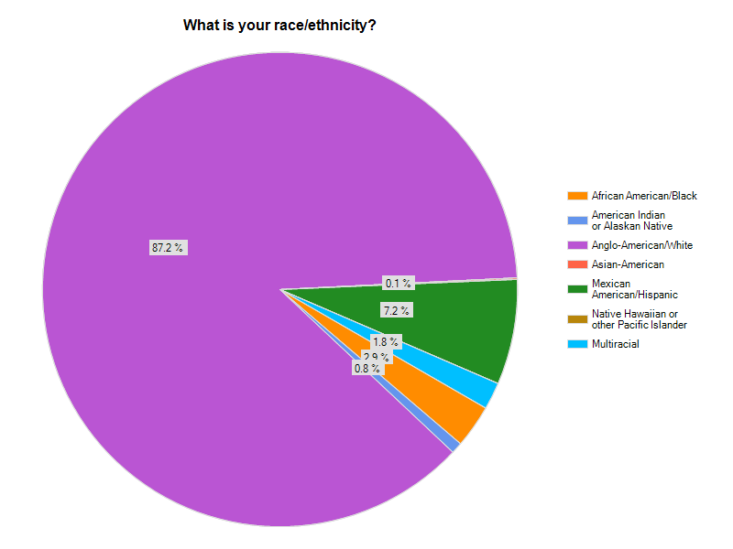
Demographics & Geography

Slide 8
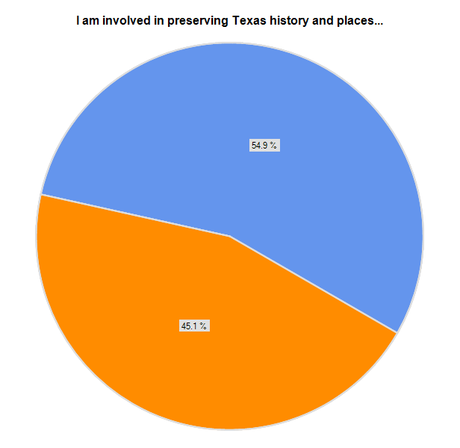
Preservation Interests
As an interested/volunteer
Through my profession or work

Slide 9
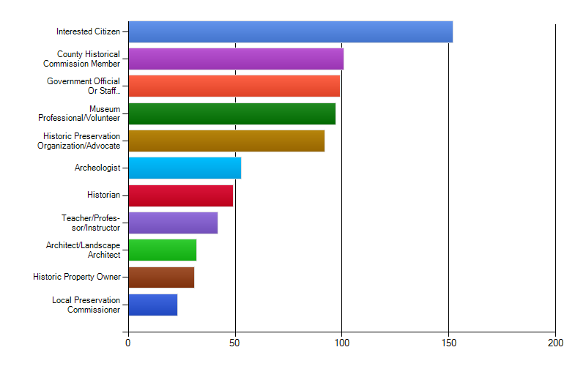
Preservation Interests
Which of the following best describes you?
Top 3

Slide 10
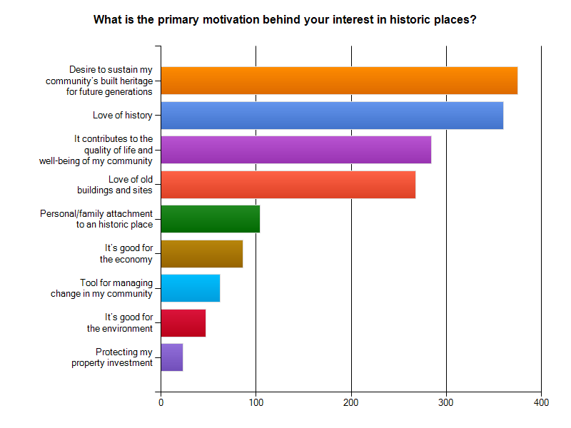
Preservation Interests
Top 3

Slide 11
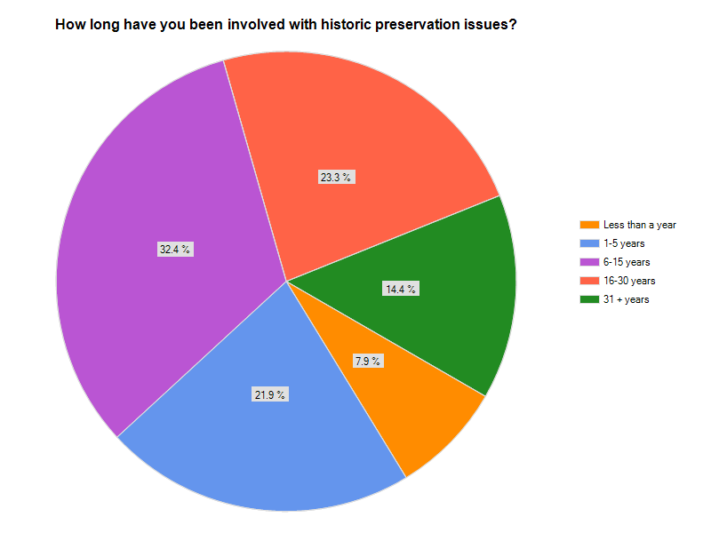
Preservation Interests

Slide 12
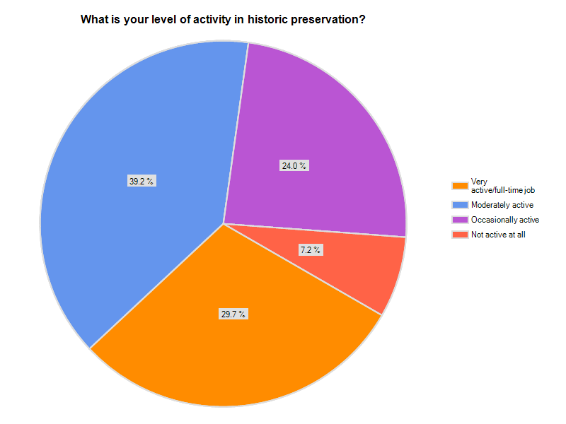
Preservation Interests

Slide 13
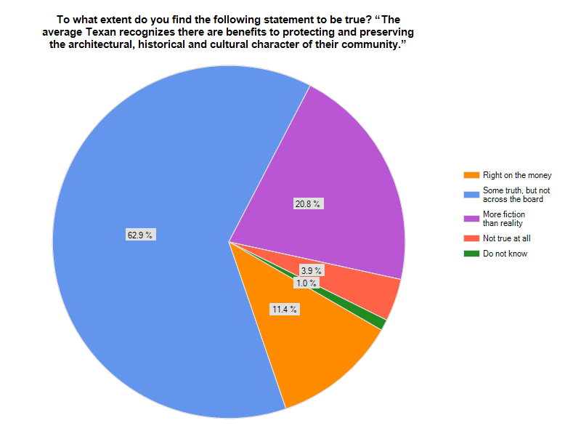
Preservation Benefits

Slide 14
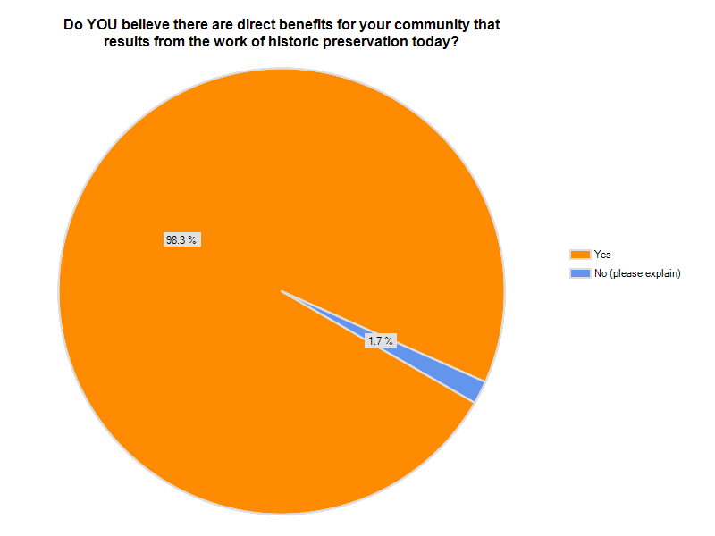
Preservation Benefits

Slide 15
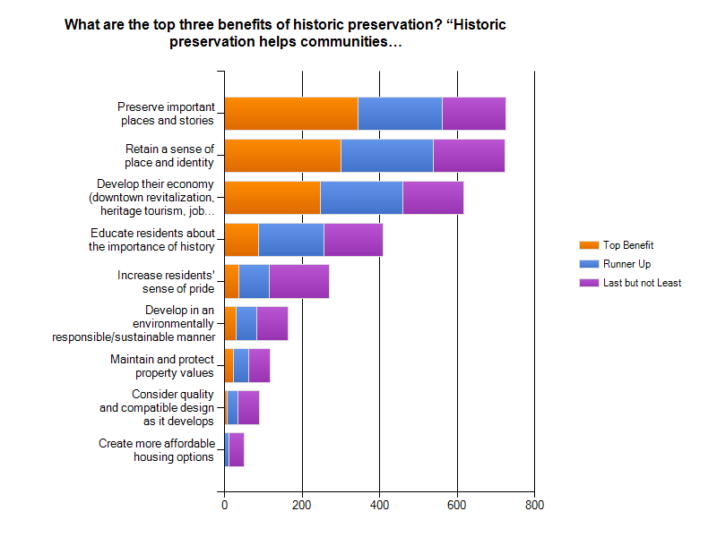
Preservation Benefits
Top 3

Slide 16
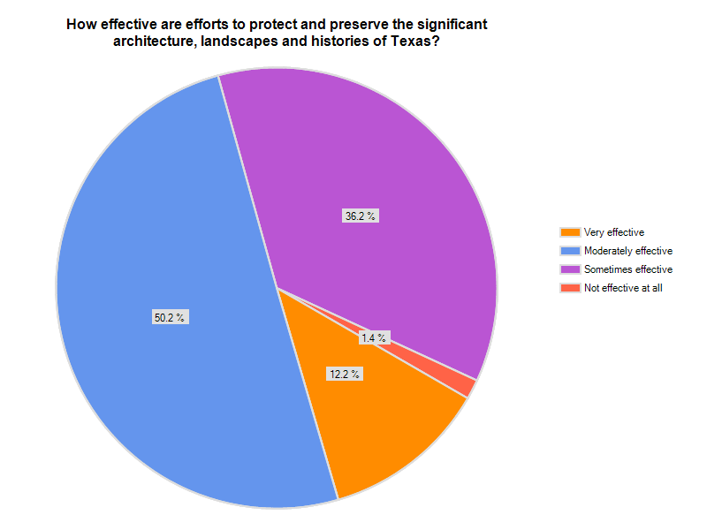
Preservation Issues

Slide 17
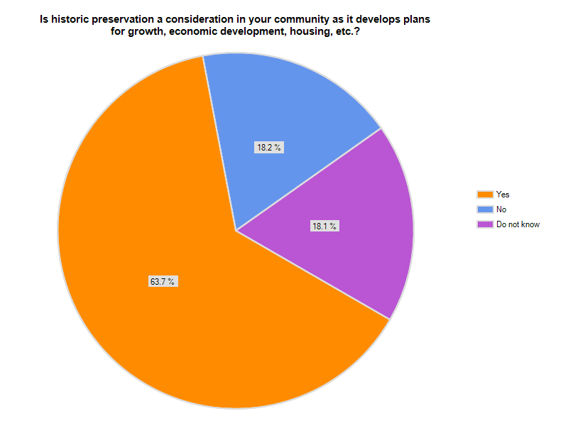
Preservation Issues

Slide 18
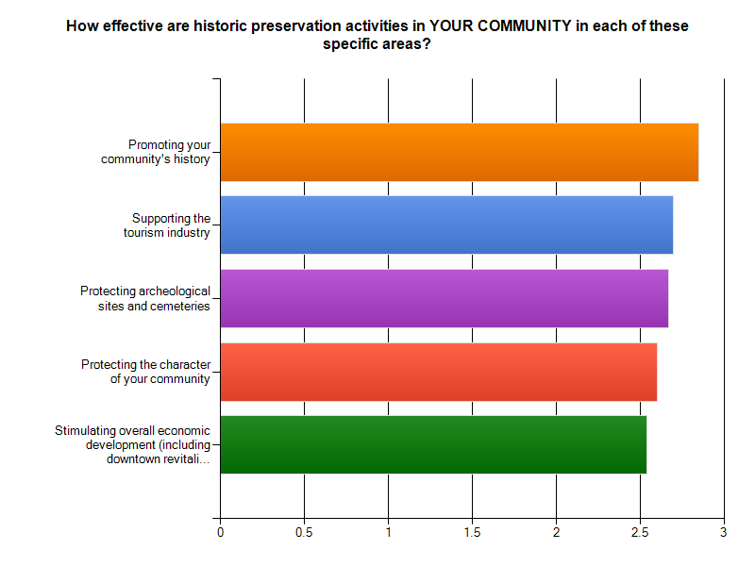
Strengths: Top Five
Top 3

Slide 19
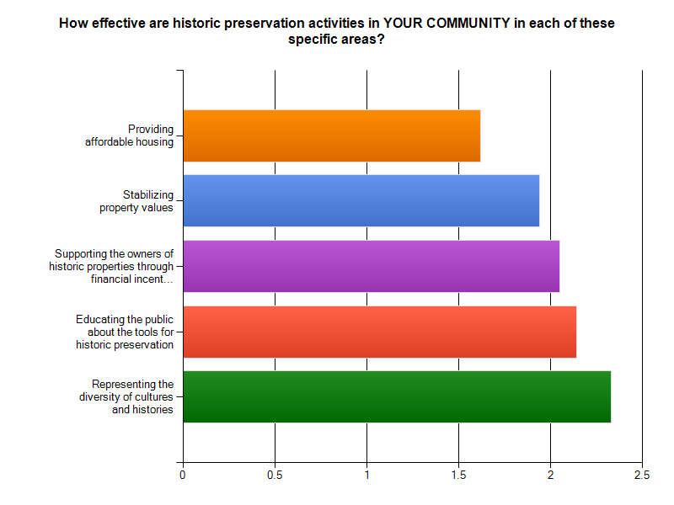
Weaknesses: Top Five
Bottom 3

Slide 20
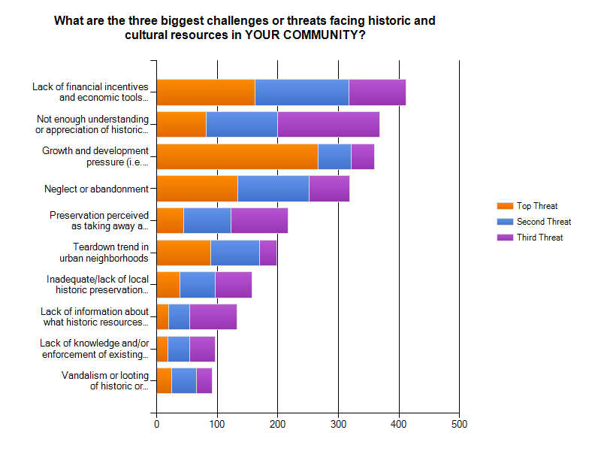
Threats
Top 3

Slide 21
Threats
Open-ended responses to biggest threats include:
Local politics
Lack of planning and zoning
Lack of planning authorized for counties
Gentrification
Untrained city staff

Slide 22
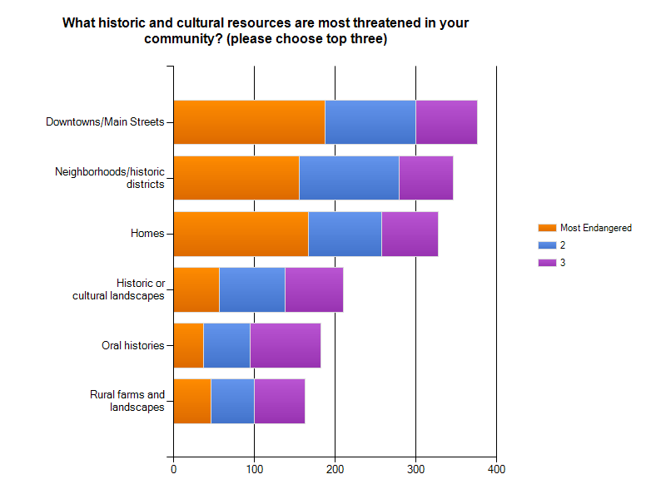
Threats
Top 3

Slide 23
Threats
Open-ended responses to threatened resources include:
Accessory buildings (garages, sheds, barns, etc.)
Brick streets and sidewalks
Collections
Dancehalls
Local businesses
Historic bridges
Native landscapes/habitats

Slide 24
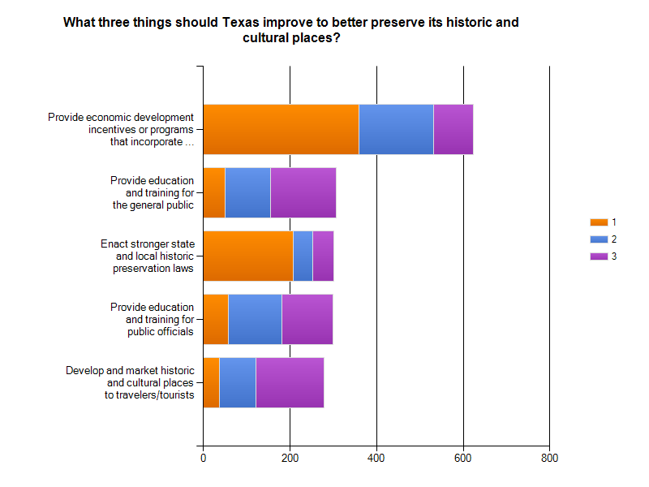
Opportunities
Top 3

Slide 25
Opportunities
Open-ended responses regarding what to improve to better preserve historic and cultural resources include:
Teach Texas history and preservation in schools
Maintain a survey and/or atlas of historic sites
Financially support good maintenance
Develop information resources on “green” historic preservation
Grant counties planning and zoning authority

Slide 26
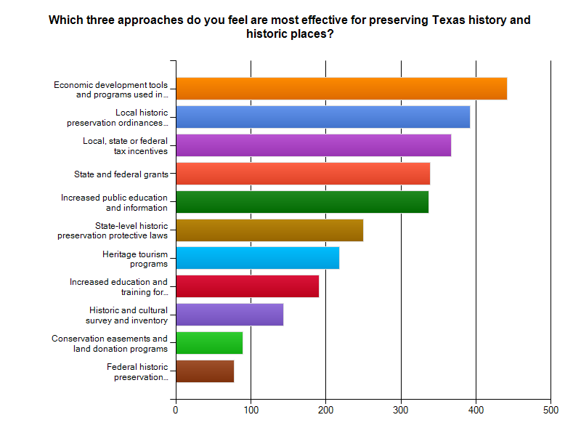
Opportunities
Top 3

Slide 27
Local Tools and Incentives
Respondents shared several local tools for preservation, including:
Generous property tax abatements
Construction waivers and Tax Increment Financing
Online database of landmarks and districts with accompanying zoning and incentives
Development of smart code
County Historical Commission review of new development in county
Web survey project
Partnering with local university, library, boy scouts, etc.

Slide 28
Using the Statewide Plan
Respondents shared their ideas on how they could use a statewide plan:
The plan can be a model or framework for communities that do not have the resources or expertise to develop their own plans
It should be an educational tool in a variety of ways, including educating the general public, outlining benefits of preservation to strengthen local discussions, and serving as a central clearinghouse of information for preservation
It should set forth consistent standards and guidelines for preservation

Slide 29
Using the Statewide Plan (cont.)
It needs to be implementation-focused; goals and actions need to be implementable and measurable, people at the local level need to be prepared to carry out the plan, and the plan needs to be tied to funding, grants and incentives
It needs to encourage survey and inventory of historic and cultural resources
It should focus on financial resources available for preservation
It should create networks and collaborations, sharing ideas, best practices and what is working/not working for different types of communities

Slide 30
Looking for more?
To view the full survey results, including all the open-ended comments, please visit this website
Questions or comments? Contact Tracey Silverman at 512/936-9615 or tracey.silverman@thc.state.tx.us

Slide 31


