Slide 1
Notes:
Hello, my name is Leslie Wolfenden.
I am the historic resources survey coordinator at the Texas Historical Commission.

Slide 2
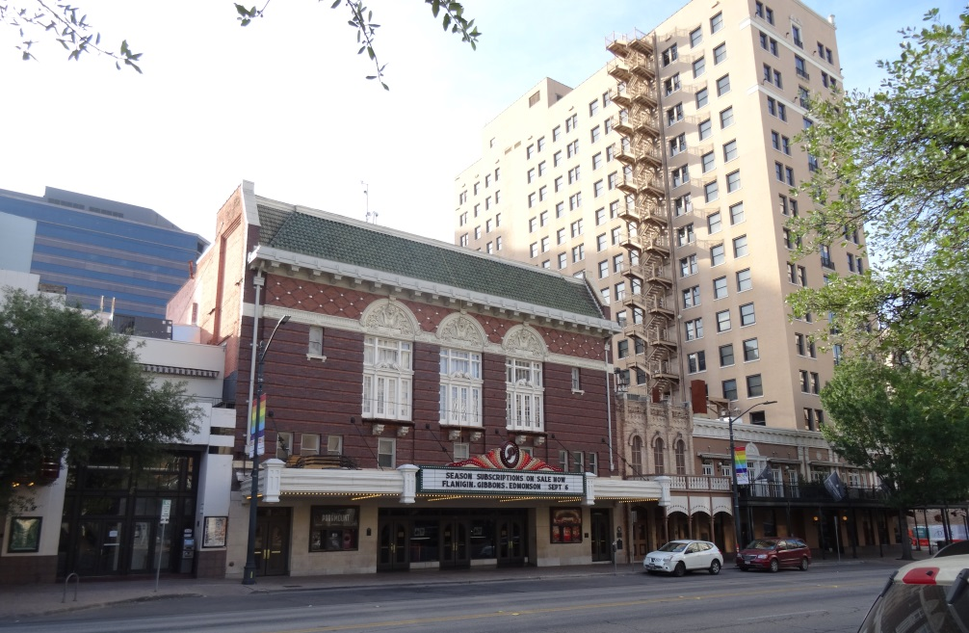
Commercial and
Civic
Architecture
Notes:
For this presentation, I am going to discuss Commercial and Civic Architecture,
And their basic architectural elements.

Slide 3
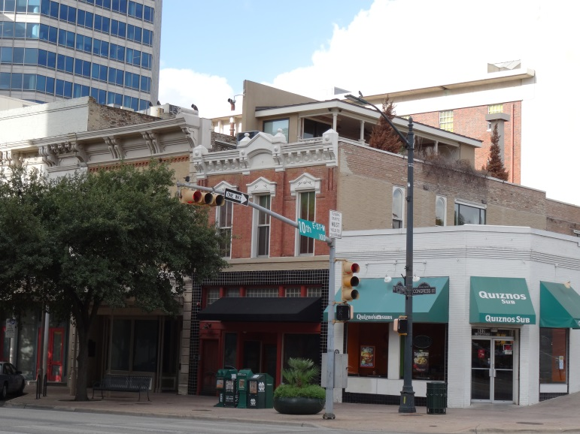
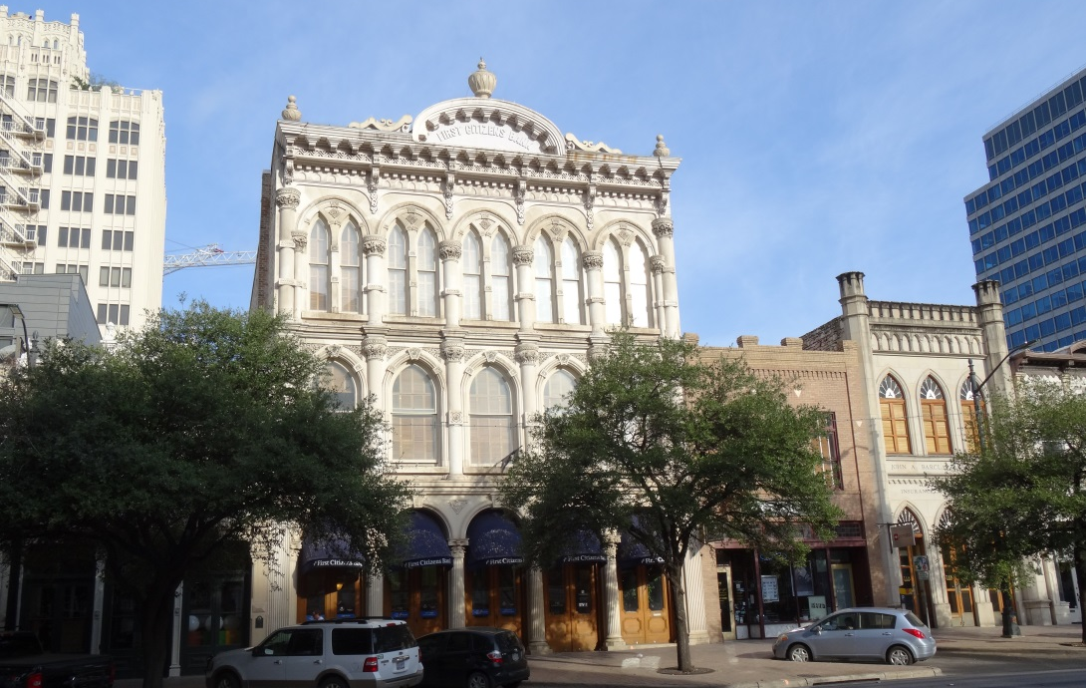
Commercial Architecture
Notes:
Unlike residential architecture, commercial architecture can be harder to categorize by architectural style.
However, commercial architecture shares a common language,
which examines the basic components of a commercial building’s street façade.

Slide 4
Commercial Architecture
Reference Materials
“The Buildings of Main Street: A Guide to American Commercial Architecture”
by Richard Longstreth
Notes:
One book that focuses on commercial buildings’ basic components is “The Buildings of Main Street” by Richard Longstreth.
This presentation primarily uses this book’s information.

Slide 5
Commercial Architecture
Notes:
Between the early 19th and the mid-20th centuries, most commercial buildings were designed to be seen from the front
and were not conceived as freestanding objects.
As you can see on this Sanborn Fire Insurance map, only the front façades are visible to the pedestrian, except on the corner buildings.
But even on corner buildings, the side elevations typically have simplified walls.

Slide 6
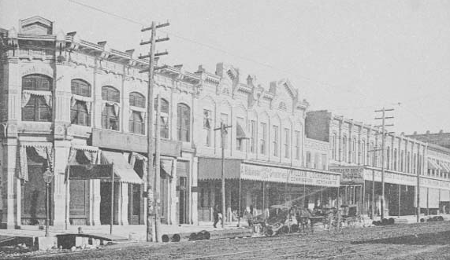
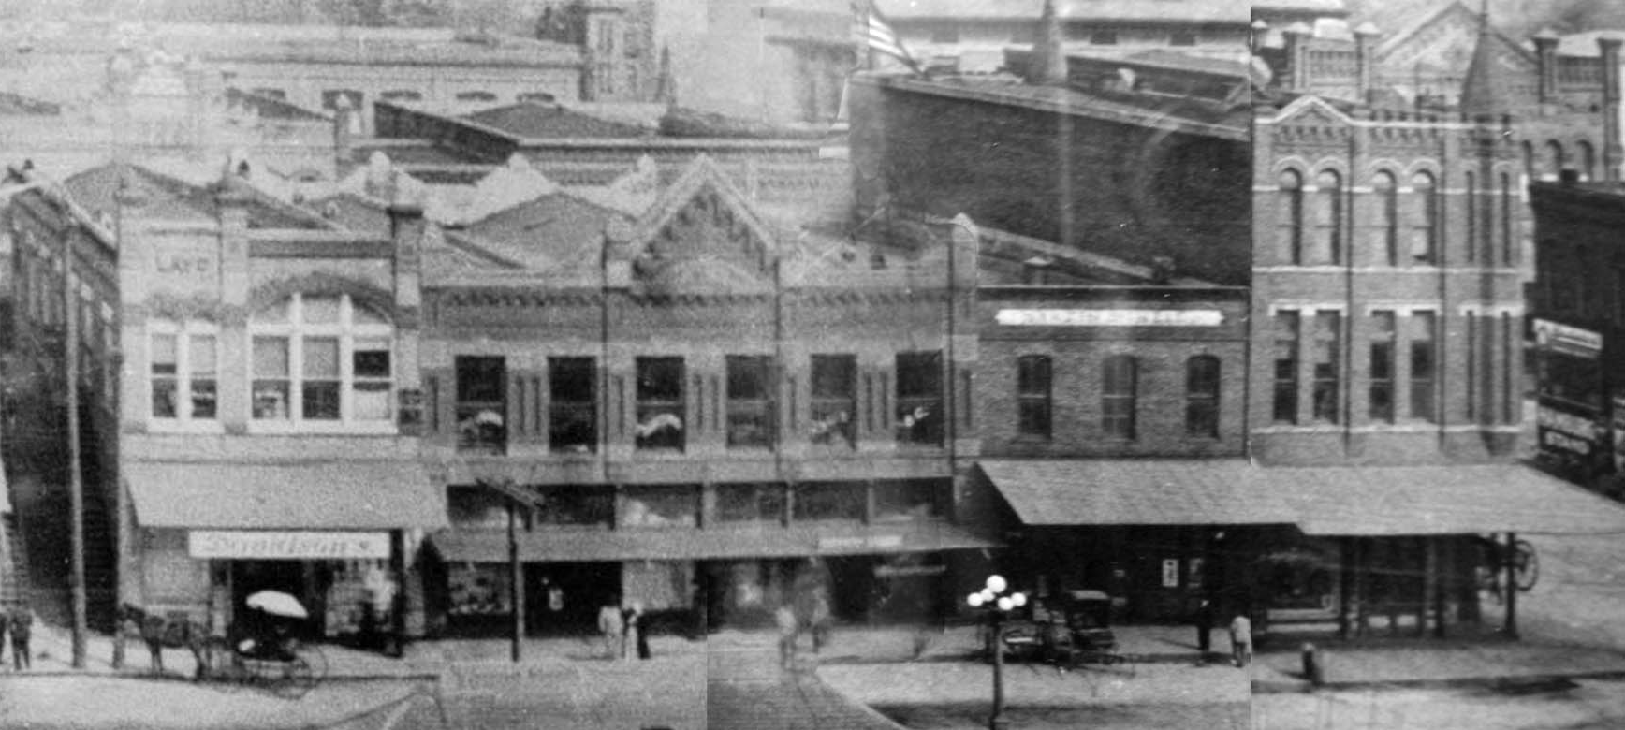
Commercial Architecture
Notes:
From the exterior, it is the front façade that gives commercial architecture its distinctive qualities
and distinguishes one building from the next.

Slide 7
Compositional Types
One-part Commercial Block
Two-part Commercial Block
Enframed Window Wall
Stacked Vertical Block
Two-part Vertical Block
Three-part Vertical Block
Temple Front
Vault
Enframed Block
Central Block with Wings
Arcaded Block
Notes:
Façade compositions can be boiled down to simple patterns that reveal the major elements used.
When these patterns appear frequently enough, they can be labeled as types.
So for this presentation, we will explore the different types listed here.

Slide 8
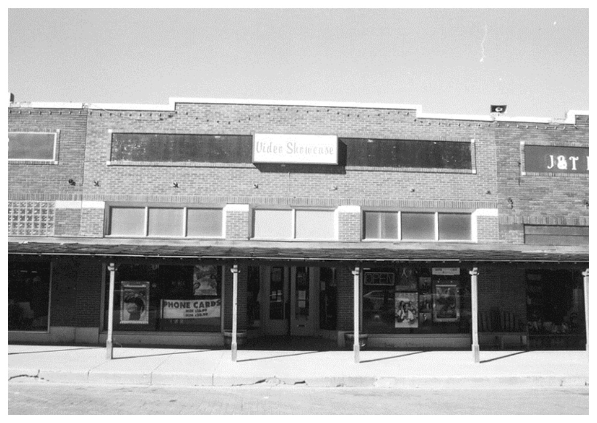
One-part Commercial Block
Parapet
Display windows
Notes:
A one-part commercial block is a simple box with a decorated façade and thoroughly urban in overtones.
It is always one-story in height.
It typically has a narrow street front with a façade consisting of plate glass windows and an entry topped by a parapet.
The parapet may vary from very plain to extremely decorative.

Slide 9
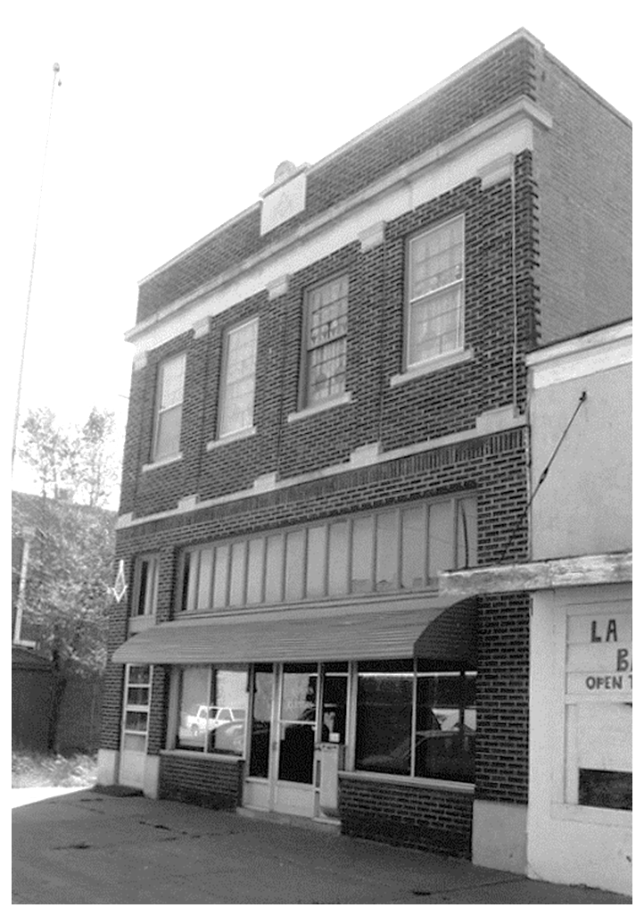
Two-part Commercial Block
Two to four stories in height
Private zone
Belt course
Public zone
Display windows
Notes:
A two-part commercial block refers to a horizontal division into two distinct zones: public versus private.
The public part is the ground floor that typically houses retail stores, professional services, or lobby.
The private section is the upper floors that may house offices, meeting rooms, or hotel rooms.
The two-part commercial block is typically 2 to 4 stories in height.
There is sometimes a demarcation between the two zones, often referred to as belt coursing.

Slide 10
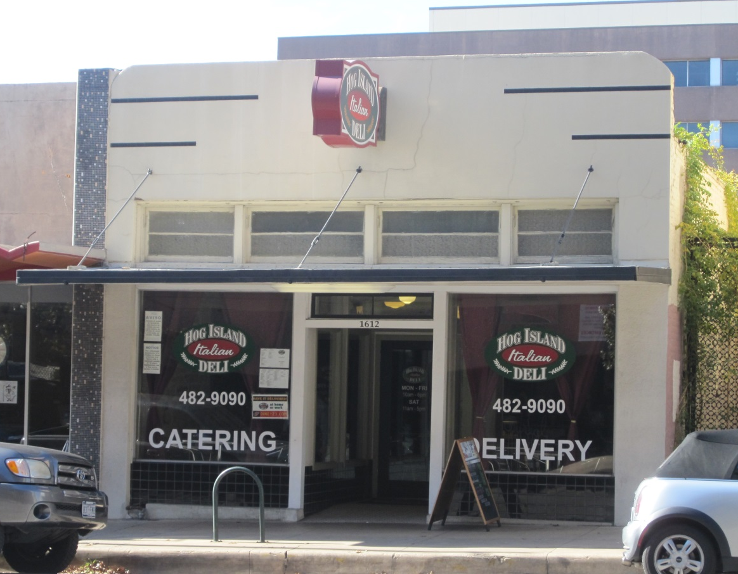
Enframed Window Wall
Decorative elements tend to be modest, often abstract
Simple surround
Little or no separation between ground floor and upper floor(s)
Large glazed display area
Notes:
The enframed window wall reflects an effort to give greater order to the façade composition of small and medium-sized commercial buildings.
This type is visually unified by framing the large center section with a wide and often continuous border,
which is frequently treated as a single compositional unit.
The decorative elements tend to be modest and abstract.

Slide 11
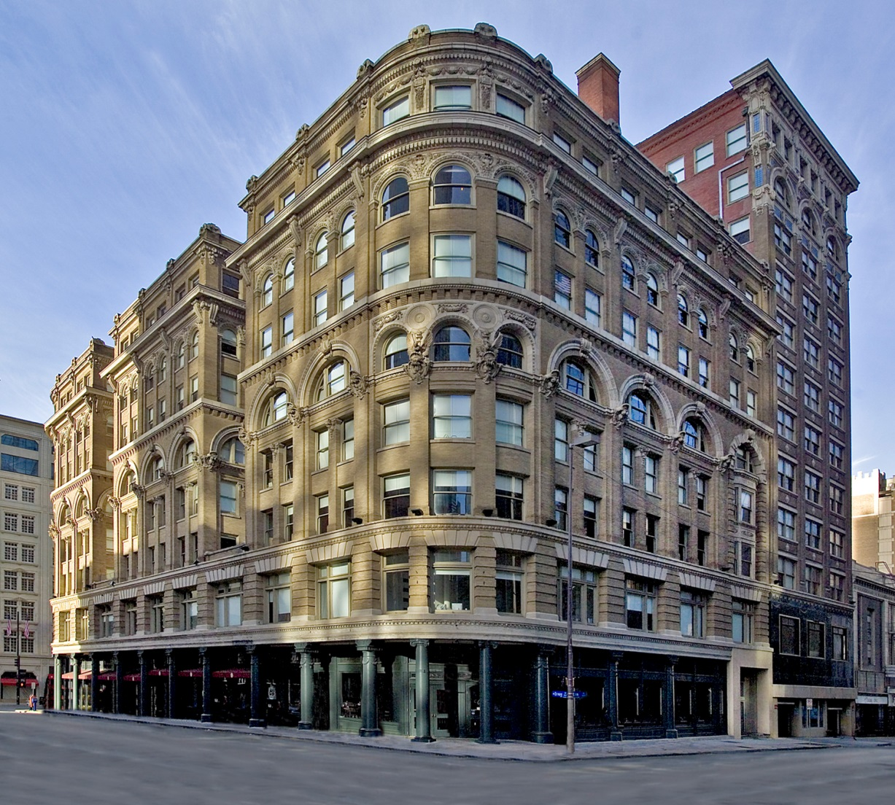
Stacked Vertical Block
Five or more stories in height
Varied treatments for each layer
Series of layers, rather than coherent whole
Similar emphasis for each layer
Photo courtesy of Steve Clicque
Notes:
The Stacked Vertical Block is typically 5 or more stories in height
With at least 3 horizontal divisions.
Each division is treated separately but none with appreciable hierarchy over the others.
There are 2 types of Stacked Vertical Block.
The first one has a slightly varied treatment of each story.
The second one combines 2 or more stories as a compositional group between other layers, which is what we see here.
Both types result in greater visual interest with the overall results being additive.
The exterior reads as series of layers rather than a cohesive whole.
This type evolved in the mid-1800s and lasted through 1900.
Wilson Building in Dallas at Main & Ervay; photo by Steve Clicque.

Slide 12
Two-part Vertical Block
At least four stories in height
Two parts:
Vertical emphasis shown by use of pilasters, engaged columns, piers, or smooth wall surface rising between windows
Upper zone: emphasis is on the “shaft” and has sense of verticality
Lower zone: the “base” is one to two stories in height
Notes:
The Two-part Vertical Block was used as a means to simplify the exterior composition of tall commercial buildings.
The façade is divided into 2 major zones.
The lower zone is 1 to 2 stories in height and is referred to as the base.
The upper zone is at least 4 stories in height, differentiating it from the shorter Two-part Commercial Block,
and is referred to as the shaft.
There is emphasis on the upper zone in its verticality and its dominance over the base,
Often is accentuated by the use of pilasters, columns, piers, or smooth wall surface rising between the windows.
It is commonly used for office buildings, department stores, and hotels.

Slide 13
Three-part Vertical Block
Identical to two-part vertical block except has distinct upper zone of generally 1 to 3 stories
Three parts:
Capital
Shaft
Base
Notes:
The Three-part Vertical Block is basically the same as the Two-part Vertical Block
Except that it has a distinct upper zone of 1 to 3 stories, comprising the Third part.
So now the building has a base, shaft, and capital.

Slide 14
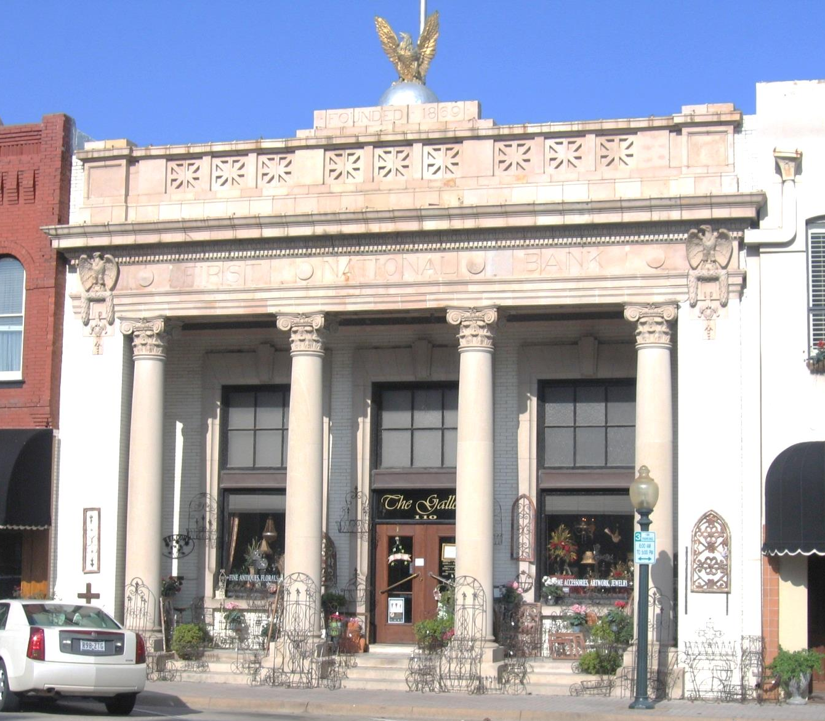
Temple Front
One compositional unit
Usually two to three stories in height
Two types:
- Portico across front
- Recessed entrance with twin columns
Notes:
The Temple Front type is treated as one compositional unit, typically 2 to 3 stories in height.
This type was developed not for commercial purposes, but for public, institutional, religious buildings, and banks.
There are two common versions of this type.
The first one has a portico across the front with 4 or more columns, as seen here.
The other one has a recessed entrance flanked by twin columns between sections of enframing wall that read as thick walls.
The Temple Front was inspired by ancient Greek and Roman architecture.

Slide 15
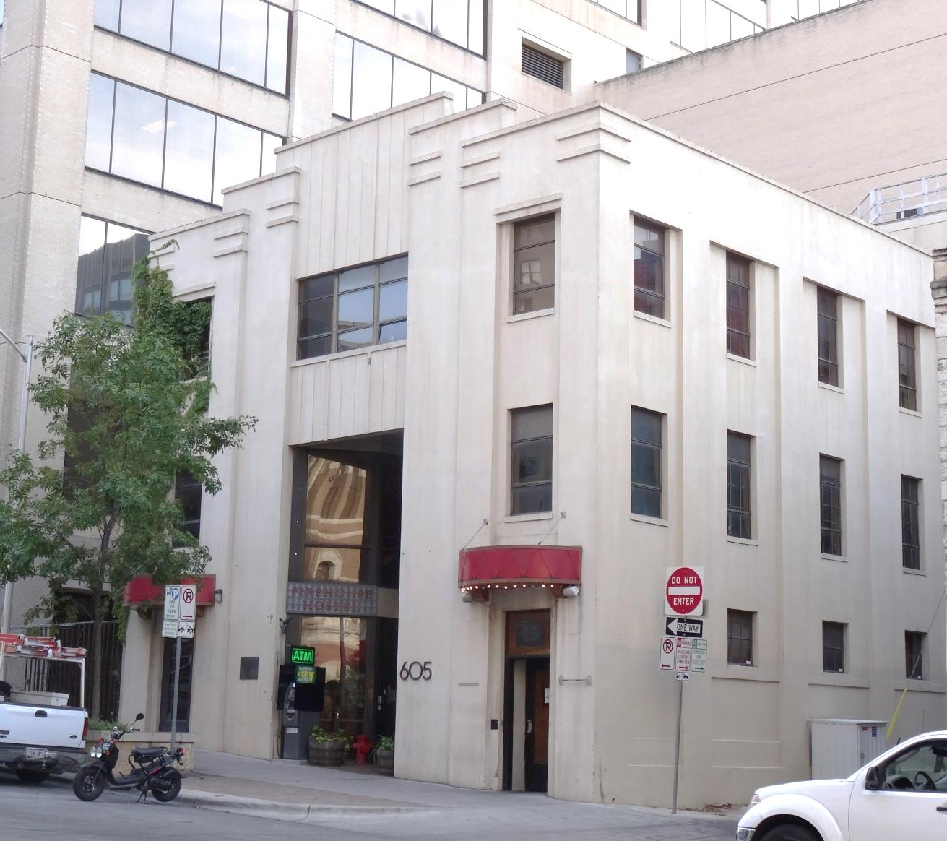
Vault
Typically two to three stories
Tall and comparatively narrow center opening
Massiveness and enclosure emphasized
Notes:
The Vault type has a façade penetrated by a tall and comparatively narrow center opening,
And sometimes by smaller ones on either side.
It is similar to the Enframed Window Wall, but here, massiveness and enclosure are emphasized over framing open interior spaces.
Often seen in banks, movie theaters, and retail operations.

Slide 16
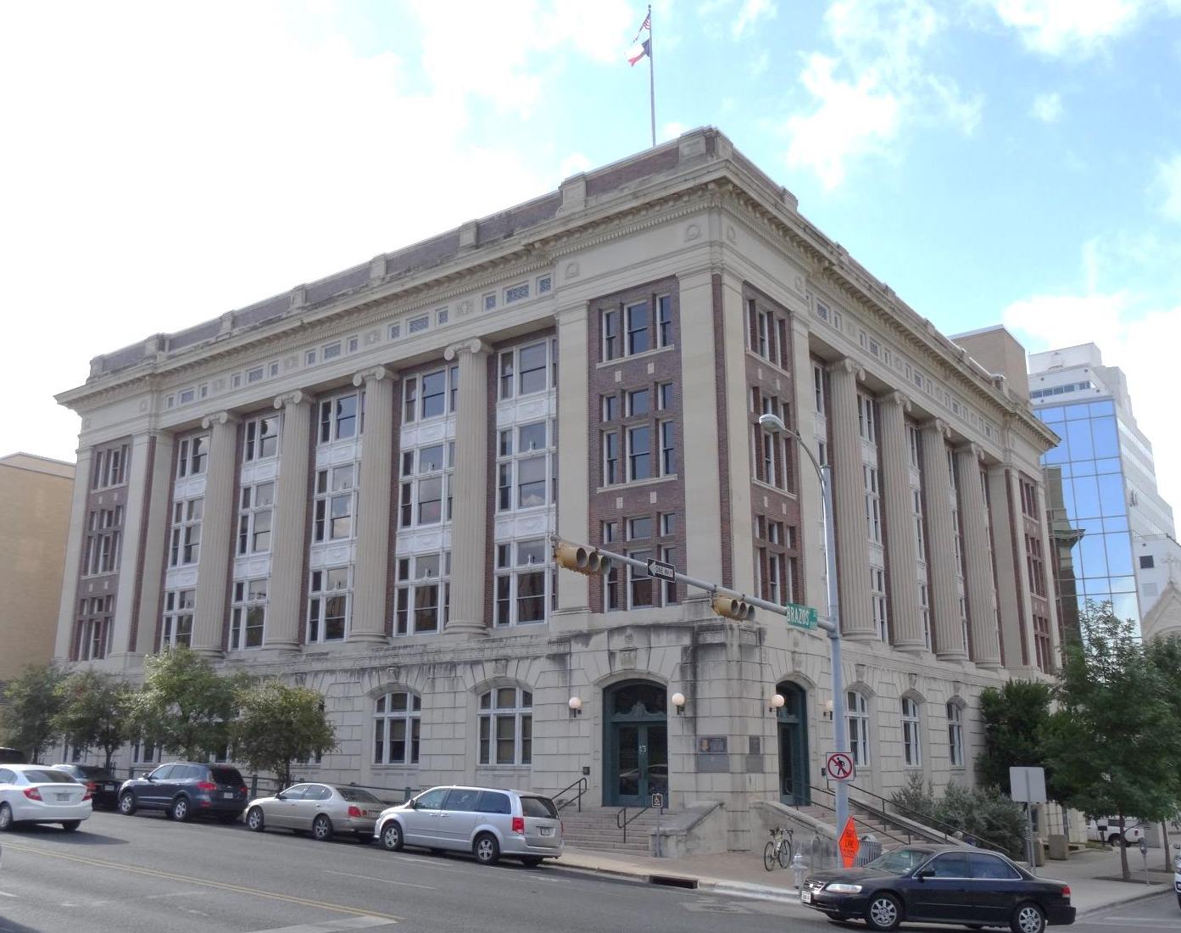
Enframed Block
Typically two to three stories high
Façade punctured by columns, pilasters, arcades or treatment suggestive of classical elements
Main section is bracketed by narrower end bays to form continuous wall plane
Notes:
The Enframed Block is generally 2 to 3 stories in height, although sometimes taller as seen in this example.
The façade is decorated with columns, pilasters, arcades, or other treatments suggestive of classical architecture.
The main section is bracketed by narrower end bays, more or less equal in height, to form a continuous wall plane.
It is often found on public and institutional buildings, as well as banks.

Slide 17
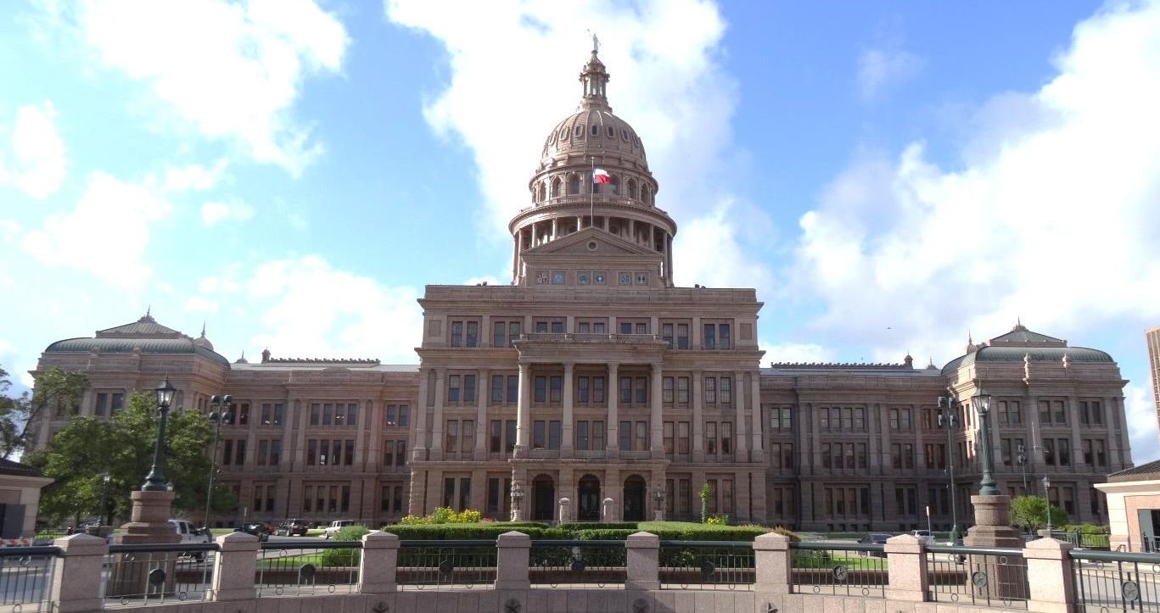
Central Block with Wings
Typically two to four stories
Projecting center section and subordinate flanking units
All three parts may read as single mass or as three related masses
2
1
2
Notes:
The Central Block with Wings is characterized by a façade generally 2 to 4 stories in height
with a projecting center section and subordinate flanking units that are at least half as wide and are often much wider.
All three parts may read as a single mass, with a centerpiece in the form of a classical portico, like the Texas state capitol building seen here,
or as three related masses with the central one extending both out from and above the wings.
The Central Block with Wings is often used for public and institutional buildings as well as banks.

Slide 18
Arcaded Block
Characterized by series of tall, evenly spaced, round-arched openings
Typically two to three stories
Notes:
The Arcaded Block is portrayed by a series of tall, evenly spaced round-arched openings
extending across a wide façade with no separate bracketing elements at the ends.
It is generally 2 to 3 stories high.
It is often used for banks and large retail stores.

Slide 19
Stylistic Influences
Notes:
The discussed compositional types make up the basic building components for commercial and civic buildings from approximately mid 1800s to mid 1900s.
These buildings may have architectural stylistic influences as well
that are more readily understood,
such as Classical Revival or Art Deco.
So you could have a two-part commercial block with Italianate influence as seen on the left,
Or even a three-part Vertical Block with Gothic Revival influence as seen in the center,
or a Vault type with Art Deco influence on the right.

Slide 20
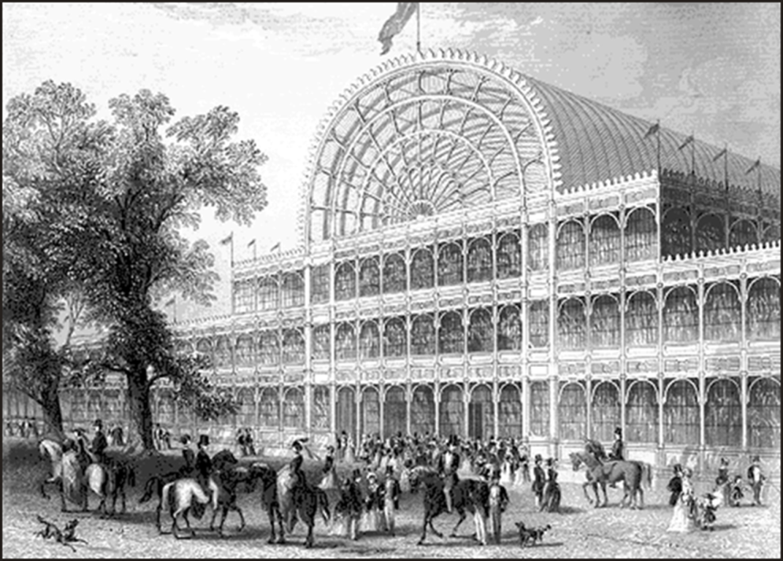
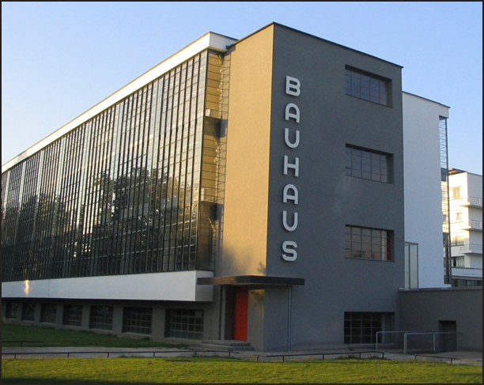
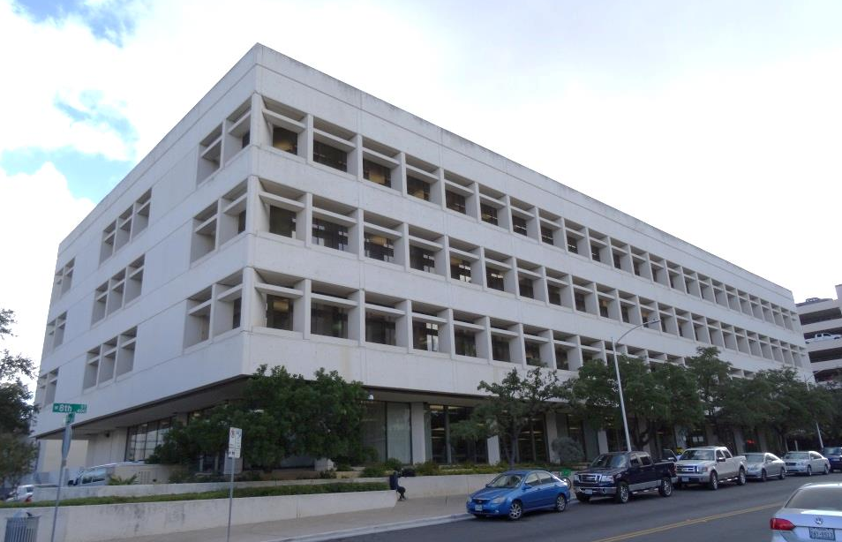
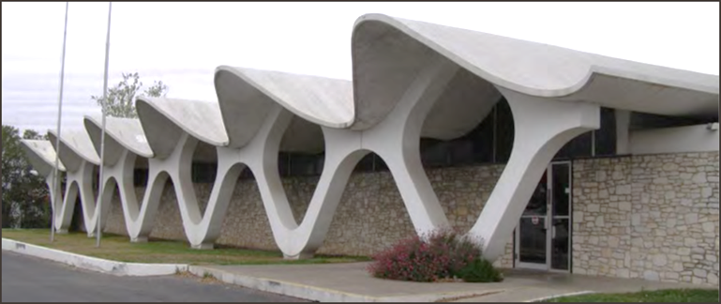
New Concepts of Architecture
Notes:
By the mid-20th century, American commercial architectural design and ideology visibly shifted.
The post-World War II era transformed the fundamental features of design and attitudes toward our physical environment.
While the beginning threads of this change occurred decades earlier, the manifestations became evident by the 1950s.
These changes affected how architects thought about buildings: massing, form, structure, function, and volume.
This revolution is what we know and understand today as being Modern Architecture.
For more on this, see the presentation on Modern Architecture.

Slide 21
Contact Information
Texas Historical Commission
www.thc.state.tx.us
Historic Resources Survey
Historic Resources Survey Coordinator: Leslie Wolfenden
512.463.3386
leslie.wolfenden@thc.state.tx.us
Notes:
My contact information is shown on this slide.
This concludes the Commercial and Civic Architecture presentation.
Thank you.

