Slide 1


Notes:
Hello. I am Leslie Wolfenden,
the Texas Historical Commission’s Historic Resources Survey Coordinator.

Slide 2
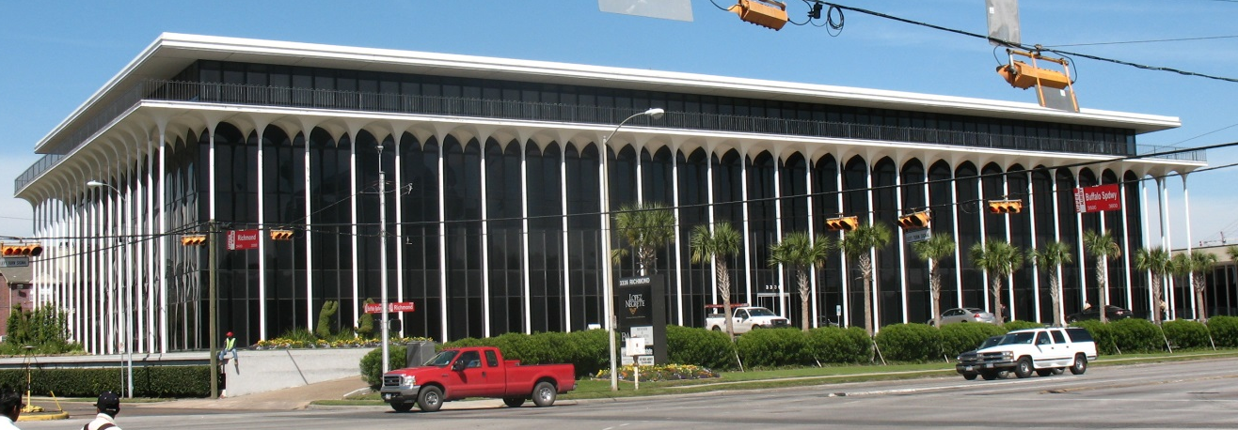
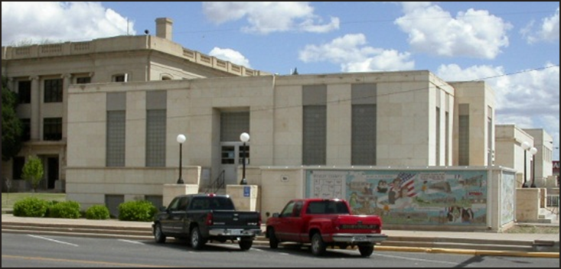
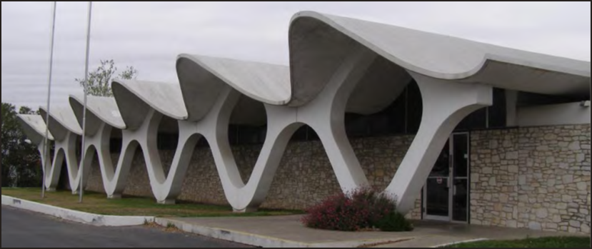
Taking Stock of Treasure:
Modern Architecture
Notes:
Today, we are going to discuss Modern Architecture.
Since modern architecture of the 20th century is coming into its own and is considered to be “historic,”
I’ll be covering where modern architecture came from, what it is, and how it evolved over time.

Slide 3

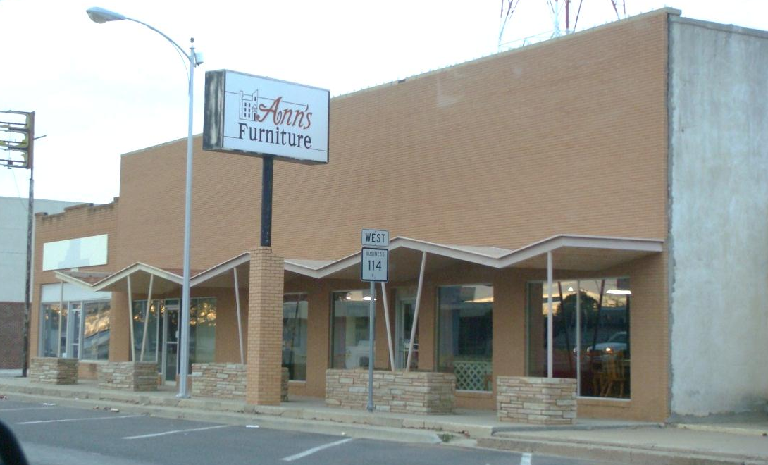
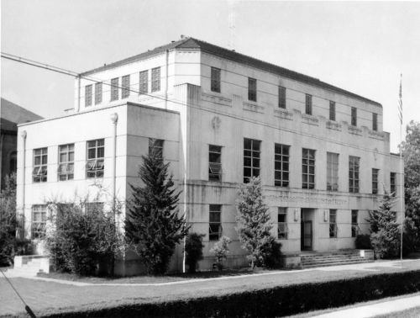
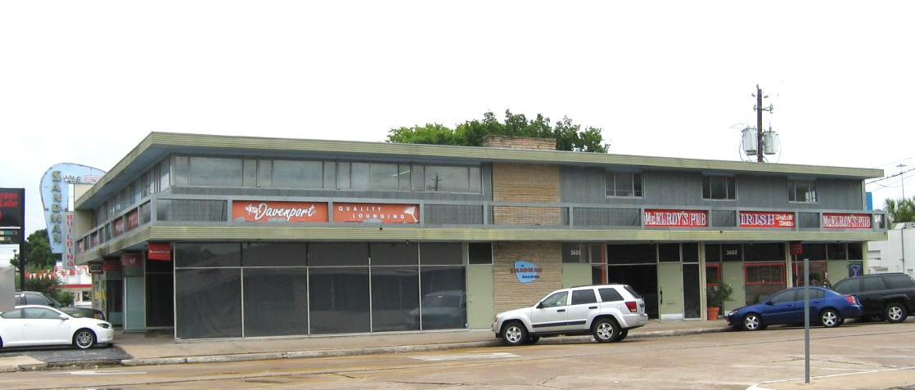
Modern Architecture
Notes:
Modern architecture began in the early 20th century with roots in the 19th century.
It was an effort to reconcile principles underlying architectural design
with rapid technological advancement and modernization of society.
The Modern Architecture time period ranges roughly from 1900s to the 1980s.
In the early 1900s, there was an evolution of thought in the European schools of design,
Kickstarting the Modern movement
And by the 1980s, Modern Architecture transitions over to Post Modernism.
Levelland, top left
The Sandman Building, Houston, top right
Richmond Ave, Houston, bottom left
Stripped Classicism, Utah, bottom right

Slide 4
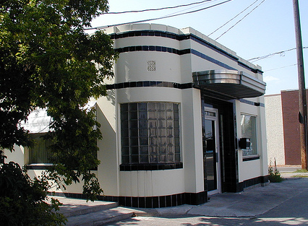
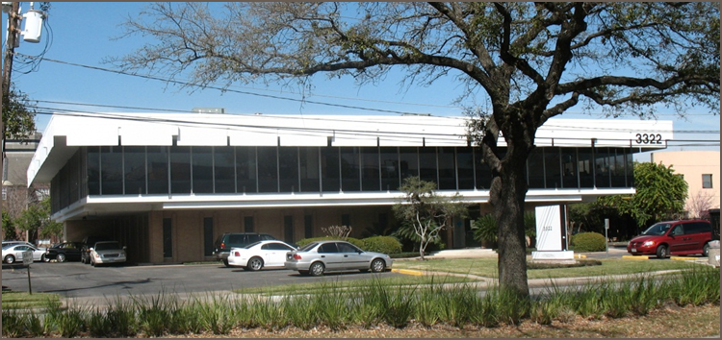
Modern Architecture
    Art Deco
    Art Moderne
    Stripped Classicism
    International Style
    Mid-Century Modern
    Googie
    New Formalism
    Brutalism
    Etc.
Notes:
Modern architecture encompasses many different styles including:
Art Deco,
Art Moderne,
Stripped Classicism,
International Style,
Mid-century modern,
Googie,
New formalism, and
Brutalism.
There are others that were more popular in Europe that we won’t cover here today,
such as Futurism, Constructivism, and Expressionism.

Slide 5
Modern Architecture
  Exact definition and scope varies widely
Characteristics:
  Simplification of form
  Creation of ornament from structure and theme of the building
  Takes form of numerous movements, schools of design, and architectural styles
Notes:
The exact definition and scope of Modern Architecture varies widely,
But the characteristics include
Simplification of form,
Creation of ornament from structure and theme of the building,
And it takes the form of numerous movements, schools of design, and architectural styles.

Slide 6
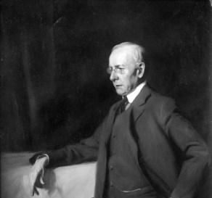
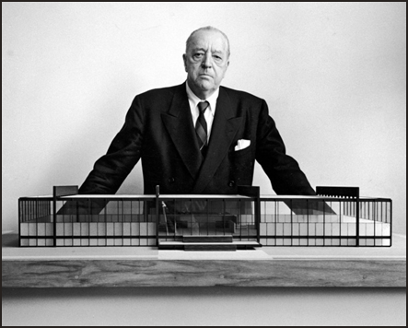
Characteristics
  Design should derive directly from its purpose
    “Form follows function” ~ Louis Sullivan
    Simplicity and clarity of forms and elimination of ‘unnecessary detail’
      “God is in the details” ~ Mies van der Rohe
      Visual expression of structure
Notes:
Design should derive directly from its purpose
In other words: “Form follows Function” as famously quoted by Louis Sullivan.
It should include simplicity and clarity of form and elimination of “unnecessary detail.”
As Mies van der Rohe said: “God is in the details”.
It is a visual expression of structure.

Slide 7
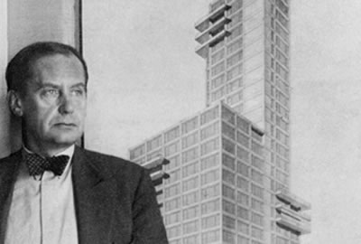
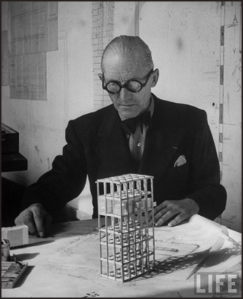
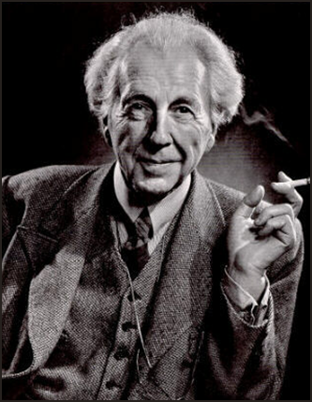
Characteristics
  Truth of materials
    Use of industrially produced materials
      Visual emphasis on horizontal and vertical lines
Notes:
Modern Architecture valued the truth of materials:
The true nature or natural appearance of a material ought to be seen
rather than concealed or altered.
Industrially produced materials are used as an adoption of the machine aesthetic.
Horizontal and vertical lines are emphasized.
Notable architects include:
Frank Lloyd Wright (bottom right)
Mies van der Rohe
Walter Gropius (top)
Le Corbusier (bottom left)
And Oscar Niemeyer
Among others.

Slide 8
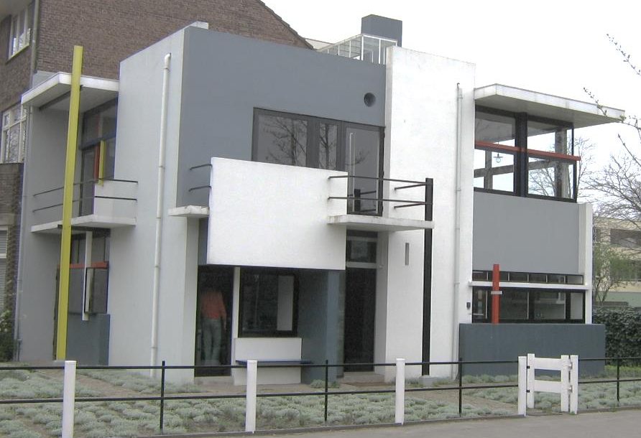
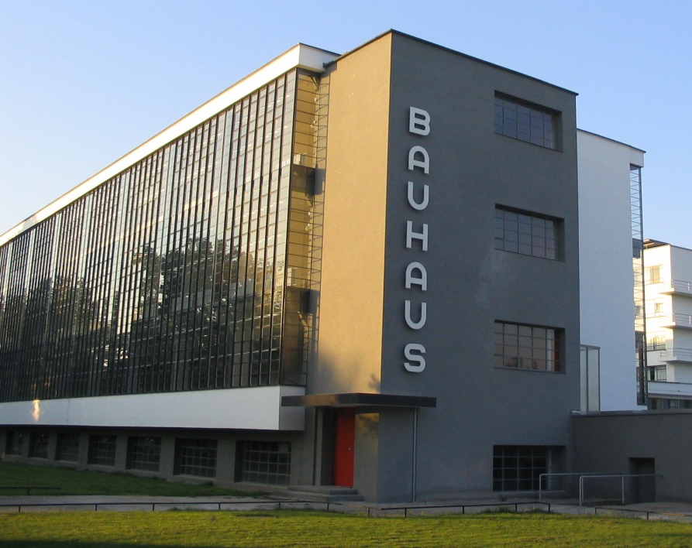
Modern Architecture
Notable schools of design and portfolios
  Deutscher Werkbund
  Wasmuth Portfolio
  De Stijl
  Bauhaus
  Harvard Five
  Case Study Houses
Notes:
Notable schools of design and portfolios were extremely important to the history and development of the modernist movement.
Of notable influence include:
The Deutscher Werkbund: from 1907 with Peter Behrens, Josef Hoffman, and Bruno Paul.
The Wasmuth Portfolio of 1910: this was Frank Lloyd Wright’s lithographs of his works from 1893-1909; this was the first publication of his work anywhere; there is a significant link between Wright’s American architecture and the first generation of modernist architects in Europe.
De Stijl of the Netherlands from 1917 includes Theo van Doesburg, Piet Mondrian, and Gerrit Rietveld (see the top right image designed by Rietveld).
The Bauhaus from 1919; this includes Walter Gropius, Hannes Meyer, and Mies van der Rohe (see bottom left image designed by Gropius).
The Harvard 5 of the 1940s, which was influenced by Walter Gropius, included John Johansen, Marcel Breuer, Lanis Gores, Philip Johnson, and Eliot Noyes.
The Case Study Houses were experiments in American residential architecture. This was sponsored by Arts & Architecture Magazine to design and build inexpensive and efficient model homes. Architects involved were Richard Neutra, Charles & Ray Eames, and Eero Saarinen.

Slide 9
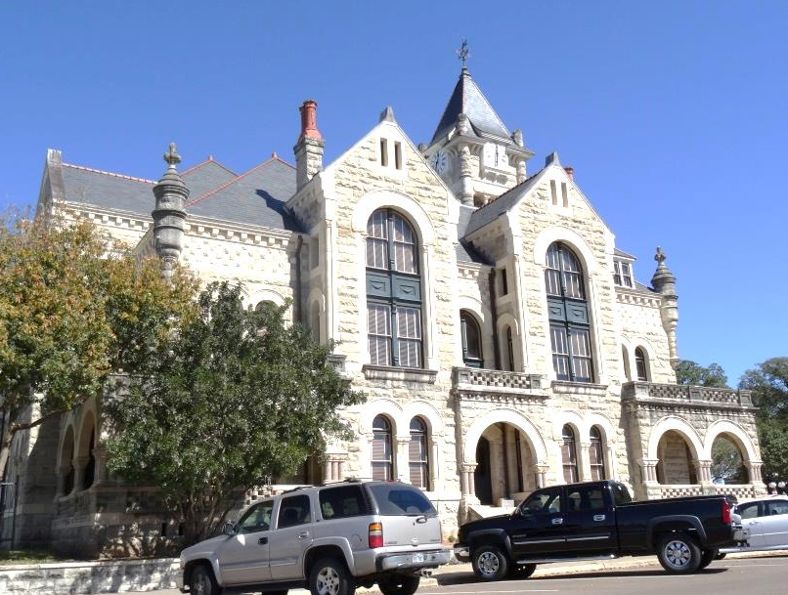
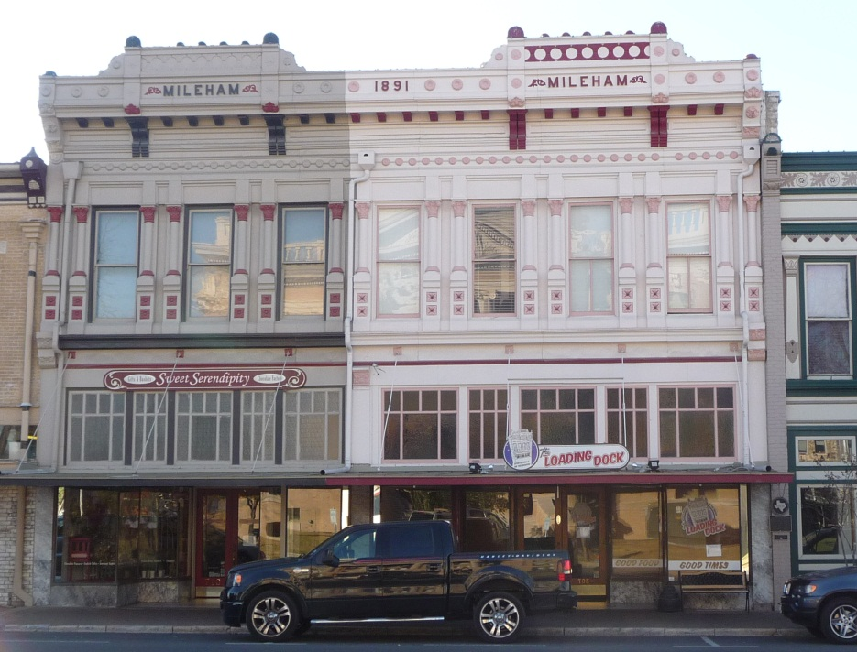
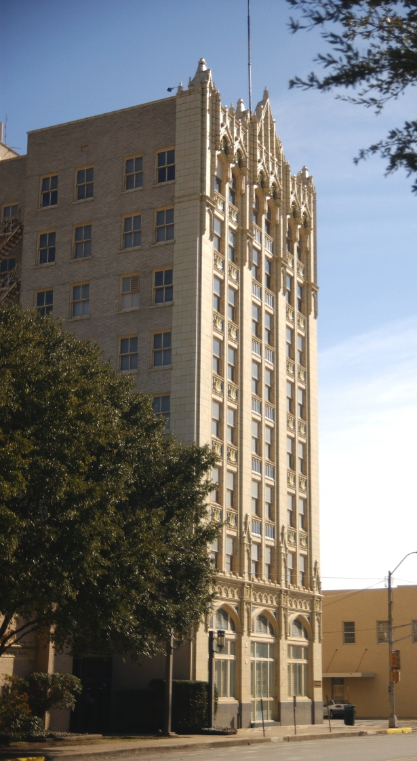
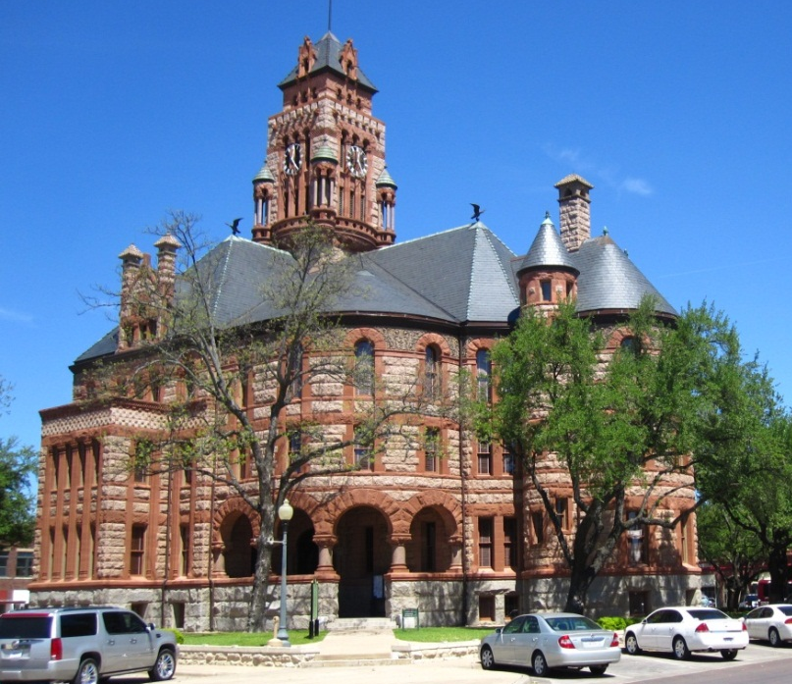
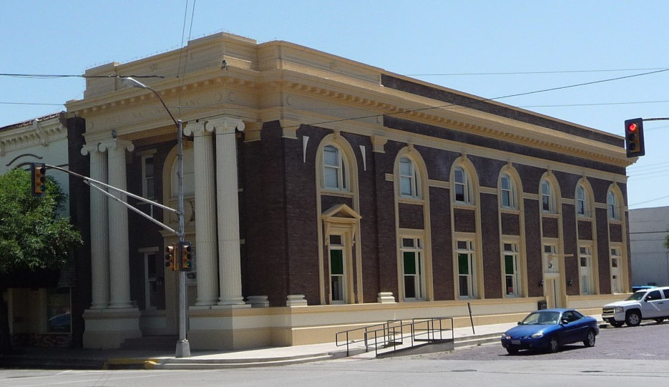
Pre-Modern Architecture: Historicism
Notes:
The modernist styles developed through a combination of thoughts, including
Results of social and political revolutions driven by technological and engineering developments,
And as a matter of taste as a reaction against eclecticism
and the lavish stylistic excesses of Victorian and Edwardian architecture
As seen on this slide.
Sonora, top left
Georgetown, top right
Corsicana, center
Ellis County Courthouse, Waxahachie, bottom left
Corsicana, bottom right

Slide 10
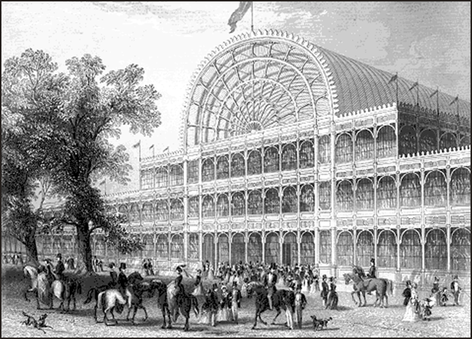
Technology
1851 Crystal Palace, London
Notes:
Technological advancement was part of the driving force of the modernist movement.
The Industrial Revolution brought iron, steel, and glass.
In the early 1830s, the section beam was invented by Eaton Hodgkinson.
This led to widespread use of iron construction as it allowed for longer spans and less wall.
It replaced load-bearing masonry and wood framing.
An early example of this is seen in the Crystal Palace at the Great Exposition in London in 1851.
This was designed by Joseph Paxton.
Crystal Palace: Joseph Paxton

Slide 11
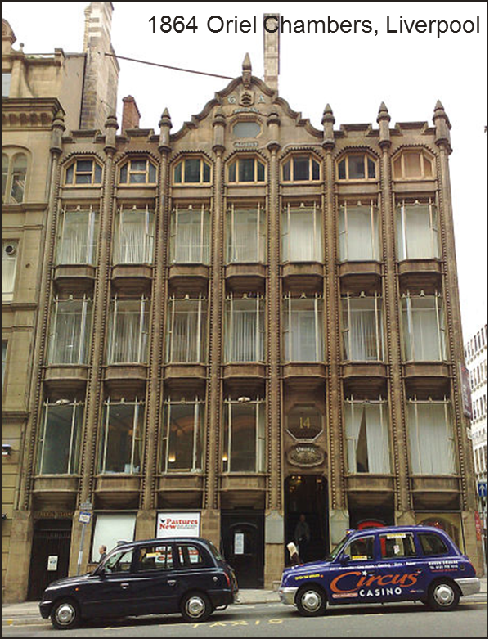
Technology
Notes:
This led to the first curtain wall made of glass and metal,
Seen here at the Oriel Chambers in Liverpool in 1864.
This was designed by Peter Ellis.
You can still see the influence of traditional architecture with the pediment and masonry details.
First curtain wall: Oriel Chambers, Liverpool by Peter Ellis

Slide 12
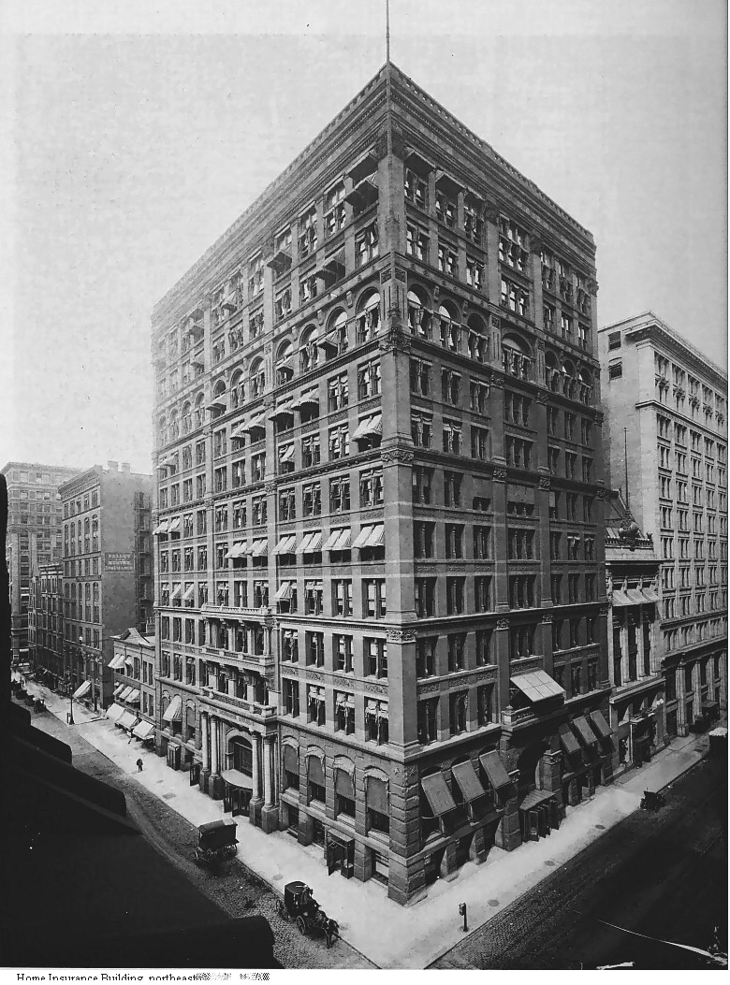
Technology
Notes:
The first fully steel-framed building was the 10-story Home Insurance Building in Chicago, built in 1885.
This is regarded as the first skyscraper and was designed by William Jenney.
This building weighed a third as much as a 10-story masonry building.
Using this method, allowed the possibility to construct even taller structures.

Slide 13
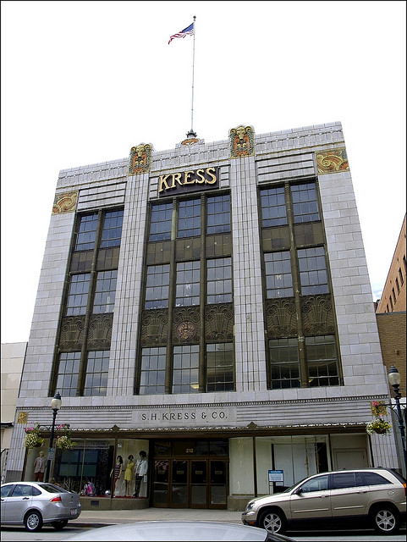
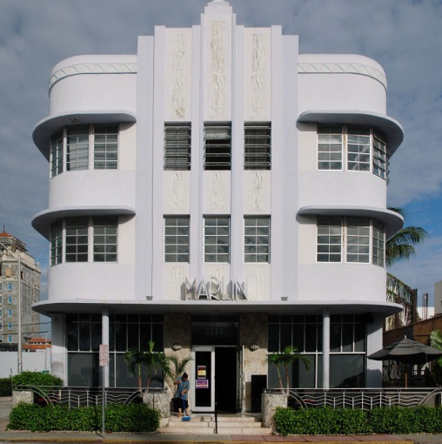
Art Deco
Notes:
The Moderne style is characterized by the adoption of the machine aesthetic,
Glorification of technological advancement and new materials,
Adopting or loosely retaining revivalist forms and motifs,
And the continued use of ornament.
The 1925 World’s Fair was held in Paris.
This Exposition epitomized what came to be called decades later “Art Deco,”
a “modern” style characterized by a streamlined classicism, geometric and symmetric compositions, and a sleek machine-age look.
The term Art Deco was derived by shortening the words Arts Decoratifs.
Characteristics of the Art Deco style include
Stylized plant and animal motifs, and hard-lined angular geometric patterning in exterior and interior ornament,
Vertical molded ornamentation
Decorative parapet and cornice
Ornamental door and window surrounds
Metal sash windows
Polychromatic decorative glass or glazed brick
Marlin Hotel, Miami
Kress Building

Slide 14
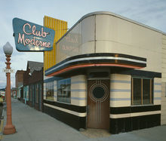
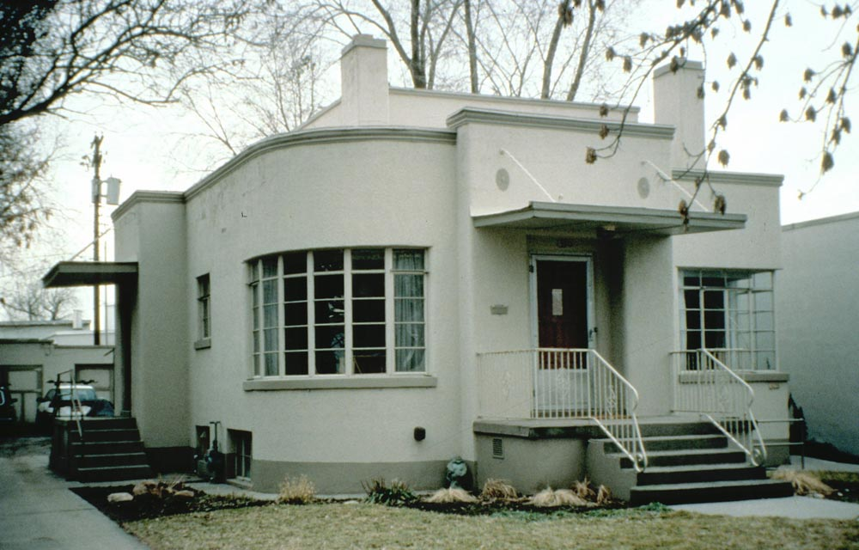
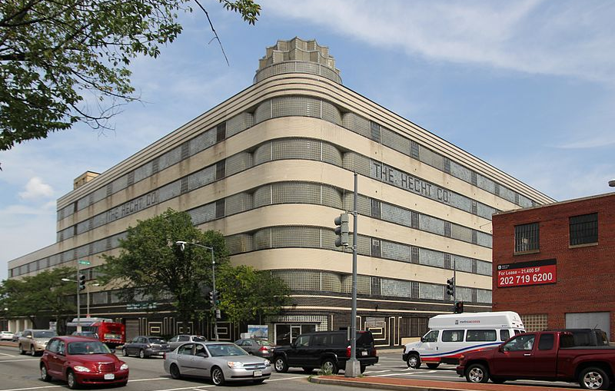
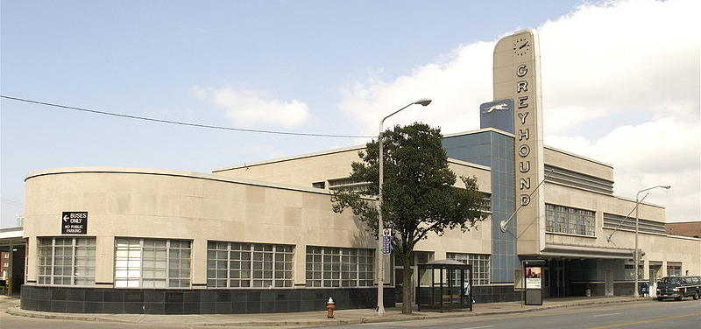
Art Moderne
Notes:
Art Moderne was popular from the 1930s to the 1950s.
It encompassed the machine aesthetic, aerodynamic imagery of transportation:
Rounded corners,
Curved windows, metal sash windows,
Smooth wall surfaces highlighted with metal trim,
Irregular plan and asymmetrical façade,
Flat roofs, and
Glass block walls and windows.
Greyhound Bus Station, Cleveland, top left
Utah, top right
Utah, bottom left
Anaconda, Montana, bottom right

Slide 15
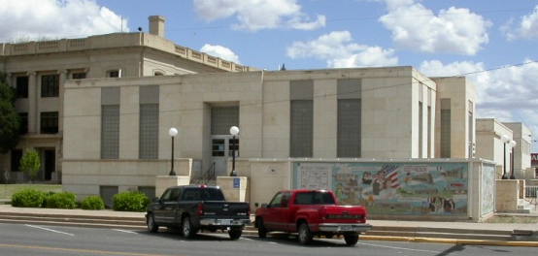
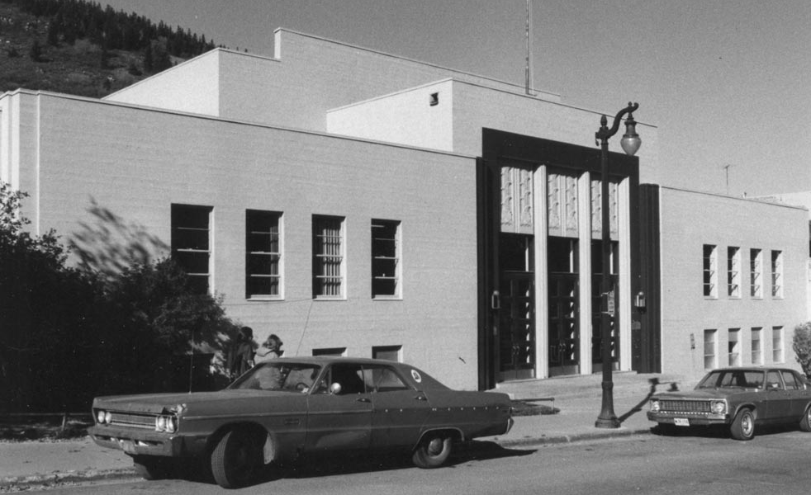
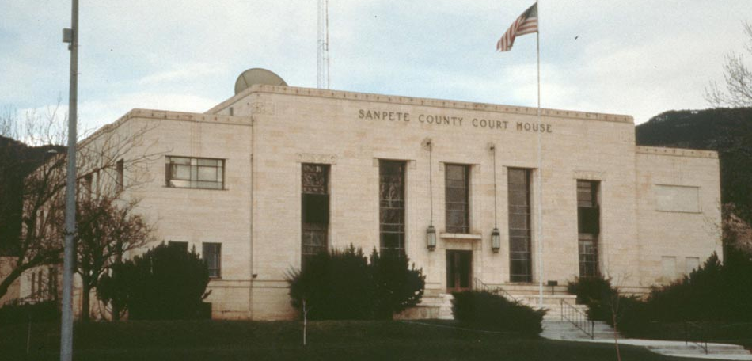
Stripped Classicism
Notes:
During the Depression Era of the 1930s and 40s, Stripped Classicism became popular.
This was also known as PWA Moderne and WPA Moderne.
Commonalities of this style include:
Symmetrical facades,
Smooth wall surfaces,
Flat roofs,
Plain narrow cornices,
Projecting pavilions,
Vertical molded ornamentation,
Framed entrances,
Piers without capitals,
And metal sash windows.
Hockley County Library, Levelland, top left
Utah, top right
East Carroll Parish Courthouse, Louisiana, bottom left
Utah, bottom right

Slide 16
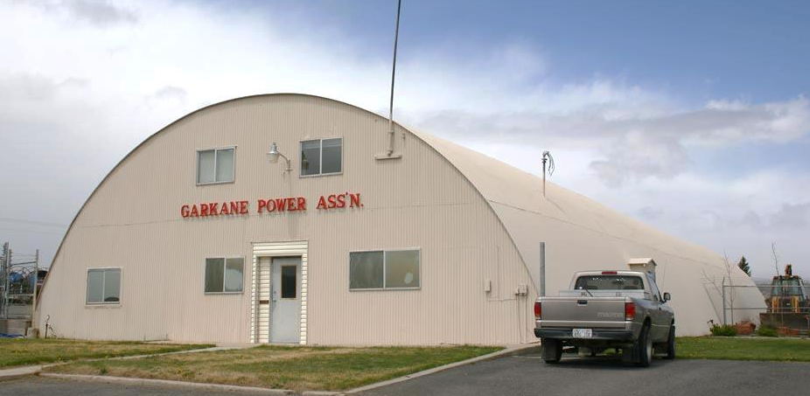
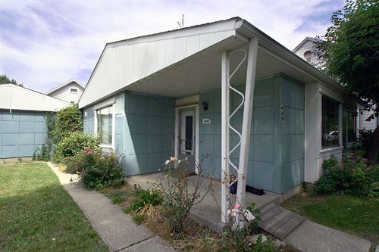
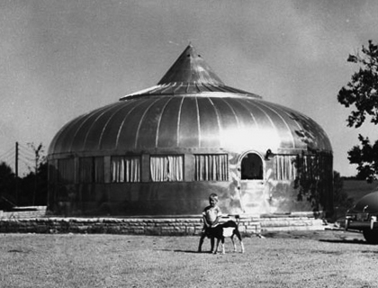
Innovation
Notes:
World War II was a major factor in driving innovations in building technology and architectural possibilities.
Material shortages led to the adoption of new materials and advancement of old ones.
Surplus postwar industrial capacity would accelerate materials and techniques.
There was a rapid demand for structures during the war
And for housing after the war.
World War II was a pivotal point in US history.
There was a shift from rural to urban populations
And the start of urban sprawl, subdivisions, and separation of uses.
There were accelerated experiments with prefabricated buildings,
such as the Quonset hut as seen in the top image,
Lustron houses (bottom left),
and the Dymaxion House or geodesic dome (bottom right).
Lustron 1947-1950
Buckminster Fuller

Slide 17
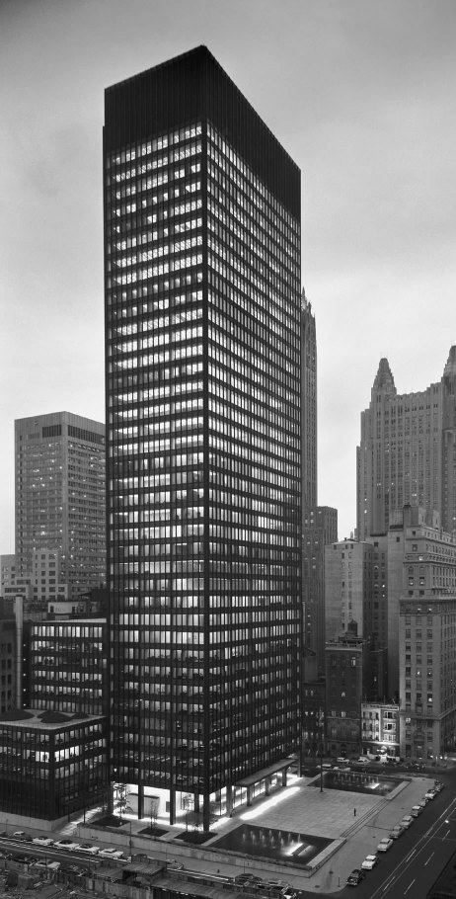
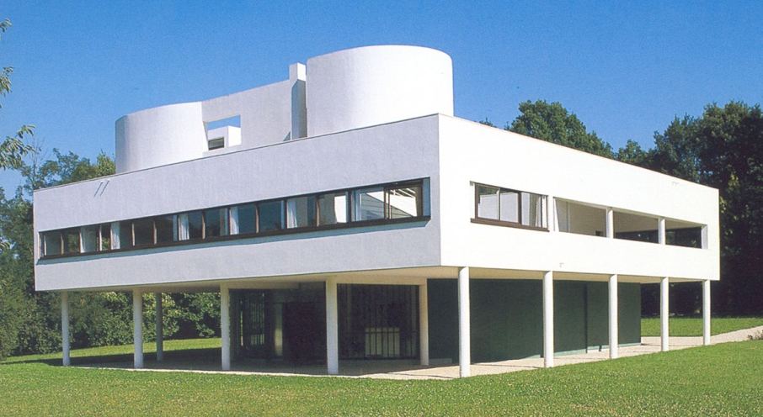
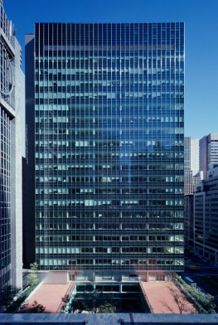
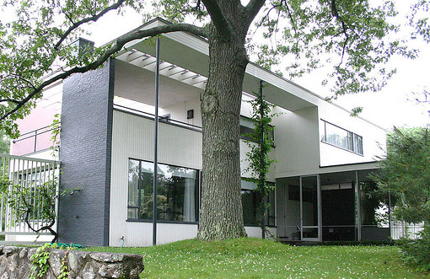
International Style
Notes:
From the 1920s to the 60s, the International Style was a combination of many distinct threads and trends in architecture
identified as stylistically similar and having a common purpose.
Of particular importance was the 1932 International Exhibition of Modern Architecture
held at the Museum of Modern Art in New York City,
It was organized by Philip Johnson and Henry-Russell Hitchcock who coined the term “International Style.”
The International Style became the pre-eminent style in institutional and commercial architecture in the United States.
The emphasis was on volume rather than mass,
And balance as opposed to preconceived symmetry.
There was a dependence on intrinsic elegance of materials, technical perfection, and fine proportions,
And the elimination of applied ornament.
The International Style was a break from architectural tradition
With simple unornamented designs
And use of common materials such as glass for facades, steel for exterior support, and concrete for floors and interior support.
The floor plans were functional and logical.
Seagram building, Mies van der Rohe, 1958, New York City, far left
Villa Savoye, Le Corbusier, 1982-1931, Poissy, France, top center
Walter Gropius House, Walter Gropius, 1938, Lincoln, MA, bottom center
Lever House, SOM, 1952, New York City, far right

Slide 18
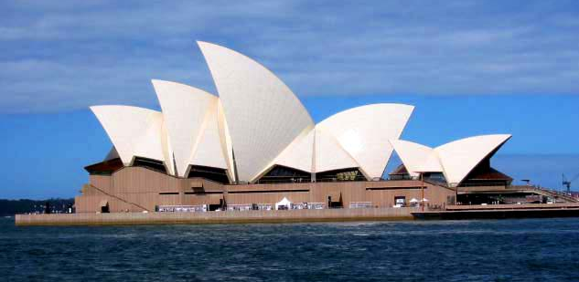
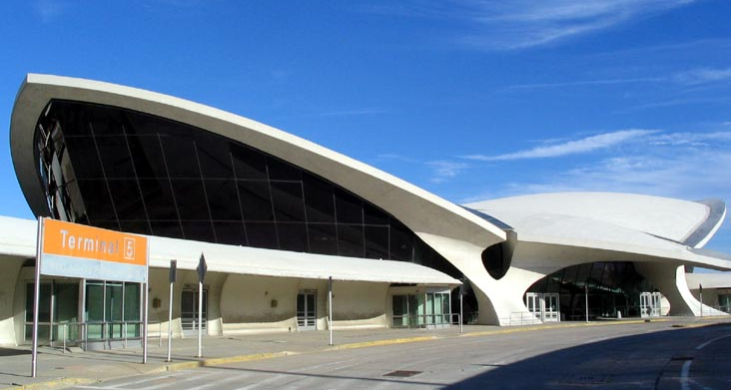
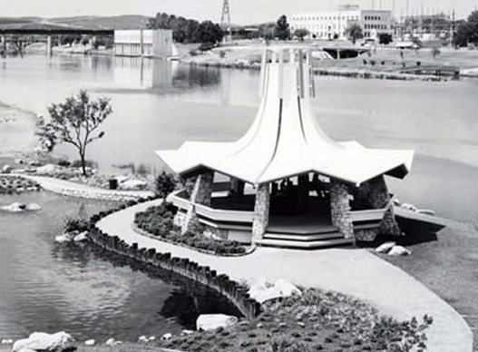
Mid-Century Modern
Notes:
As a reaction to the purely functional form of the International Style,
The Mid-Century Modern came into being in the 1930s and lasted to the 1960s.
It experimented with organic forms that were more human and accessible.
It was popular for its democratic and playful nature.
It made structural advancements in the use of reinforced concrete,
Concrete shell construction,
And the geodesic dome.
Preeminent architects of this style include Eero Saarinen and Alvar Aalto.
Sydney Opera House, Jorn Utzon, 1973, Sydney, Australia, top left
TWA Flight Center, Eero Saarinen, 1962, New York City, top right
Fannie Davis Gazebo, 1970, Austin, bottom right

Slide 19
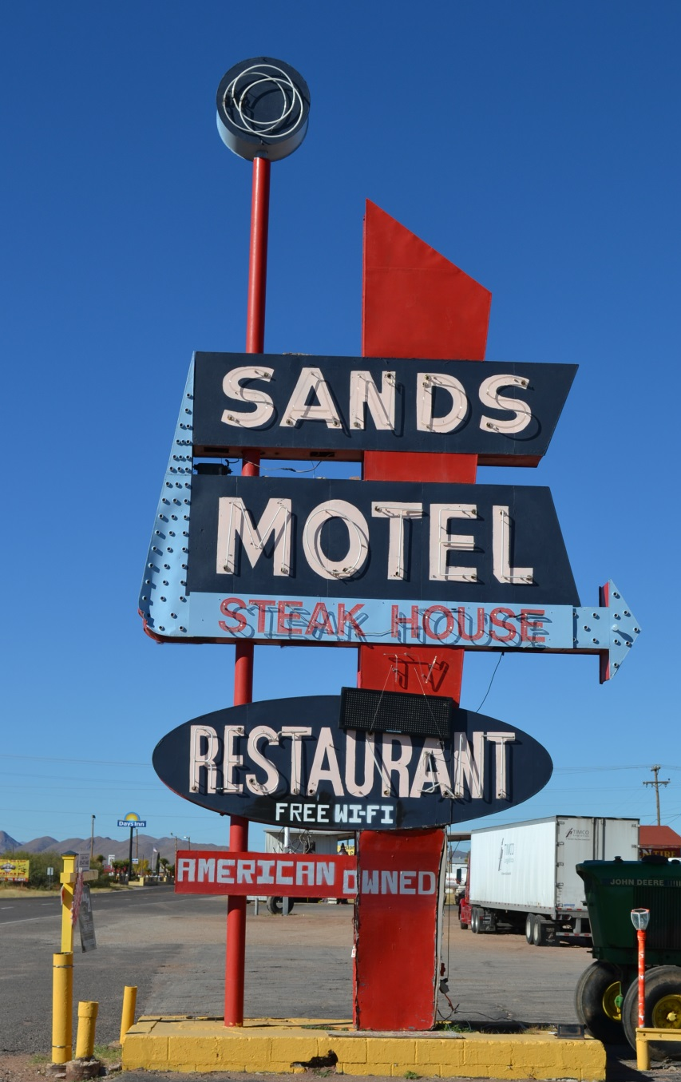
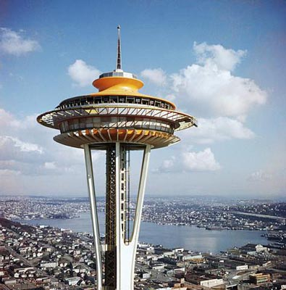
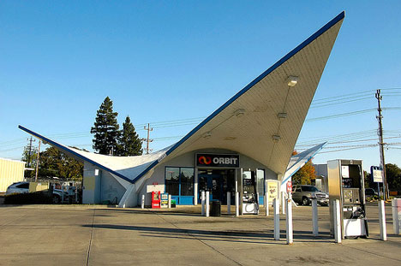
Googie
Notes:
Inspired by imagery of the Atomic Age and the Space Age, the Googie Style came into being.
It used atomic orbital patterns, flying saucers, upswept roofs, geometric shapes, starbursts, and bold use of glass, steel and neon.
On the whole, it originated out of California in the late 1940s
and was more or less exclusive to the United States.
Googie heavily influenced retro-futurism,
appropriately exemplified in the ‘The Jetsons’ cartoon, and Disney’s Tomorrowland.
Googie was used for diners, movie theaters, motels, gas stations, cafes, car washes
– the eye-catching shapes, colors and lighting were essentially architectural billboards advertising the business to vehicles on the road.
Space Needle, Seattle, 1962, top right

Slide 20
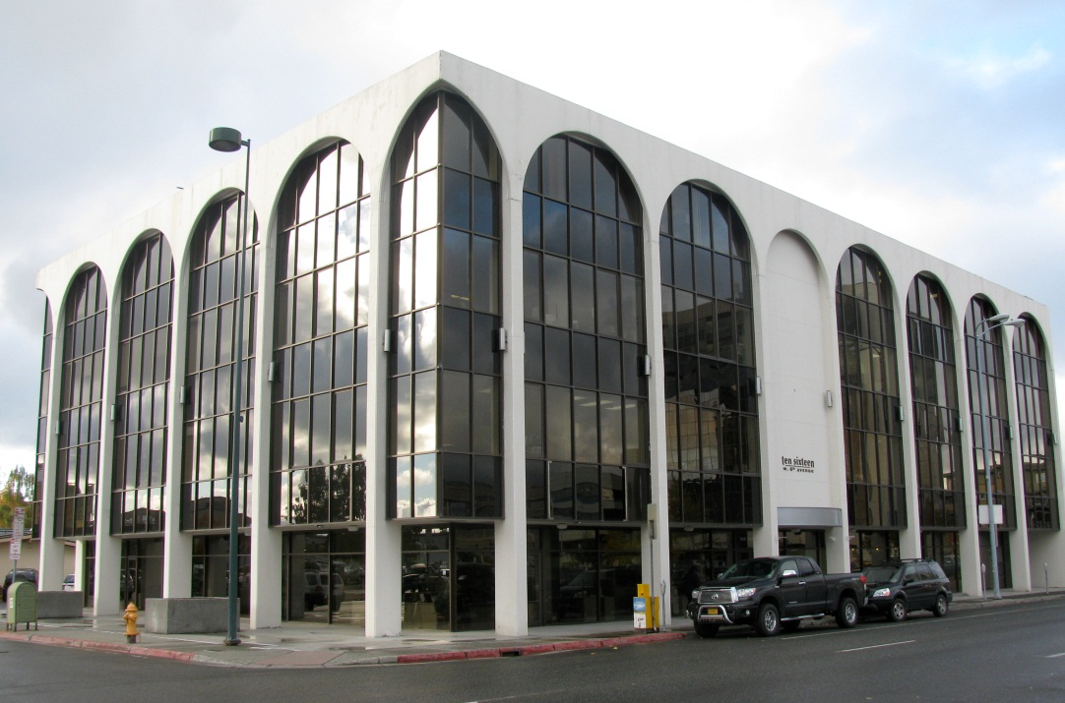
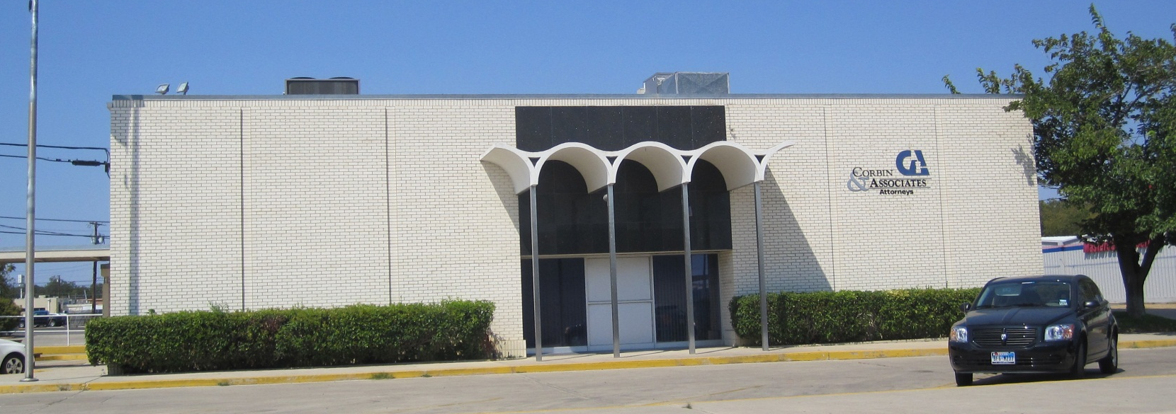
New Formalism
Notes:
In direct contrast to Googie’s exuberance, New Formalism emerged in the 1950s and lasted through the 1970s.
It blended elements of Classicism,
seen in the rigid symmetry, use of columns or arcades, and high-end materials,
with the International Style.
Killeen, bottom

Slide 21
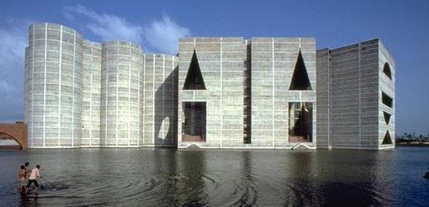
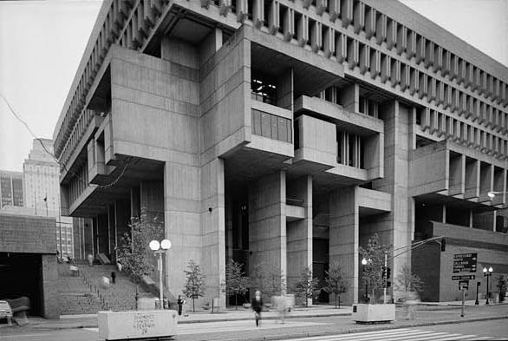
Brutalism
Notes:
Another architectural style that responded to the International Style was Brutalism that flourished from the 1950s to the 70s.
It was popular for creating works of monumental quality, such as government and institutional buildings.
The emphasis is on more substantial materials, such as concrete and brick.
These buildings were typically massive in character and fortress-like
to create an image that communicated strength, functionality, and frank expression of materiality.
The word “Brutalism” derives from Beton Brut, meaning “raw concrete.”
Boston City Hall, 1968, Kallmann McKinnell & Knowles, Boston, left
Le Corbusier, Chandigarh, India, top right
LBJ Library, 1971, SOM, Austin, bottom right

Slide 22
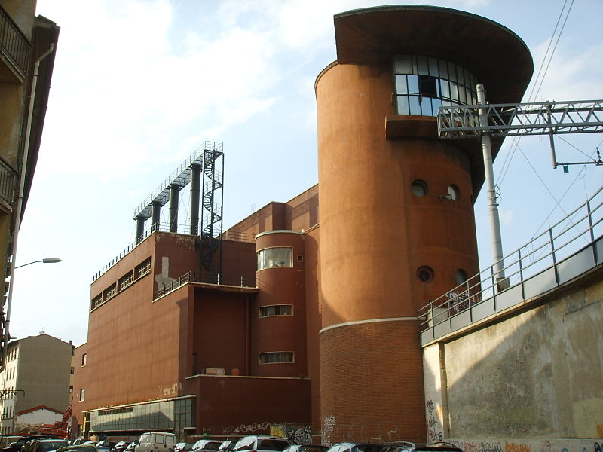



Modern Architecture: Others
Arts & Crafts
Futurism
And more…
Constructivism
Expressionism
Notes:
There are other forms of modern architecture, such as Futurism, Constructivism, and Expressionism,
But these were more commonly seen in Europe, rather than the United States.
Futurism: Italian, anti-historicism, strong chromaticism, long dynamic lines suggestive of speed, motion, urgency, and lyricism (1909-1940). Angiolo Mazzoni Heating Plant and Main Controls cabin at Santa Maria Novella railway station, Florence Italy 1929
Constructivism: Russian, particular material properties and spatial presence (1920s-1932). Vladimir Tatlin Tatlin’s Tower model (never built), 1919
Arts & Crafts: English, aesthetic design and decoration and a reaction against styles that were developed by machine production (1860-1930s). Greene & Greene Gamble House, Pasedena California 1908
Expressionism: Europe, distortion, fragmentation or the communication of violent or overstressed emotion; biomorphic forms (1905-1930). Erich Mendelsohn Einstein Tower, Potsdam-Berlin Germany 1919-1922

Slide 23




Modern Architecture
Notes:
Modern architecture is now within the 50-year time period that is considered “historic”
By the National Register of Historic Places.
So these types of buildings need to be included in historic resources surveys
And be evaluated for significance and integrity.
Beaumont, bottom left
JE & LE Mabee Regional Heritage Center, 1976, Plainview, top left
City Hall, Pittsburg, bottom right

Slide 24



Post Modernism
Notes:
And by the 1980s, Modern Architecture transitions over to Post Modernism
as a response to the perceived blandness and failed Utopianism of the Modern movement.
Post Modernist architecture was one of the first aesthetic movements to openly challenge Modernism as antiquated and “totalitarian”,
favoring personal preference and variety over objective, ultimate truths or principles.
It rejects the notion of ‘pure’ form or ‘perfect’ architectonic detail,
instead conspicuously drawing from all methods, materials, forms and colors available to architects.
Notable architects include Michael Graves, Frank Gehry, Philip Johnson, and Robert Venturi.
Frank Gehry (top left) Walt Disney Concert Hall, Los Angeles 2003
Philip Johnson (right) AT&T Building, now Sony Building, Manhattan 1984
Michael Graves (bottom left) Team Disney Building, Burbank CA 1986

Slide 25
Contact Information
  Texas Historical Commission
  www.thc.state.tx.us
  Historic Resources Survey
    Historic Resources Survey Coordinator: Leslie Wolfenden
        512.463.3386
        leslie.wolfenden@thc.state.tx.us
Notes:
My contact information is on this slide.
This concludes the presentation on Modern Architecture.
Thank you for joining me and I hope that this presentation was helpful.

Slide 26


