Slide 1
Poetry in Nature: Writing Activities and Comparisons to Caddo Poetry
Kathy Lathen
Texas History
Webb Middle School, Garland ISD
Garland, Texas

Slide 2
Lesson Objective
To often we ask students to write a brief summary of what they have learned. What if we asked them to create poetry which includes the results of their investigations of the Caddo and the land they call home? In this lesson, students will document observations and write poetry reflecting connections with the environment.

Slide 3
Kee Whut Nah Sundah People: A Caddo Journey, by Guyneth Bedoka (1999)
Moccasin My Feet
(caddoan burial rites)
moccasin my feet
clothe me ribbon and cloth
my journey home has come
sing to me of peace
and bid me farewell
talk to me
as you usher me homeward
as you wash you grief away
the gentle rain removes my
traces upon the earth
stand not to the east
bar not my journey home
my riverward path
the river i must cross
is dark and rough
prepare my moccasin feet
that i might cross swiftly
light the way for me
with torch of fire
for six days and nights
light my journey home
Book available for purchase at Caddo SHS, Alto, Texas.
Excerpt taken from page 25
What are the top 10 keywords of this poem and the next? Explain.
What are the natural elements of the poems?
What are the connections to the past and present found within the poems?

Slide 4
Kee Whut Nah Sundah People: A Caddo Journey, by Guyneth Bedoka (1999)
in the sparkle of the morning dew
in the redness of earth
in the bones of time
in the souls of mankind
in the voices of the old
in deserted camp grounds
in death
in life
in the morning pray
in the yellowness of dawn
in the purples and pinks of sunset
in the trails of hunger and pain
that stained our journey of life
in those who have gone before
in memories of the past
they come on the wind
twisting
turning
curving
coiling
seeking
calling
enticing
Excerpt from pp 29 - 30
Wind Poems
riders on the wind
meandering to and fro
a spiritual odyssey
they seek
my mind,
heart and soul
voyaging on the clouds
borne by raindrops
riding the rays of the sun
wayfarers in the moonlight
in the echoes of old songs
sung in the twilight
in the essence of the grass
burrowed in the bark of trees
in sounds of darkness
in light
in shadow

Slide 5
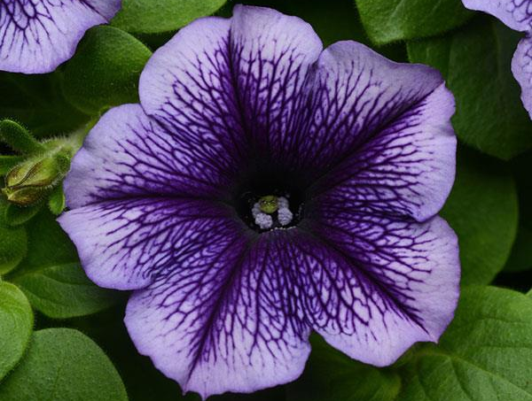
Take a Deeper Look at Nature
The following video is from Walt Disney Productions. “Donald in Mathmagic Land” (1959) is a thirty minute educational video that explores mathematics in creative ways beyond 2 + 2 = 4. In this segment, we’re taking a look at the Pythagorean Theorem that awaits just outside your door.
https://www.youtube.com/watch?v=U_ZHsk0-eF0&t=680s

Slide 6
Snap Pictures, Observe, and Document
As students take in the natural surroundings, they should open up their imagination to the past. Remember, this land was once a thriving agrarian community that lived off the land without the conveniences of our time. As modern-day explorers, snap pictures, observe, and document the natural world today, but imagine the touch, sights, smells, and sounds of long ago.

Slide 7
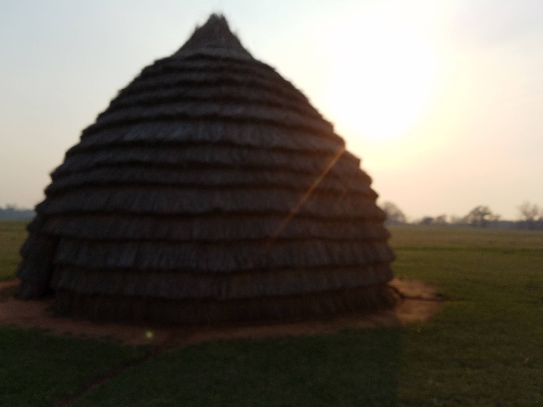
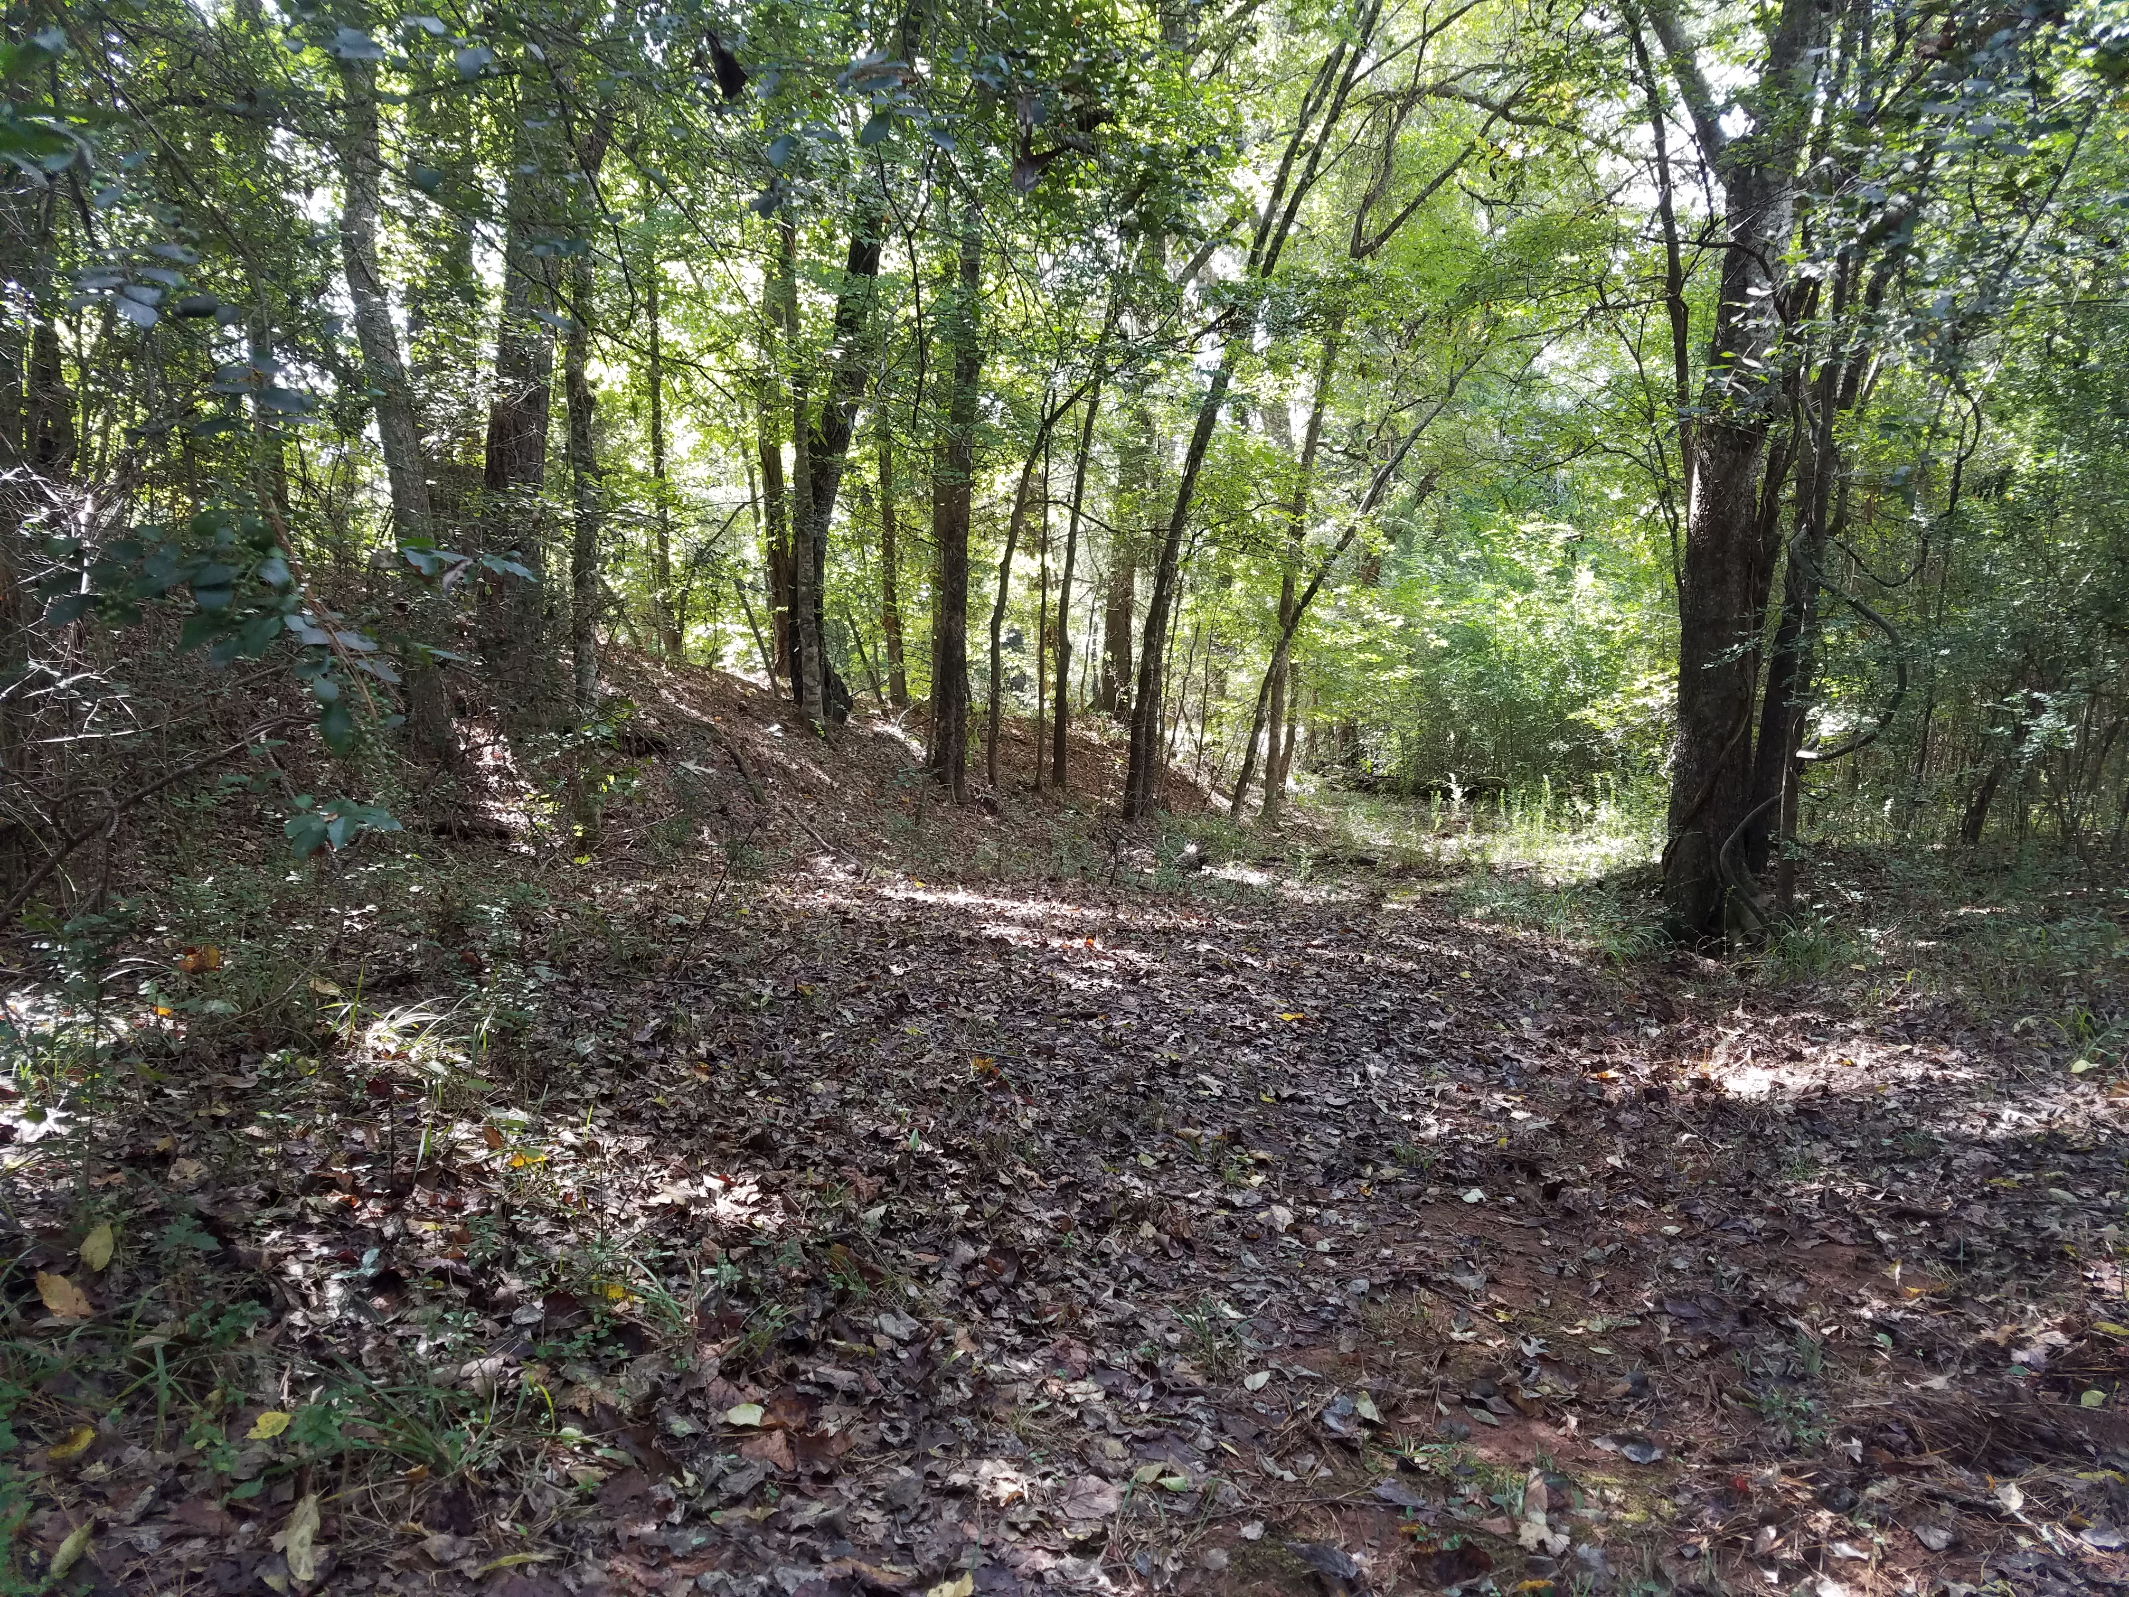
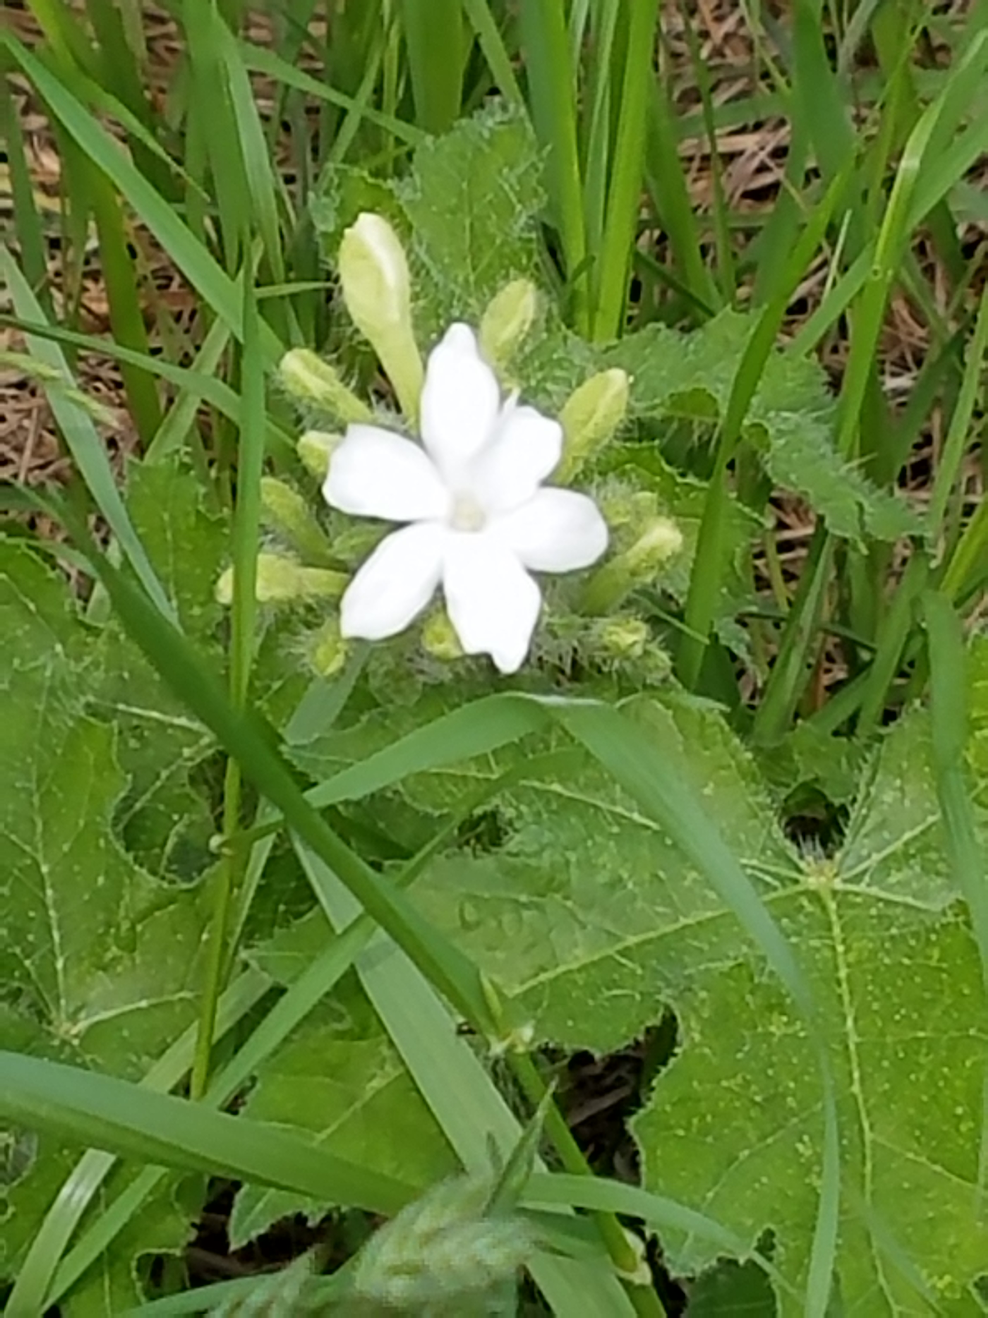
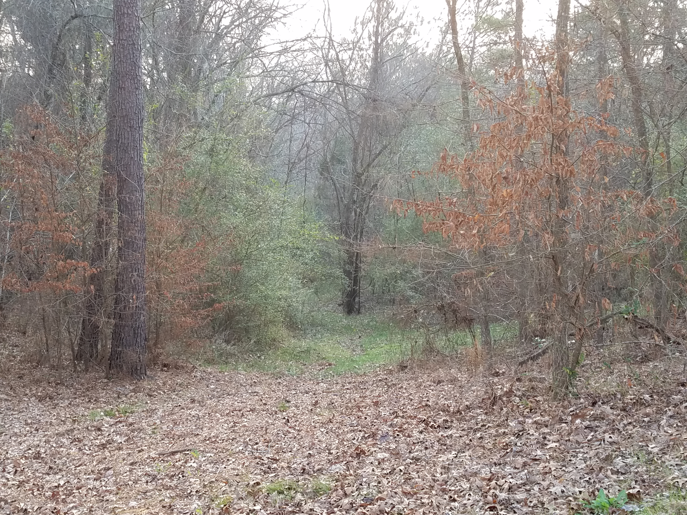
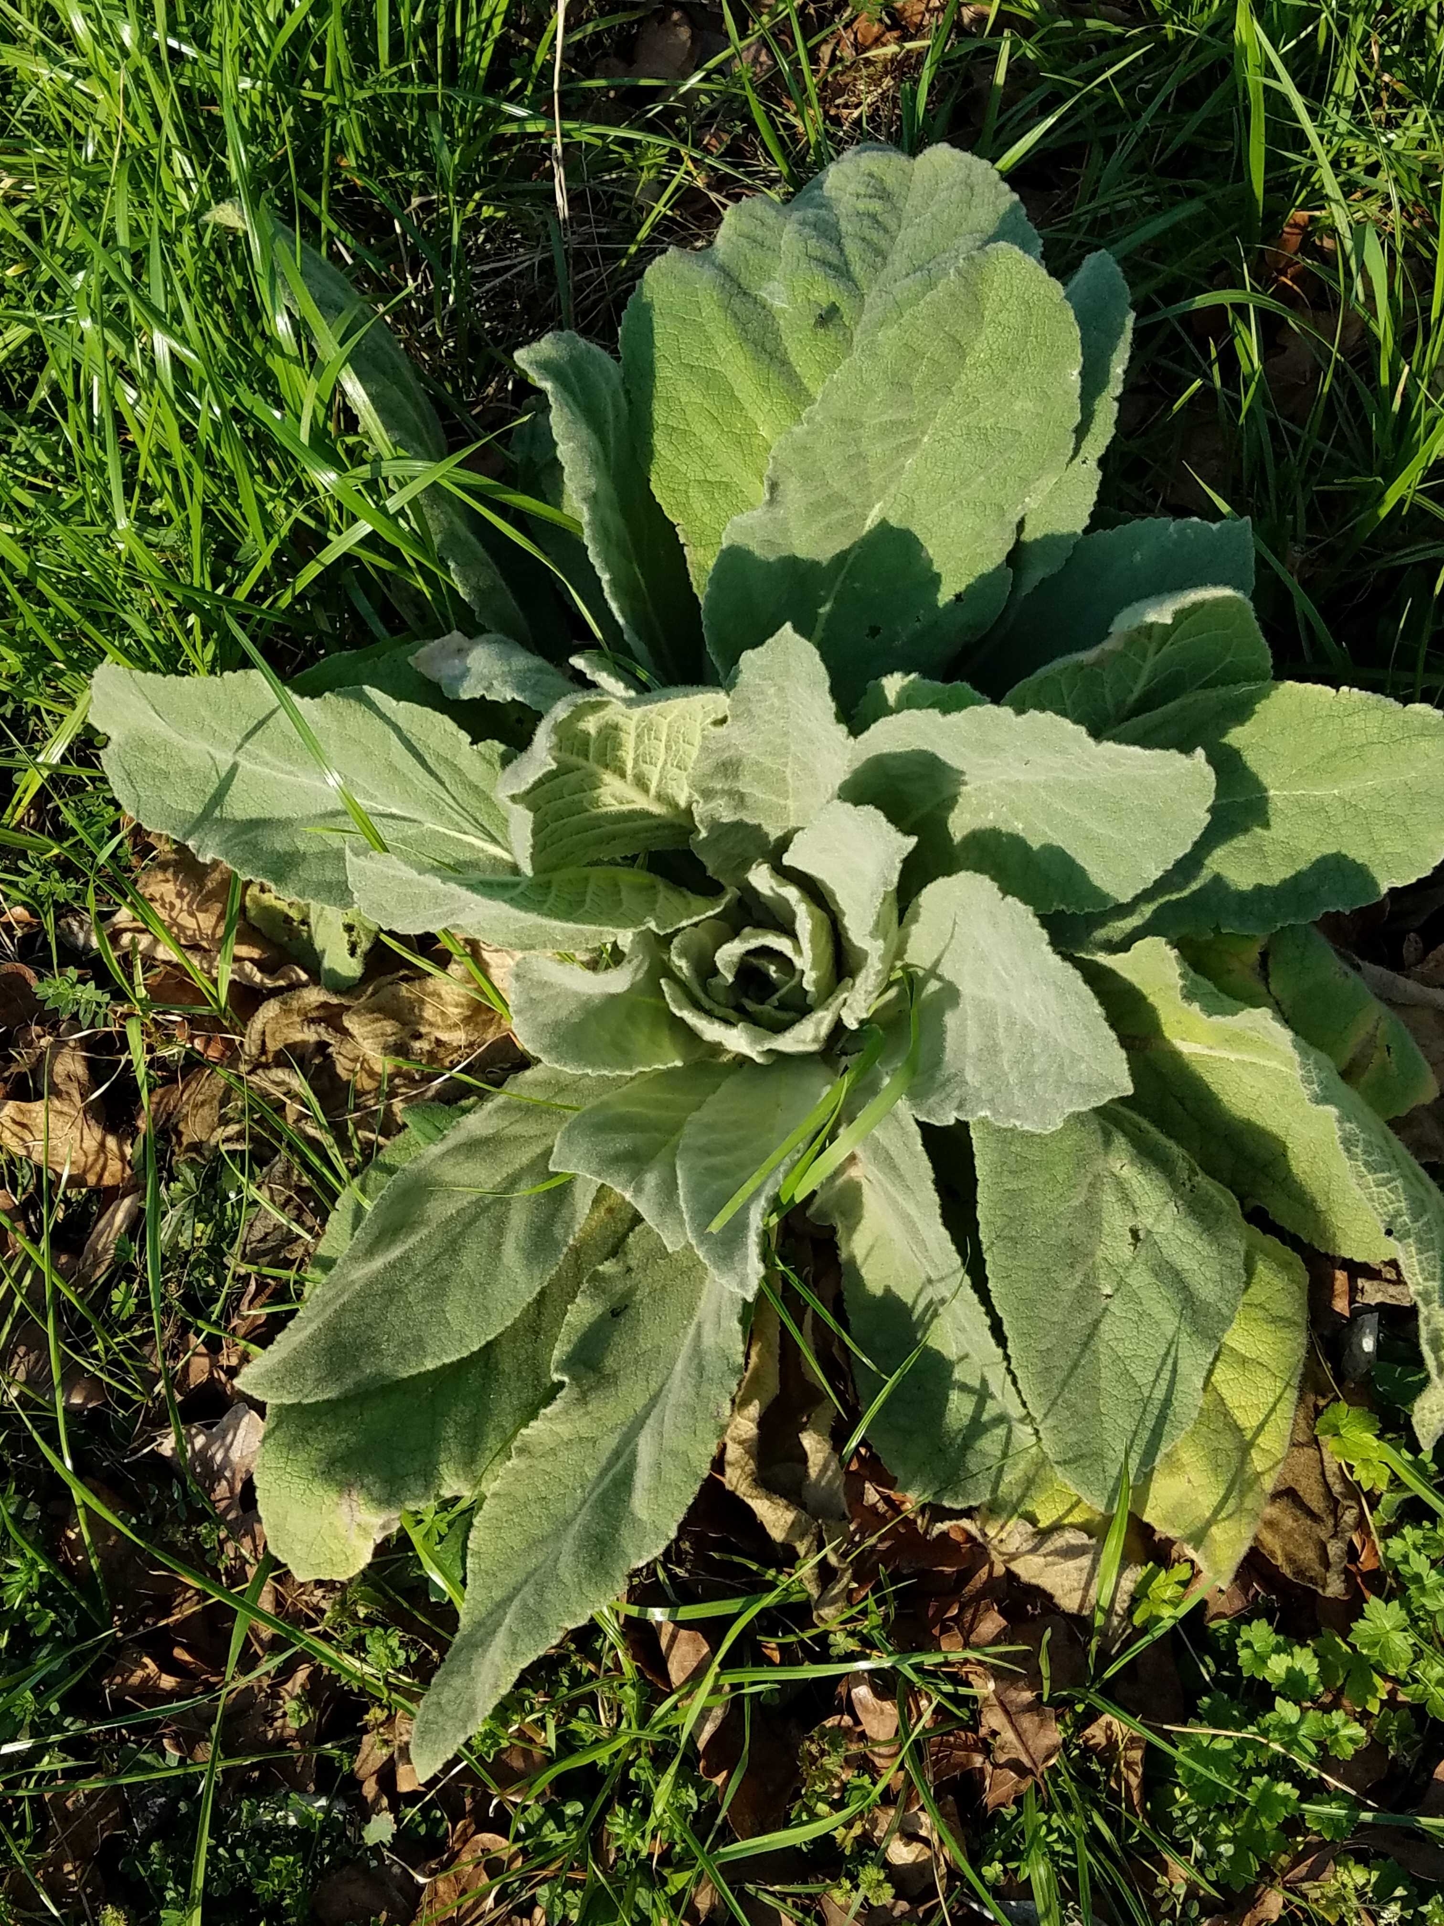
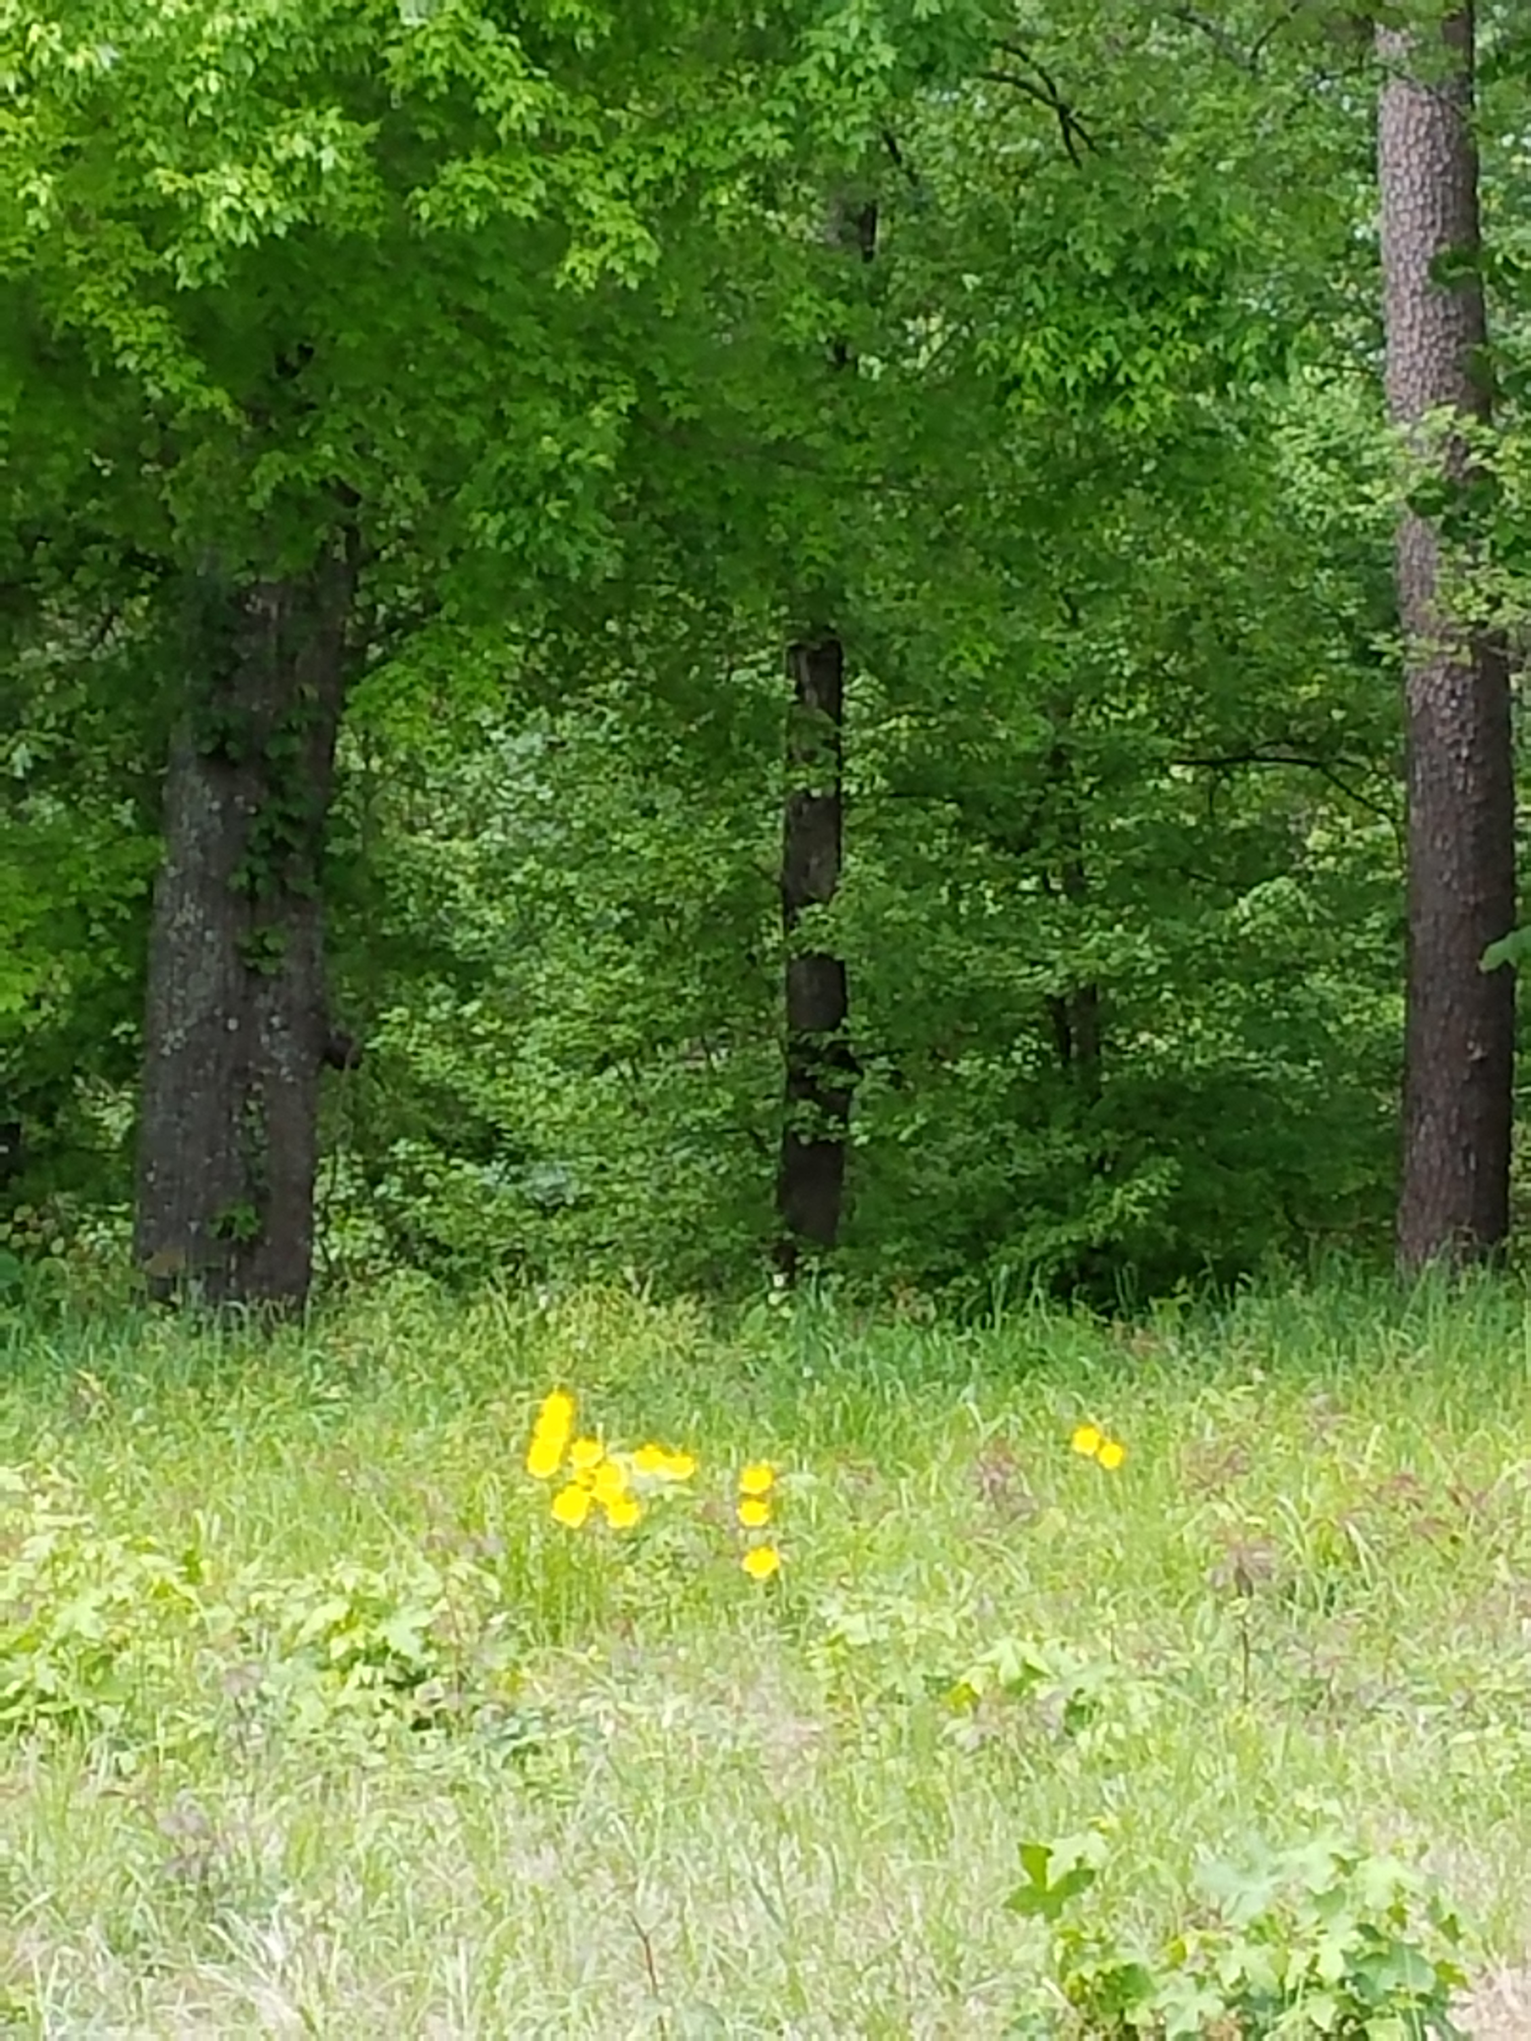
Snap Pictures, Observe, & Document

Slide 8
Handouts for the Classroom:
Depending on your subject, you will need references possibly for the flora, fauna, geography, and physical regions of Texas.
Texas Almanac
https://texasalmanac.com/sites/default/files/images/maps/PhysicalReg.pdf

Slide 9
Cornell Notes
By using Cornell Notes to document information and observations, a student creates questions for continuing study and reflection.

Slide 10
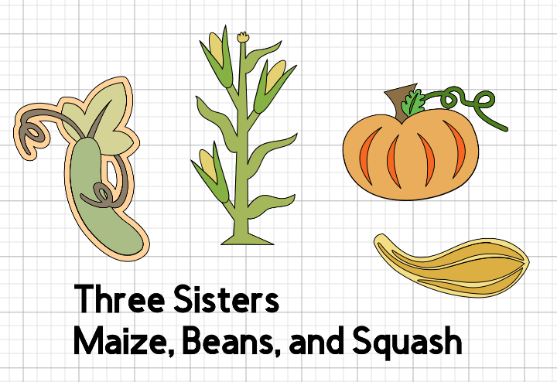
One Pager
Flip the Cornell Notes page over and create a visual display of the information. Be sure to include the main idea with the details too.

Slide 11
A Sample of Poetry for the Classroom
Acrostic
  Bio Poem
  Name Poem
Cinquain
Diamante
Free Verse
Haiku

Slide 12
Poetry References and
Online Activities
www.readwritethink.org
http://www.readwritethink.org/files/resources/interactives/acrostic/
http://www.readwritethink.org/files/resources/interactives/diamante/
http://www.readwritethink.org/classroom-resources/student-interactives/haiku-poem-interactive-31074.html
http://www.readwritethink.org/files/resources/lesson_images/lesson43/RWT016-2.PDF
http://www.readwritethink.org/files/resources/lesson_images/lesson43/RWT016-2.PDF

Slide 13

Caddo House
Writing Page
Use the lines to write one poem reflecting your observations and conclusions of the land and its people.
How is your poem similar or different to the work of Guyneth Bedoka?

Slide 14
Additional Resources

Slide 15
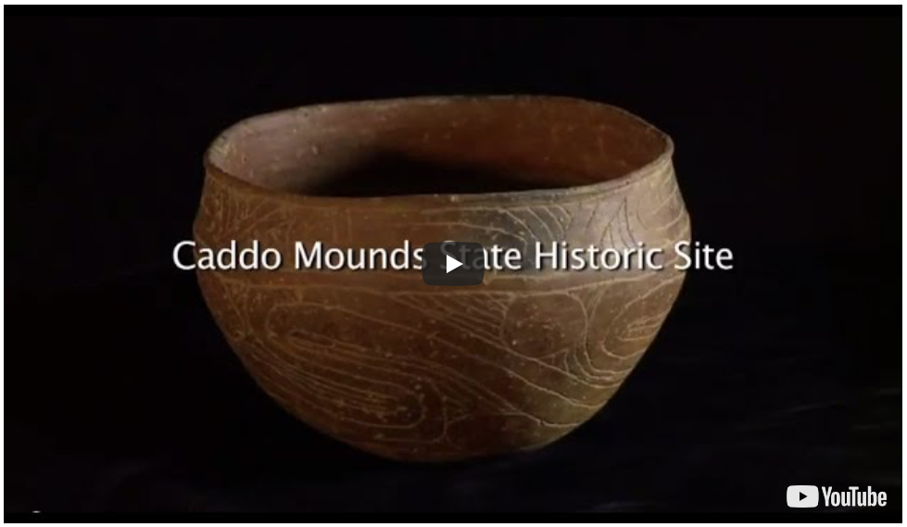
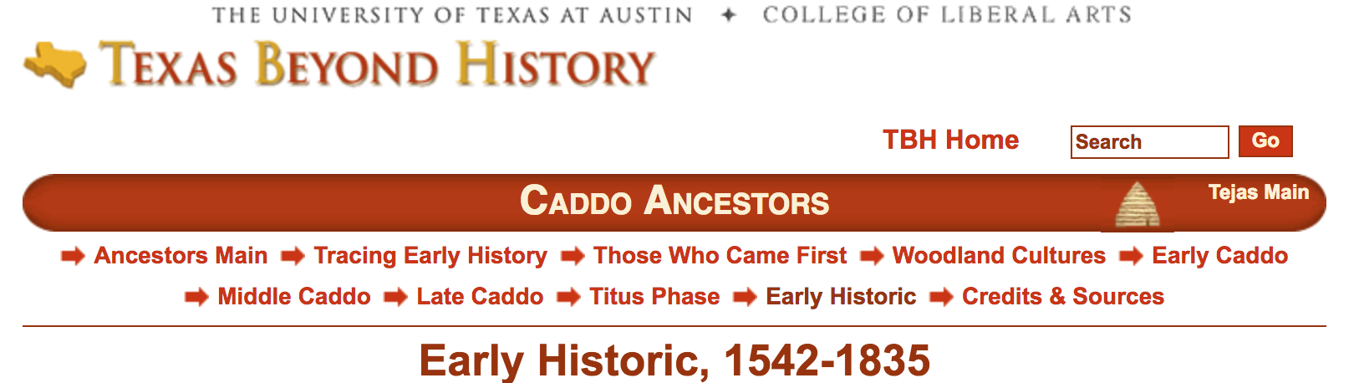
Connect to the Past
The Indigenous People of East Texas
Analyze video and website for PAGES through the centuries along a timeline for future reference.

Slide 16
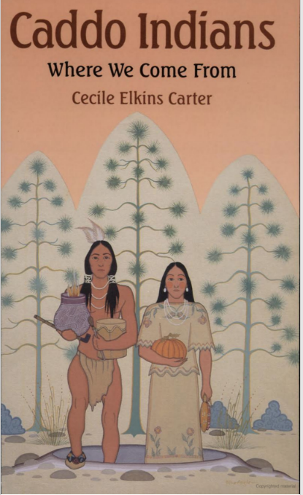
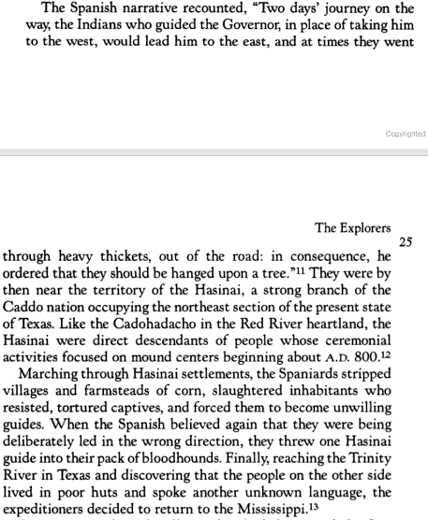
“out of the road”

Slide 17

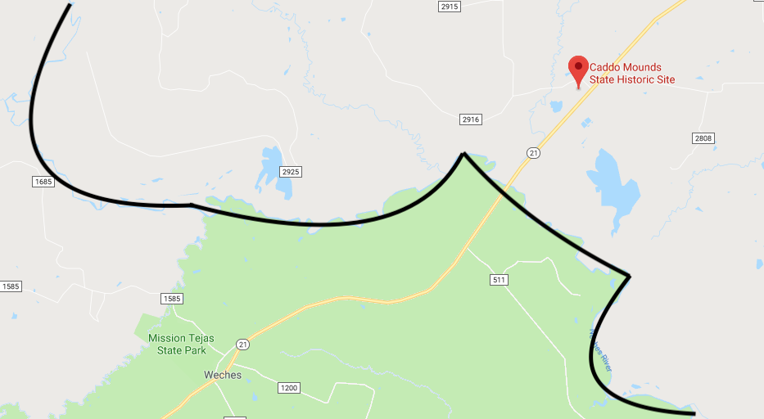
First Contact with Europeans
  Moscoso Entrada (1542)
  Map: “Routes of Cabeza de Vaca, Coronado, and DeSoto and Moscoso”
What questions do you have for the cartographers of maps such as these?
Google Maps:
The Neches River is identified on the map.

Slide 18
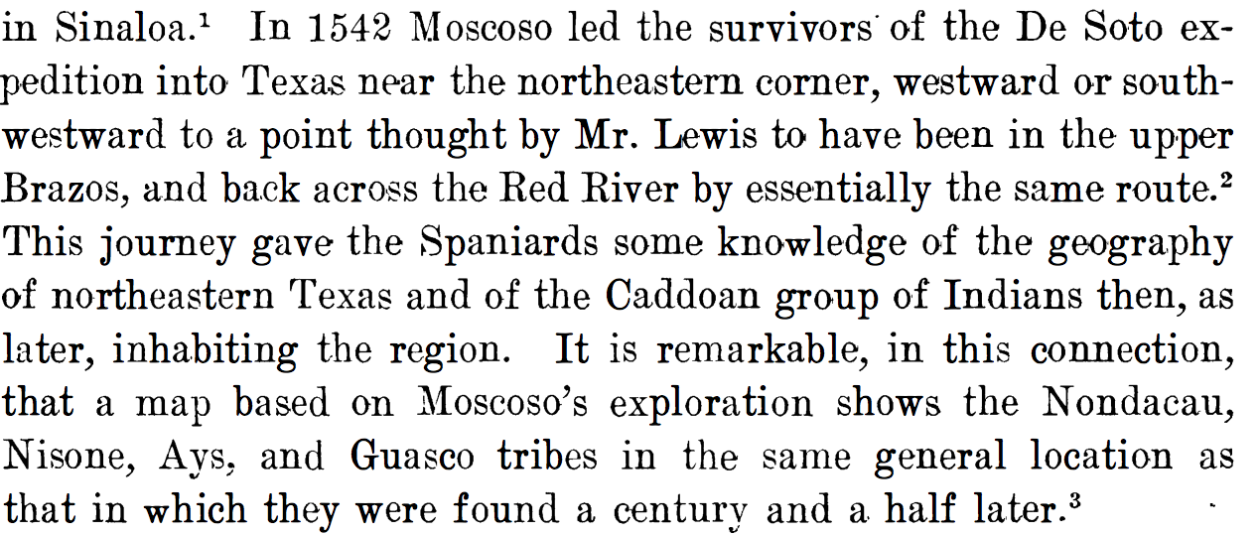
Luis de Moscoso Alvarado in East Texas
How complex is the geography of northeastern Texas?
Bolton, Herbert E. “The Spanish Occupation of Texas, 1519-1690.” The Southwestern Historical Quarterly, vol. 16, no. 1, 1913, p 4., www.forgottenbooks.com/en/readbook/TheSouthwesternHistoricalQuarterly_10155786#7.

Slide 19
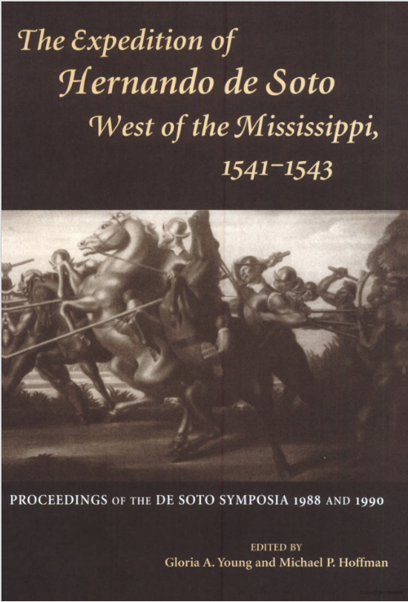
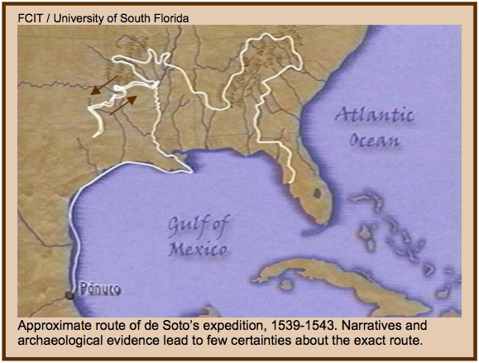
Following Footnote #3
Why does the exact route of the Moscoso Entrada remain a mystery?

Slide 20
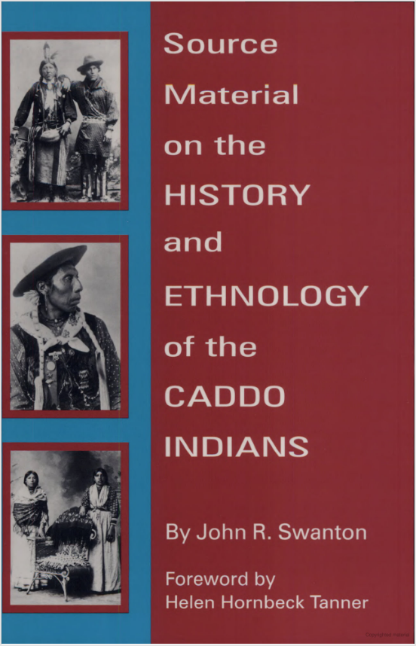
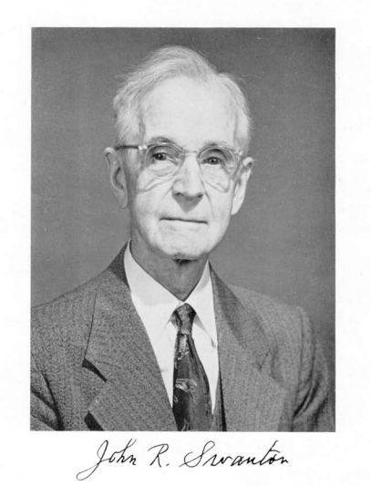
John R. Swanton,
What other tribes were a focus of his ethnohistory studies? What are the connections between them?
Ethnohistory-the study and reconstruction of the history and culture of indigenous people.

Slide 21
DBQ Resources
http://viewpure.com/rU4_w3Nin3k?start=0&end=0
https://www.texasbeyondhistory.net/tejas/ancestors/historic.html
www.forgottenbooks.com/en/readbook/TheSouthwesternHistoricalQuarterly_10155786#7
http://legacy.lib.utexas.edu/maps/atlas_texas/routes_texas_explorers.jpg
http://nationalhumanitiescenter.org/pds/amerbegin/exploration/text1/desoto.pdf
https://books.google.com/books?id=EIt0uRRwPPMC&pg=PA107&lpg=PA107&dq=Moscoso+%22gentleman+of+elvas%22&source=bl&ots=Zx_KsTwSdY&sig=rP_GdBFDS-wxvCAlJyhvrJHShkk&hl=en&sa=X&ved=0ahUKEwj5w6mV0YTcAhWEzIMKHQyjCE44ChDoAQhXMAw#v=onepage&q&f=false

Slide 22
DBQ Resources Continued
https://books.google.com/books?id=eYtJfJ9yDEQC&printsec=copyright#v=onepage&q&f=false
https://books.google.com/books?id=Mqf-6-Mc7OsC&printsec=frontcover&source=gbs_ge_summary_r&cad=0#v=onepage&q&f=false
http://www.nasonline.org/publications/biographical-memoirs/memoir-pdfs/swanton-john.pdf
https://texasalmanac.com/sites/default/files/images/maps/PhysicalReg.pdf

